Slide 1
Teacher Information
This resource is intended as a source of information and case studies for teaching and learning about issues surrounding poverty across several curriculum areas and units. The points raised will be explored further in the teaching resources found at the end of these slides.
Please refer to the ‘Notes’ section of this presentation for additional information and source references.
It is our hope that you will take part/all of these slides and use them in a way that best suits your purposes. As such, the slides are editable so that the content, case studies and tools included in this resource are flexible for teachers and students to use in classroom instruction, independent student research or presentations.
If you do edit this resource, please ensure content and photos from this resources remain with the appropriate credit to Caritas Australia and the photographers.
For more school resources, please visit: caritas.org.au/resources/school-resources/
Stay up to date with events and resources! Subscribe to Caritas Australia’s Education e-newsletter
Copyright Policy: Material within our resources come from a variety of sources and authors, including Caritas Australia staff, volunteers, overseas partners and news organisations. These resources and the information, names, images, pictures, logos are provided “as is”, without warranty. Any mistakes brought to the attention of Caritas Australia will be corrected as soon as possible. To review the full Caritas Australia Copyright Policy, please visit: Caritas Australia​​
Links to external sites: This site contains links to external web sites. Caritas Australia takes no responsibility for the content of such sites, nor do links to such sites imply endorsement of the views expressed therein. External links are provided for informational purposes only.
Published September 2024

Slide 2
Curriculum links
RELIGIOUS EDUCATION
While there are many Religious Education Curricula around the Australia, it is not surprising that there are many common themes. Here are the common themes in this resource.
Living the mission of Jesus
Loving our neighbours
Catholic Social Teachings: Human Dignity, Preferential Option for the Poor, Solidarity, Subsidiarity and Participation, Care for our Common Home and the Common Good.
Charity and Justice
Sharing (fair share)
CIVICS AND CITIZENSHIP
Year 3: Why people participate within communities and how students can actively participate and contribute AC9HS3K07
Year 4: diversity of cultural, religious and/or social groups to which they and others in the community belong, and their importance to identity AC9HS4K09
Year 5: how citizens (members of communities) with shared beliefs and values work together to achieve a civic goal AC9HS5K07
GEOGRAPHY
Year 3: he similarities and differences between places in Australia and neighbouring countries in terms of their natural, managed and constructed features AC9HS3K05
Year 4: the importance of environments, including natural vegetation and water sources, to people and animals in Australia and on another continent AC9HS4K05
Sustainable use and management of renewable and non-renewable resources AC9HS4K06
Year 5: the influence of people, including First Nations Australians and people in other countries, on the characteristics of a place AC9HS5K04
Year 6: Australia’s interconnections with other countries and how these change people and places AC9HS6K05
ECONOMICS AND BUSINESS
Year 5: types of resources, including natural, human and capital, and how they satisfy needs and wants AC9HS5K08
Year 6: influences on consumer choices and strategies that can be used to help make informed personal consumer and financial choices AC9HS6K08

Slide 3
students
Learning about challenges to the health, wellbeing and safety of others and our earth can be hard. If you are feeling worried or upset about anything you have learnt about through this resource, make sure you talk to your teacher or trusted adult. They can share your concerns via our website.
Do you have an idea for how Caritas Australia can improve our school resources? We would love to hear it! Please email education@caritas.org.au

Slide 4
First Nations people are advised that this resource and external links may contain images, voices and names of people who have died.

Slide 5
Poverty primary school resource
Notes:
A mother and her children playing in the dry dirt as they experience drought in Kenya. Photo: Thom Flint/CAFOD

Slide 6
Contents
What is Australia?
Poverty in Australia
Poverty throughout the world
Causes and impacts of poverty
Church’s teaching on poverty
Caritas Australia’s response
Call to action
Ronita completes homework while her two children sleep nearby on the floor of their small home in the Philippines. Photo: Richard Wainwright/Caritas Australia

Slide 7
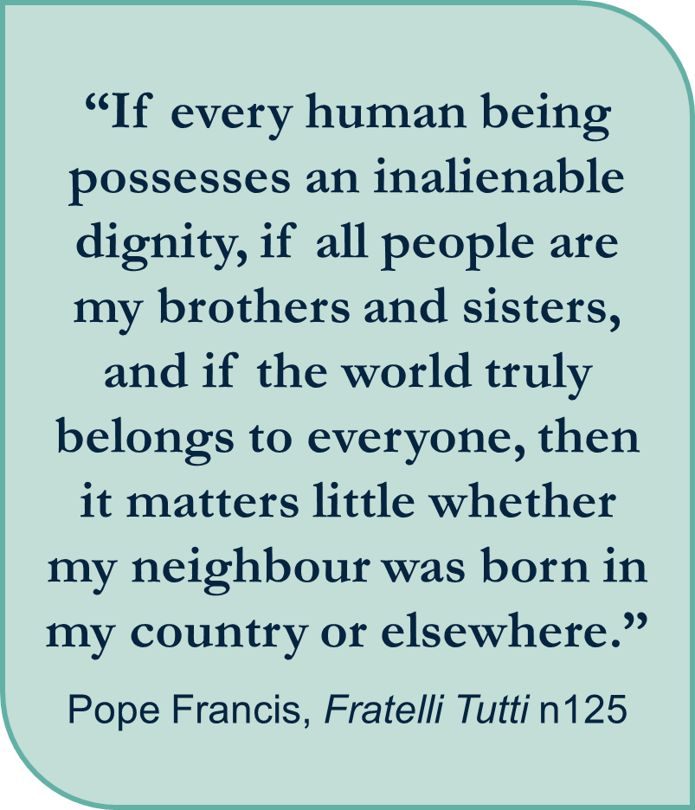
Notes:
Khalina fled Ukraine and has refugee living with a friend on the Ukraine and Polish boarder. As she waits for the war to end, she helps other refugees from using her language skills to translate, helps to organize sleeping places, assists with onward journey and with medical emergencies. Photo: Philipp Spalek/Caritas Germany
Quote: “If every human being possesses an inalienable dignity, if all people are my brothers and sisters, and if the world truly belongs to everyone, then it matters little whether my neighbour was born in my country or elsewhere.”
Pope Francis, Fratelli Tutti n125

Slide 8
What is poverty?
Notes:
An aerial view of a barangay in Quezon City, Philippines. Photo: Richard Wainwright/Caritas Australia

Slide 9
Poverty is …
Poverty means not having enough money for basic needs such as food, drinking water, shelter or education.
It is a state or condition in which a person or community lacks the financial resources and essentials for a minimum standard of living.
Poverty means that the income level from employment is so low that basic human needs can't be met.
A women holding her baby within her house in Kenya. Photo: Thom Flint/CAFOD
Notes:
For students
https://kids.kiddle.co/Poverty
For Teachers
Poverty entails more than the lack of income and productive resources to ensure sustainable livelihoods. Its manifestations include hunger and malnutrition, limited access to education and other basic services, social discrimination and exclusion as well as the lack of participation in decision-making. Various social groups bear disproportionate burden of poverty.
Source: United Nations
https://social.desa.un.org/issues/poverty-eradication

Slide 10
Extreme poverty
Extreme poverty is when people are living below the international poverty line.
The International Poverty Line is US$2.15* per day, and it means that people don’t have enough money to meet their basic needs of food, clothing, shelter etc.
* PPP (Purchasing Power Parity)
Notes:
Source: World Bank Group
https://www.worldbank.org/en/topic/measuringpoverty
https://povertyandinequality.acoss.org.au/faq/#poverty-definitions
Purchasing Power Parity (PPP)
In 1990, a group of independent researchers and the World Bank proposed to measure the world’s poor using the standards of the poorest countries in the World. They examined national poverty lines from some of the poorest countries in the world and converted the lines to a common currency by using purchasing power parity (PPP) exchange rates. The PPP exchange rates are constructed to ensure that the same quantity of goods and services are priced equivalently across countries. Once converted into a common currency, they found that in six of these very poor countries the value of the national poverty line was about $1 per day per person, and this formed the basis for the first dollar-a-day international poverty line.
After a new round and larger volume of internationally comparable prices were collected in 2005, the international poverty line was revised based on 15 national poverty lines from some of the poorest countries in the World. The average of these 15 lines was $1.25 per person per day (again in PPP terms), and this became the revised international poverty line.
We used the poverty lines of those same 15 poorest countries from 2005 (holding steady the yardstick against which we measure) to determine the new global poverty line of $1.90 in 2011 PPP.
In 2022, the poverty line shifted from $1.90 to $2.15. This reflects a change in the units in which the World Bank expresses its poverty and inequality data – from international dollars given in 2011 prices to international dollars given in 2017 prices.
What is Purchasing Power Parity (PPP) and how is it determined? PPP allows us put each country’s income and consumption data in globally-comparable terms. The PPP is computed on the basis of price data from across the world, and the responsibility for determining a particular year’s PPP rests with the International Comparison Program (ICP), an independent statistical program with a Global Office housed within the World Bank’s Development Data Group.
ICP Source - https://www.worldbank.org/en/programs/icp

Slide 11
Poverty in Australia
Notes:
Tereesa teaches her children art and craft skills at their home in western Sydney. Photo: Richard Wainwright/Caritas Australia

Slide 12
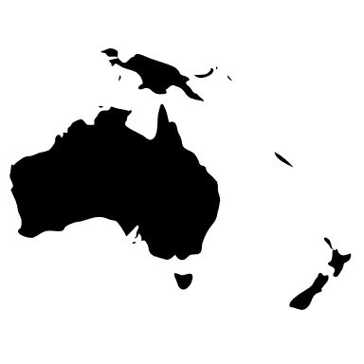
Who is at Risk of Poverty in Australia?
Those with low education attainment
First Nation Peoples
Sole parent families
>65
Those aged 65 and over, especially women
Unemployed and Underemployment
Those living in disadvantaged areas
Notes:
Source: ACOSS
https://povertyandinequality.acoss.org.au/poverty/

Slide 13
Poverty in Australia (2022)
3.3 million (13.4%) Australians living in poverty*
761,000 (16.6%) are children
The poverty line in Australia in dollar value is $489 per week for a single adult and $1,027 per week for a couple with two children.
* Using Australia's national poverty line
Notes:
Source: ACOSS
https://povertyandinequality.acoss.org.au/poverty/

Slide 14
Poverty throughout the world
Notes:
Children eating lunch in their home that is made out of recycled materials in Samoa. Photo: Caritas Australia

Slide 15
Global poverty reduction was dealt a severe blow by the COVID-19 pandemic and a series of major shocks during 2020-22, causing three years of lost progress.
Source: World Bank
photo
Photo: Rose Clough
Notes:
Distribution of COVID-19 School Care kits in the Solomon Islands.
Source: 2024 World Bank Poverty Overview
https://www.worldbank.org/en/topic/poverty/overview
Global poverty reduction was dealt a severe blow by the COVID-19 pandemic and a series of major shocks during 2020-22, causing three years of lost progress.
Source: World Bank

Slide 16
Poverty in our world today
700 million
or 1 in 8 people around the world live in extreme poverty on less than $2.15 per day.
2.2 billion
people do not have access to clean water, including 115 million people who drink surface water.
750 million
people do not have enough food to eat.
Notes:
Source:
World Bank Group
https://www.worldbank.org/en/topic/poverty/overview
WHO
https://www.unwater.org/publications/who/unicef-joint-monitoring-program-update-report-2023
FAO/
https://www.unwater.org/water-facts/water-food-and-energy
Source: The state of food security and nutrition in the world 2024 (who.int)

Slide 17
Poverty in our world today
One half
of the world’s poor are children.
3.5 billion
people lack safely managed sanitation; nearly half of the global population.
244 million
Children are not in school across both primary and secondary education.
Notes:
Source: World Bank
https://www.unicef.org/social-policy/child-poverty
https://www.unwater.org/water-facts/wash-water-sanitation-and-hygiene
https://ourworldindata.org/global-education?insight=hundreds-of-millions-of-children-worldwide-do-not-go-to-school#key-insights

Slide 18
Causes and Impacts of Poverty
Notes:
A general view of the area a landslide occurred next to the Rural Training Centre near the capital Honiara, Solomon Islands. Photo: Neil Nuia

Slide 19
Causes of Poverty
It would be impossible to list all the factors that cause poverty in our world today.
Here are some of the main ones that Caritas Australia confronts every day.
HEALTH FACTORS
Poor health
Communicable diseases, such as COVID-19, malaria and influenza
Living with a disability
Poor sanitation
POLITICAL FACTORS
Indigenous injustice
Conflicts and wars
NATURAL FACTORS
Natural disasters
Climate change
Unclean water
OTHER FACTORS
Gender inequalities
Racism
Disability discrimination
Lack of education

Slide 20
Sustainable development goals
In 2015, the Sustainable Development Goals (SDGs) were released.
These are 17 goals for everyone, everywhere.
All 17 goals are interconnected, and they aim to overall achieve 3 extraordinary things by 2030:
• End extreme poverty
• Fight inequality and injustice
• Fix climate change
Credit: United Nations
Notes:
Image source: https://sustainabledevelopment.un.org/?menu=1300
For more information on the Sustainable Development Goals, please visit: https://www.caritas.org.au/resources/school-resources/

Slide 21
Sustainable development goals
Goal 1 of the Sustainable Development Goals is No Poverty.
It aims to end poverty in all its forms everywhere by 2030.
Through locally-led programs Caritas Australia works with all people, with shared hope and compassion, towards a world where there is no poverty, where all can thrive and reach their full potential.
Credit: United Nations
Notes:
Source: Sustainable Development Goals
https://sdgs.un.org/goals/goal1

Slide 22
Sustainable development goals
Unfortunately, we are not going to reach the goal of zero poverty by 2030. COVID-19 has led to a rise in global poverty.
In 2022, 712 million people were living in extreme poverty, an increased of 23 million people compared to 2019. With an expected 590 million people living in extreme poverty in 2030.
Distribution of COVID-19 School Care kits in the Solomon Islands. Photo: Caritas Australia
Notes:
Source: Sustainable Development Goals
https://sdgs.un.org/goals/goal1
https://www.worldbank.org/en/topic/poverty/overview

Slide 23
Poverty and climate change
Climate change is one of the single biggest threats to reducing poverty.
Pope Francis wrote a letter (encyclical) to all people called Laudato Si’, emphasising the link between climate change and poverty. Natural disasters such as droughts, floods and cyclones are becoming more frequent and the majority of them are occurring in developing countries.
Many of the world’s poorest countries have made small contributions to climate change, yet they are the most vulnerable to its effects and find it more difficult to make necessary adaptations.
India experiencing rising sea levels due to global warming. Photo: Caritas India
Notes:
Promoting climate justice | Caritas Australia

Slide 24
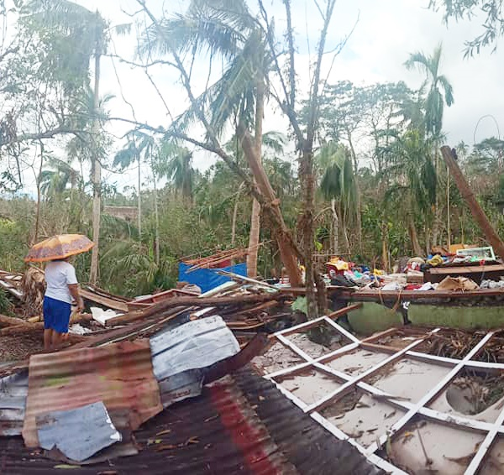
Effects of Climate change
Our partner communities have told us the seas are rising around their homes, rains are coming earlier or later, the droughts are lasting longer, the farming seasons are more unpredictable, fresh water is becoming scarcer, and extreme weather events such as cyclones are becoming fiercer.
They have spoken of the harsh impacts this is having on their families, livelihoods, health, crops and food security.
Destruction caused by Typhoon Goni in the Philippines. Photo: Caritas-Caceres Naga

Slide 25
Church’s Teaching on Poverty
Notes:
Leaia, her sister and their children stand in front of their home they built using recycled materials in Samoa. Photo: Caritas Australia

Slide 26
LAUDATO SI’
In 2015, Pope Francis wrote a letter, or encyclical, called Laudato Si' to all people.
This encyclical is based on the Catholic Social Teaching Care For Our Common Home and the idea that everything is connected.
He explained that 'Nature cannot be regarded as something separate from ourselves...We are part of nature" Laudato Si’ n139.
Notes:
Source: https://www.vatican.va/content/francesco/en/encyclicals/documents/papa-francesco_20150524_enciclica-laudato-si.html

Slide 27
Pope Francis, Laudato Si’ n 49
Notes:
Zimbabwe Integrated Community Development Program and Putting Children First Program
Photo credit: Caritas Australia

Slide 28
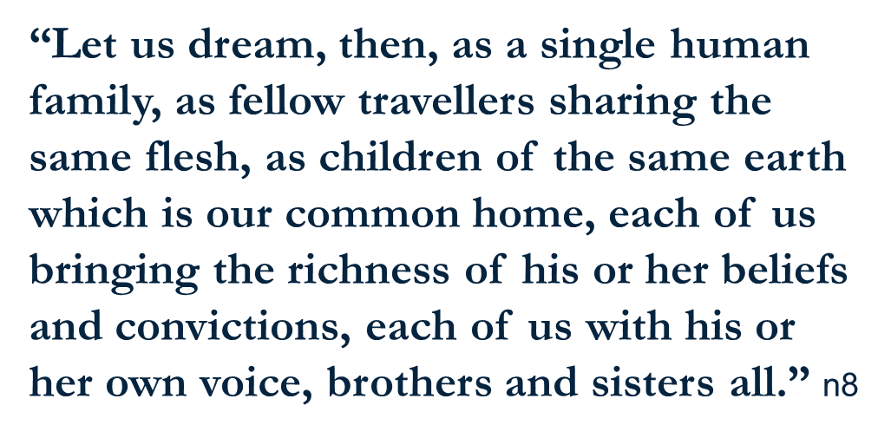
FRATELLI TUTTI
Pope Francis, in his third encyclical (letter), Fratelli Tutti, encourages us to dream as one global family sharing our common home.
Leaia (left) stands with Rosa (right) from Caritas Samoa in front of the rainwater tank that has now been installed at Leaia’s home. Photo: Caritas Australia

Slide 29
Catholic social teaching
HUMAN DIGNITY
Every person is made in the image of God. We are all valuable and worthy of respect and fairness because we are all human.
SOLIDARITY
We are all connected. We need to work together and support each other as one human family. It is a way of saying “I’m here with you”.
PREFERENTIAL OPTION FOR THE POOR
The Bible teaches us to take extra special care of the most vulnerable people in society. We should try to create a fairer world.

Slide 30
Catholic social teaching
COMMON GOOD
We should always try to think about what is good for everyone, not just ourselves. It’s about living together in a community.
SUBSIDIARITY/
PARTICIPATION
All people should be able to participate in their community and have a say in decisions that affect them.
CARE FOR OUR COMMON HOME
We believe that care for our common home is vital for the common good of all people. We are to be protectors of creation and of one another.

Slide 31
Caritas Australia Response
Notes:
Caritas volunteers helping those who are escaping Ukraine impacted by war. Photo: Philipp Spalek/Caritas Germany

Slide 32
CARITAS AUSTRALIA’S RESPONSE
We work alongside our local partners to build on existing local strengths and resources, so that communities can drive their own development.
Our long-term programs focus on strategies that work towards ending poverty. With our partners we ensure that the communities are at the centre of the decision-making process.
Thu and his wife Linh live in the Quang Tri province, Vietnam. After Linh suffered a stroke, Thu became her primary carer. Photo: Phan Tan Lam/Caritas Australia

Slide 33
Caritas Australia's Response
Strategies include:
education programs
sustainable agriculture training
financial management
access to water and sanitation
responding to an emergency, providing immediate needs and assist in rebuilding communities affected by conflicted and disaster
leadership programs​
Laxmi (16) studying civil engineering at a technical school that is four hours walk from her home. Laxmi’s grades excelled after joining the child club and she became top of her class in many subjects. Photo: Richard Wainwright/Caritas Australia
Notes:
Laxmi (16) studying civil engineering at a technical school that is four hours walk from her home. Laxmi’s grades excelled after joining the child club and she became top of her class in many subjects and received a number of prizes in recognition of her academic achievements. Photo: Richard Wainwright/Caritas Australia

Slide 34
Examples of Caritas Australia’s support
LEADERSHIP PROGRAMS
Janice strongly believes in the importance of keeping First Nations culture alive and strong in the community. She teaches other people skills she learnt from her elders.
Learn more here
LIVELIHOOD PROGRAMS
Memory completed a carpentry course in Malawi and is now able to use her new skills to work for one of the largest hydroelectric power company’s and support her family.
Learn more here
WATER AND SANITATION
Laxmi advocated for water taps to be installed at her school in Nepal so students could access clean drinking water.
Learn more here
EDUCATION
The Faithful Companions of Jesus (FCJ) supported Ronita to be able to complete her secondary education, while being able to raise her young children.
Learn more here
Notes:
Photo credits (L-R): Richard Wainwright (Australia), Caritas Australia (Malawi), Richard Wainwright (Nepal), Richard Wainwright/Caritas Australia (Philippines).
NOTE: These can be used as additional case studies.

Slide 35
Case Study - Leaia
Watch Leaia’s Story
Notes:
Leaia standing in front of her newly installed water tank. Photo: Caritas Australia

Slide 36
Leaia, Samoa
While Samoa is a beautiful country surrounded by water, there is not enough clean drinking water in some areas. This makes life very hard for many families like Leaia’s.
Leaia lives with her family on the island of Upolu in Samoa. She was worried about running out of water.
Leaia stands in front of her children, her brother (right) and her younger niece (far left) and nephew (middle) outside their home in Samoa. Photo: Caritas Australia
Notes:
Source: Ministry of Finance, Samoa, 2017

Slide 37
Leaia, Samoa
Their home is not connected to a piped water system, so their only source of water was rainwater collected in old fridges.
However, due to climate change they are experiencing shorter rainy seasons and longer dry seasons. This has left Leaia’s family without enough clean water.
When their water ran out, Leaia and her children had to collect water in containers from a neighbour down the street. The children would have to take several breaks as the buckets were very heavy for them to lift.
Leaia’s collection of old fridges and buckets her family used to collect rainwater from a make-shift roof. Photo: Caritas Australia

Slide 38
Leaia, Samoa
Her children would also miss school during the dry season as there was a lack of clean water at school too.
With the support of Caritas Australia's local partner Caritas Samoa, a 3,000 litre water tank was installed at Leaia's home. She and her family now have a steady supply of clean drinking water!
Next year, they will also have a toilet built through the program, which will further improve their health and living conditions.
Leaia standing in front of the newly installed water tank along with a Caritas Samoa representative. Photo: Caritas Australia

Slide 39
Notes:
Leaia stands in front of the new rainwater tank that has been installed at her home. Photo: Caritas Australia

Slide 40
‘Our love is not to be just words or mere talk, but something real and active.’
1 John 3:18

Slide 41
Call to action
Notes:
Students participate in the Hearts 4 Climate action. Photo: Caritas Australia

Slide 42
See
What are the causes and consequences of poverty?
Who are most likely to experience poverty?
What are the challenges faced by people who are experiencing poverty?

Slide 43
Judge
What does the Church teach us about helping our neighbour?
How does your faith inspire you to act?
How can you get involved and support the agencies of the Church?

Slide 44
ACT
Raise awareness of poverty with your family, friends and community.
Have a voice. Contact decision makers such as your local politician.
Fundraise to support the work of church agencies.
Volunteer. Ask about opportunities with local church agencies.
Donate goods in-kind such as food and blankets to local agencies.

Slide 45
Pray
For all those experiencing and at risk of poverty
For our community to work together to combat poverty
For our Church to continue to amplify the voice of the poor and marginalised and promote charity and justice
Caritas Prayer Service on Poverty

Slide 46
Fundraise
There are many ways you can make a difference in the lives of others through fundraising!
Penola Catholic College cooked pancakes to fundraise for Caritas Australia. Photo: Western Weekender/Melinda Sanders
St Augustine’s ran a ‘Coins for Caritas’ Day. Photo: St Augustine’s School Wodonga
Students at St Charles Waverly held a Zooper Dooper Day. Photo: St Charles Waverly
Ivy sold fabric origami cranes to raise funds for Caritas Australia. She called her business ‘Cranes for Ukraine’. Photo: Mel Maria Catholic Primary School

Slide 47
WHAT YOUR DONATIONS CAN DO!
$6 can provide a rooster chicken for a school in the Solomon Islands.
$10 can provide warm blankets to families living in a refugee camp.
$25 can help a family to establish a vegetable garden to feed their family in the Democratic Republic of Congo.
$50 can help support training for child’s club management in Nepal.
Notes:
L-R
Shaniella holds a chicken at the Rural Training Centre near the capital Honiara, Solomon Islands. Caritas Australia provided 200 chickens to help boost the schools agricultural production and food security. Photos: Neil Nuia.
A primary school has been set up as a shelter in Poland, Germany for Ukrainian people who are displaced due to war. Photo: Fabian Berg/Caritas Germany.
Rosalie harvests plants used for natural medicine which she has grown in a neighbours garden near her home in Bukavu, eastern Democratic Republic of Congo. As well as selling second-hand shoes, Rosalie makes an income by growing and selling natural medicine at her local market. Photo: Arlette Bashizi
Laxmi (16) facilitating a wall magazine poster making session with Child Club members at her old school in Jajarkot district, western Nepal. Wall magazines are used to highlight issues such as child rights, child protection, child marriage and labour exploitation. Photo: Richard Wainwright/Caritas Australia

Slide 49
Caritas Australia education resources
For more resources, please visit: caritas.org.au/resources/school-resources/
We would love to hear from you! To send feedback, enquiries or comments, please email education@caritas.org.au
Stay up to date with events and resources! Subscribe to Caritas Australia’s Education e-newsletter

