Slide 1
Teachers
This PowerPoint contains information on the strengths-based approach to community development (SBA). It begins with an exploration of student’s own understanding of the Catholic Social Teaching principle of Human Dignity, explores the main principles of the SBA and what it looks like in practice in Caritas Australia’s programs in Malawi and then encourages students to think about their collective strengths.
This approach to development strongly aligns with current research and practice related to the concept of resilience. It is an approach that can provide useful reflections for our lives and that of our school communities.
You will find suggested activities and further information in the ‘Notes’ section of each slide. Please refer to these to get the most out of this presentation.
For more school resources, please visit: caritas.org.au/resources/school-resources/
Stay up to date with events and resources! Subscribe to Caritas Australia’s Education e-newsletter
To review Caritas Australia’s Copyright Policy, please visit: Caritas Australia​​
Updated May 2024

Slide 2
Students
Learning about challenges to the health, wellbeing and safety of others and our earth can be hard. If you feel worried or upset about anything you have learnt about through this resource, make sure you talk to your teacher or trusted adult. They can share your concerns via our website.
Do you have an idea for how Caritas Australia can improve our school resources? We would love to hear it! Please email education@caritas.org.au

Slide 3
First Nations people are advised that this resource and external links may contain images, voices and names of people who have died.

Slide 4
Strengths-based Approach to Community Development
Secondary School Resource
Notes:
Photo credit: Laz Harfa

Slide 5
Notes:
Watch the video and stop at each of the ‘pause points’. Discuss the questions as a class or ask students to write them down as a reflection task.
NOTE: This video will open in a web browser.
Source: CST - Human Dignity on Vimeo: https://vimeo.com/600689371

Slide 6
Human Dignity
a belief that every person is made in the image of God and is intrinsically valuable and worthy of respect, simply because they are human.
a quality of being human, independent of ethnicity, creed, gender, sexuality, age or ability
A reality challenged by poverty, hunger, oppression and injustice
Laxmi (16) and her mother Mankala (52) outside their home in Jajarkot district, western Nepal. Photo: Richard Wainwright/Caritas Australia
Notes:
Read through the definition for Human Dignity.
For more resources on Human Dignity and the other Catholic Social Teaching principles, see our online toolkit: www.caritas.org.au/CST

Slide 7
Human Dignity
As a class, brainstorm different key terms that are used to explain Human Dignity.
Individually, write your own explanation on the term, Human Dignity, using all or some of the key terms identified.
Students who attended the Sandhurst Justice Matters Camp using their talents to work as a team to collate images. Photo: Caritas Australia
Notes:
At the conclusion, ask students to share their own explanation of the term, Human Dignity.

Slide 8
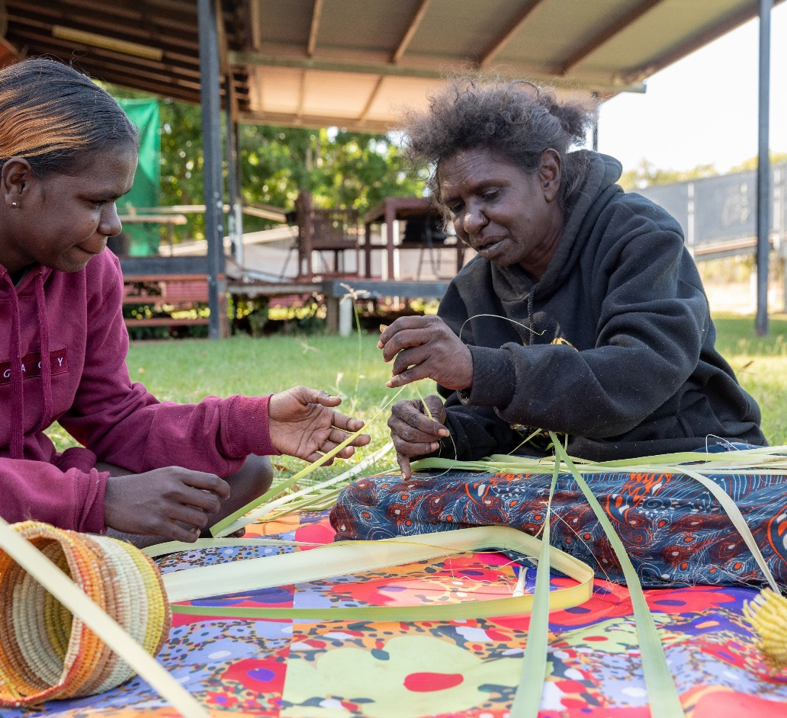
Human Dignity
We each have talents and abilities that God has blessed us with. When we identify these and combine them with everybody else's gifts and strengths, we realise that together we can achieve far more than when everybody works alone.
We call this a Strengths-based Approach.
This is the same in your classroom as it is in the communities that Caritas Australia works with all around the world!
Janice (right) shows her daughter Tiffany how to prepare pandanus leaves collected from a forest near Djilpin Arts, Northern Territory, Australia. Photo: Richard Wainwright/ Caritas Australia

Slide 9
Nobody has nothing
When we see images of communities who are living in poverty we can focus on what they don’t have.
Caritas Australia works in regions of the world where people are marginalised and vulnerable to experiencing poverty and injustice. Despite the many challenges people face, we believe in every individual’s inherent and God-given dignity and worth, and that each individual has unique gifts and talents.
Nobody has nothing.
Leaia and her children walk to collect water in Samoa. Photo: Laura Womersley/Caritas Australia

Slide 10
Nobody has nothing
Everyone in the community are agents of change, regardless of who you are or how old you are, everyone has something to contribute. Everyone is considered equal, precious, and valuable.
The strengths-based approach honours and upholds this dignity and empowers all people to be architects of their own development.
A family in Vietnam participated in a Caritas Australia-supported program to obtain assistance for their children with a vision impairment. Photo: Phan Tam Lan

Slide 11
Needs vs Strengths
Development programs are activities that support families and communities to have what they need. They can include increasing food supplies, accessing clean water, education and training, health programs and how to increase income etc.
Traditionally, international development programs have focused on the needs and problems that communities face.
Ronita (22), in her school uniform, walks down a local street in Quezon City, Philippines, on her way to school. Photo: Richard Wainwright/ Caritas Australia
Notes:
Working towards the Common Good means thinking about what is good for everyone, not just ourselves.

Slide 12
Needs vs Strengths
But with the Strengths-based Approach, community members recognise their collective strengths, abilities and what can they do despite their challenges to work together towards the Common Good*. They are the architects of their own development and work alongside partners of Caritas Australia to create meaningful change.
This leads to stronger, more resilient communities and successful programs.
Chiquito (left) and his family members work together on their farm in Timor-Leste. Photo: Tim Lam/ Caritas Australia
* Thinking about what is good for everyone, not just ourselves.
Notes:
Working towards the Common Good means thinking about what is good for everyone, not just ourselves.

Slide 13
Needs vs Strengths
What do you see?
A glass half-empty…
or half-full?
Photo: Tropical Cyclone Pam has caused widespread destruction in Vanuatu. Credit: Adventist Development and Relief Agency.

Slide 14
Needs vs Strengths
All too often, development programs have only paid attention to the half-empty part: people’s needs and problems.
The Strengths-based Approach focuses on the glass being half-full: this is where the strengths, gifts and talents of a community lies.
Photo: Tropical Cyclone Pam has caused widespread destruction in Vanuatu. Credit: Adventist Development and Relief Agency.

Slide 15
Strengths can be:
Human |  | Natural |  | Social
 | skills knowledge labour compassion health |  | land water fertile soil animals |  | social networks groups/clubs associations organisations
Physical |  | Financial
 | roads and bridges schools clinics transport water supply |  | cash livestock grain stores savings
Notes:
Think about the different communities you are a part of. What strengths and assets do you have collectively, that you could use to work for social justice?

Slide 16
Strengths-based approach
Strength-based Approach
The approach starts with 'what people have' and builds on this. It ensures that communities design their own development and it leads to more sustainable change.
Tarsini (centre) meets with her Village Savings and Loans Group at her home. Photo: Laz Harfa

Slide 17
Strengths-based approach
Through this approach, communities:
Map their assets using a variety of tools
Develop a vision for their community
Share skills and assets with each other
Strengthen positive community relationships and trust
Work together to advocate for community needs
Regularly monitor their own progress

Slide 18
SEE – THINK – WONDER
These photos are from Malawi. When you look at the images what do you see? What do you think about the community and the place? What do you wonder?
Notes:
Photo captions (L-R):
Memory sweeping leaves from the ground outside her family home in Mwanza district, southern Malawi. Photo: Tim Lam/Caritas Australia
Memory (centre) with her parents, Lector and Lute, and siblings in their village in Mwanza district, southern Malawi. Photo: Tim Lam/Caritas Australia
Memory’s former teacher Billy trains the next generation of carpenters at a technical college near the city of Blantyre. Photo: Tim Lam/Caritas Australia

Slide 19
Case Study - Malawi
Memory and her family live in a remote village in Malawi. Malawi is one of the poorest countries in the world and many families don’t have enough food to eat. But after working with Caritas Australia’s local partner CADECOM, Memory’s family and community are now enjoying the results from their hard work.
Memory on her family farmland near their village in Mwanza district, southern Malawi. Photo: Tim Lam/Caritas Australia

Slide 20
Growing more food
Memory’s family and community have many strengths. They have land, farming tools and time to farm, but they found it hard to grow enough food to eat.
Building on these strengths the community has learnt new irrigation farming techniques with the support of CADECOM.
Now they can grow more food from the land they have.
Memory (left) and her family are seen on their farmland near their village in Mwanza district, southern Malawi. Photo: Tim Lam/Caritas Australia

Slide 21
Raising goats
Community members save money together through a Village Savings and Loans Group.
Members can then borrow some money (loan) for an activity and then pay the group back so another member can borrow money for their activity.
Memory’s parents were very happy to receive a goat as members of their Village Savings and Loans Group.
Memory’s parents, Lector and Lute, carrying a goat that was provided to them by CADECOM. Photo: Tim Lam/Caritas Australia

Slide 22
Selling honey and caring for the environment
Another strength of the community was the land and natural environment. The community have been able to use this beautiful area to start beekeeping.
Now they can collect honey to sell while also caring for their local environment which is good for the community and the bees!
Community members wearing beekeeping suits collect honey from a bee hive. Photo: Caritas Australia

Slide 23
Handwashing
Families have used their skills to build handwashing devices to stay healthy.
Many communities do not have access to clean, running water; which is crucial in reducing the spread of diseases. The simple act of washing hands with soap and water can reduce diarrhoea by over 40 percent.*
*Source: United Nations
Vellina washes her hands outside her home in Malawi. Photo: Tim Lam / Caritas Australia

Slide 24
Income generation
The community are able to generate an income from turning excess crops into a product they can sell. In this case, bananas.
The community have worked together and learnt how to make banana wine.
They earn income from selling the wine which enables them to buy other essential items and to afford healthcare.
As part of the Caritas Australia-supported program, community members learnt to make banana wine as an income generating activity. Photo: Tim Lam / Caritas Australia.

Slide 25
Resilient communities
Through the Strengths-based Approach, Memory and her community have learned to use their strengths to grow more food, increase their income and stay healthy!
Memory (centre) with her parents, Lector and Lute, and siblings in their village in Mwanza district, southern Malawi. Photo: Tim Lam/Caritas Australia
Along with your generous support, this program is also supported by the Australian Government, through Australian NGO Cooperation Program (ANCP).

Slide 26
What are our strengths?
Think about the different communities you are a part of.
What strengths and assets do you have collectively, that you could use to work for social justice?
Shaniella using the skills she has learnt from the agriculture and poultry management program in the vegetable garden at the vocational training school. Photo:Neil Nuia

Slide 27
More information on Strengths-based Approach
Visit the Caritas Australia website:
‘From Aid to Empowerment’ blog
Our Approach
Notes:
Women farming in Nepal. Photo: Richard Wainwright/Caritas Australia

Slide 28
Credits
Content adapted in part and with permission from the Coady International Institute, St Francis Xavier University.

