Slide 1
students
Learning about challenges to the health, wellbeing and safety of others and our earth can be hard. If you are feeling worried or upset about anything you learn about through this resource, make sure you talk to your teacher or trusted adult. They can share your concerns via our website.
Do you have an idea for how Caritas Australia can improve our school resources? We would love to hear it! Please email education@caritas.org.au

Slide 2
Lebanon Crisis Appeal
The Caritas Lebanon Network is on the ground responding to emergency needs in Beirut.
Credit for all photos: Caritas Lebanon

Slide 3
About the crisis
The ongoing crisis in Gaza is spreading, and the fighting on Lebanon’s southern border is creating a heartbreaking humanitarian emergency across the country.
As conditions get worse, Lebanon is struggling even more under the weight of a severe economic crisis.
Caritas Lebanon staff sorting through critical supplies.

Slide 4
About the crisis
Over 1 million people have been displaced from their homes due to hostilities.
Over 2,300 people have been killed, including children.
Food prices have risen 628% in just two years due to runaway inflation.
Hospitals are rationing electricity, and parts of the population are now at risk of hunger.

Slide 5
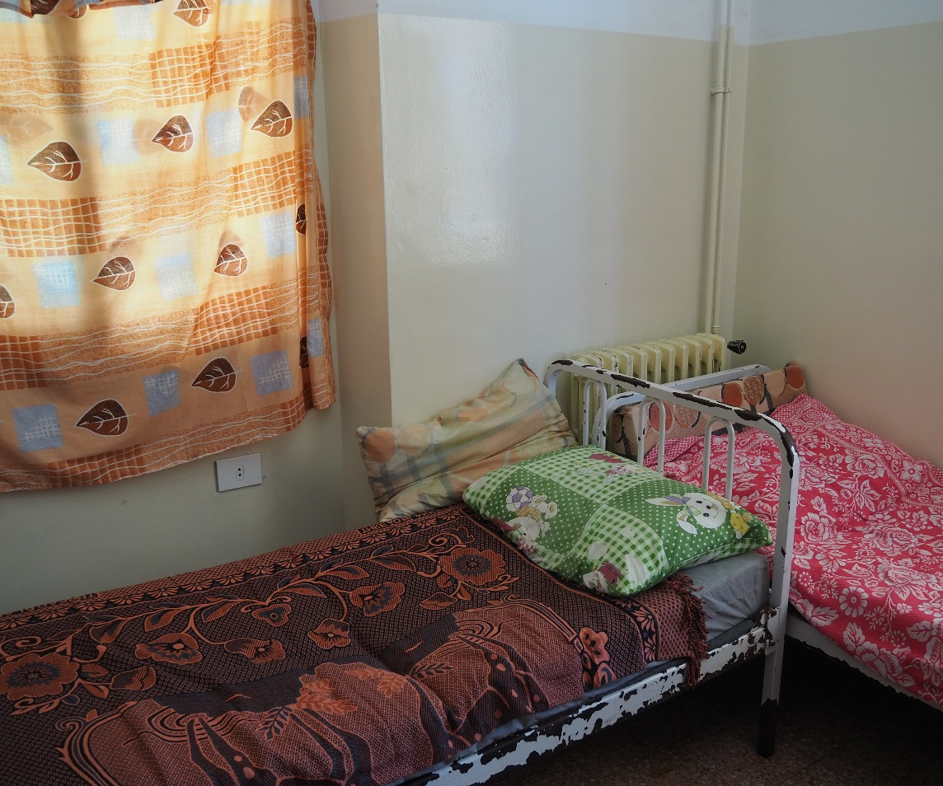
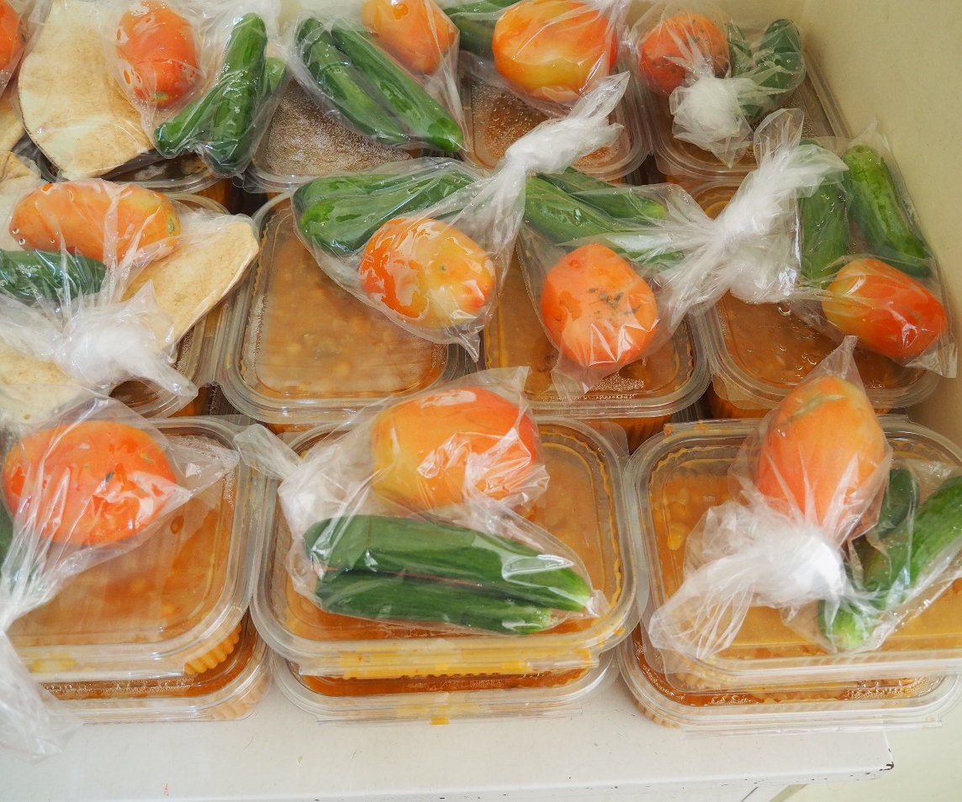
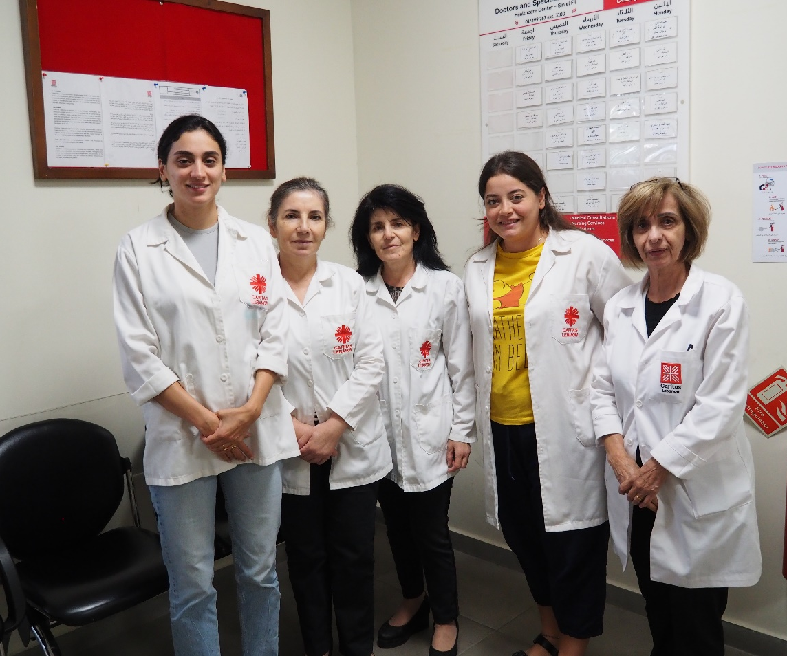
Caritas Australia’s Response
In partnership with Caritas Lebanon, we are supporting:
Emergency shelter for families
Access to food and essential items
Primary healthcare centres and mobile clinics

Slide 6
UPDATE FROM Caritas Lebanon
Update from Cindy Hakmeh from Caritas Lebanon
Our partner Caritas Lebanon has been working tirelessly to support vulnerable communities facing a dire humanitarian crisis.

Slide 7
How your school can help
Communities devastated by conflict and economic instability urgently need your support.
Your donation can help families access shelter, food, water and medical care.
Caritas Lebanon preparing food for those in need

Slide 8
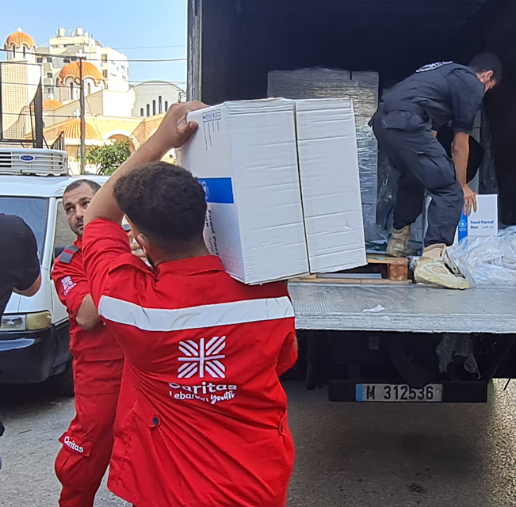
How your school can help
Set up an online fundraiser and raise vital funds for people in need bit.ly/caritas-lebanoncrisis
Raise awareness
Donate to the crisis www.caritas.org.au/lebanon
Pray for Lebanon
Fresh food supplies being carried by Caritas Lebanon staff.

Slide 9
Prayer
The righteous flourish like the palm tree, and grow like a cedar in Lebanon.
Psalm 92
The Caritas Lebanon team gather together.

Slide 10
God of all creation,
We hold in our hearts all the pain of the word.
In these anxious days, we pray especially for the
people of Lebanon.
Our country has been deeply enriched by Lebanese culture and faith.
We know that Jesus travelled in Lebanon.
He would have been distressed by the current conflict
between places he knew and loved.

Slide 11
We pray that in our time all violence may cease,
that compassion will reign,
and that all people will recognise their shared dignity
as children of God.
Jesus said, ‘blessed are those who mourn.’
He also said, ‘blessed are the peacemakers.’
May our grief be a seed that grows into tree that shades everyone,
as does the cedar of Lebanon.
God of light, be with us all,
Amen.

