Slide 1
Introduction

Slide 2
ABOUT THE THEME
This year, the theme For All Future Generations is inspired by the story of the burning bush in the book of Exodus (Exodus 3:1–20).
In this story, God tells Moses that he has heard the cry of the people. God responds to injustice and chooses Moses to speak to Pharaoh.
Though Moses is afraid, God promises to be with him. Thus, God says, ‘By this name I shall be invoked for all future generations.’
As God called Moses, so now God calls us to work for all future generations.
God said,
'This is my name for all time; by this name I shall be invoked for all generations to come.'
Exodus 3:15

Slide 3
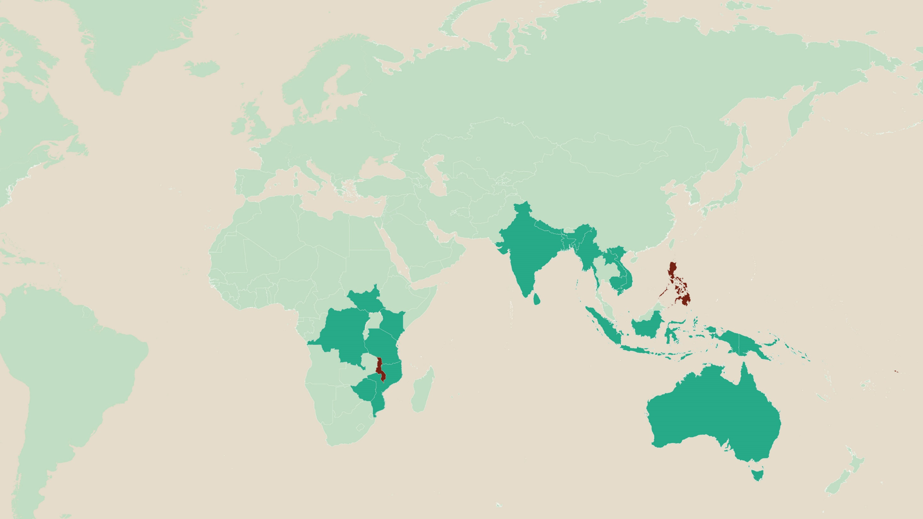
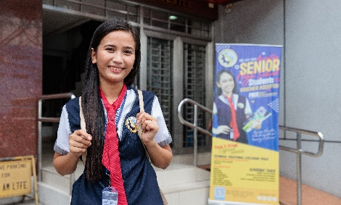
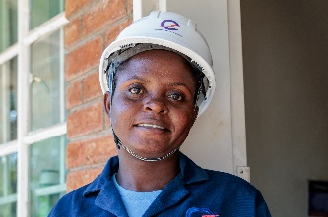
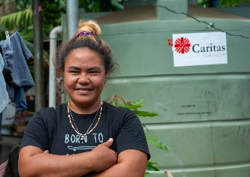
For over 60 years, Caritas Australia has worked hand in hand with the most marginalised and remote communities in Australia and overseas to confront the challenges of poverty.
PHILIPPINES
MALAWI
SAMOA
WHERE WE WORK (EXC EMERGENCIES)
FEATURED COUNTRIES

Slide 4
RONITA’s story
PHILIPPINES

Slide 5
ronita’s story
philippines
Ronita, 22, lives with her husband and two children in a barangay (local district) in Metro Manila, in the Philippines.
Ronita left school when she became pregnant as a teenager, which could have had a life-long impact on her ability to find work and provide for her family. Thankfully she heard about a program run by Caritas Australia’s local partner, the Faithful Companions of Jesus (FCJ).

Slide 6
Ronita’s story
philippines
The program is called the Alternative Learning System (ALS) and enabled Ronita to re-enrol in her studies and continue learning in a safe and flexible environment – even with the arrival of her second child.
It wasn’t easy. Ronita often wouldn’t get enough sleep with caring for her children and studying into the early hours of the morning. Sometimes she would skip lunch at school as she was unable to afford it.

Slide 7
Ronita’s story
philippines
With determination and perseverance, Ronita completed her ALS classes and went on to earn her Senior High School Diploma.
Having her diploma enabled Ronita to secure a job at a call centre.
With the support of the FCJ, Ronita has overcome tremendous obstacles to enjoy better employment prospects and a brighter future for her whole family.

Slide 8
With your generosity, our local partner FCJ can continue to support communities living in urban slums in the Philippines through a variety of programs.
The young mothers’ group enables young mothers to support each other while also learning how to stay healthy and manage their finances.
A health clinic is visited weekly by a doctor and community nurse, providing essential medical care to the community.
Other programs include literacy skills, food processing, urban gardening, upcycling and income generating activities.

Slide 9
“I have now graduated senior school and I am so proud of myself. I feel hopeful for the future. Now it’s not impossible for me to achieve my dream. Thank you.”
Ronita

Slide 10
Leaia’s story
samoa

Slide 11
LeaIA’s story
samoa
Samoa may be a country surrounded by water, but access to clean drinking water is scarce in some areas, with many families facing extreme hardship as a result.
Leaia lives with her family on the island of Upolu in Samoa. Not having reliable access to clean water was a concern for Leaia and her family.

Slide 12
LeaIA’s story
samoa
Their home is not connected to a piped water system, so they used to rely solely on rainwater collected in old fridges. However, with shorter rainy seasons and longer dry seasons due to climate change, they could run out of water.
When their water ran out, Leaia had to walk with her young children to collect water in buckets and containers from a neighbour down the street.

Slide 13
LeaIA’s story
samoa
With the support of Caritas Australia's local partner Caritas Samoa, a 3,000 L water tank was installed at Leaia's home. She and her family now have a steady supply of clean drinking water at home.
Next year, they will also have a toilet built through the program, which will further improve their health and living conditions.

Slide 14
“I hope this program helps other families in need, like mine. Thank you, Caritas, we are very thankful and grateful for the water tank. It has helped us so much and made our daily life easier.”
Leaia

Slide 15
MEMORY’s story
MALAWI

Slide 16
memory’s story
malawi
Memory is 26 years old and lives in rural Malawi. As the eldest child in a low-income farming family, Memory had to take on many household chores and farming activities to support her parents.
They struggled to pay for Memory’s school fees and school supplies, and Memory often had to walk to school barefooted.

Slide 17
memory’s story
malawi
Despite the challenges she faced, Memory understood that education was her best chance of breaking the cycle of poverty.
With the support of Caritas Australia and its partner the Catholic Development Commission in Malawi (CADECOM), Memory undertook a three-year carpentry course. CADECOM supported her by providing part of her tuition and boarding fees.

Slide 18
memory’s story
malawi
Memory became the first female carpenter from her village!
Today, Memory works as a carpenter at a hydroelectric power station. Her income has enabled Memory to provide some financial support to her parents.
In the future, Memory wants to build a house for her parents and own her own workshop to support and employ others in her community.

Slide 19
With your generosity, the program also supported Memory’s family and community.
Memory’s parents received a goat as members of the Village Savings and Loans Group.
Bee keeping enables the community to earn an income from selling honey while also caring for their environment to protect the bees.
Memory’s family has increased the amount of food they can grow by learning about irrigation farming from CADECOM.

Slide 20
“Many women in my community drop out of school because they can’t afford school fees, which leads to more poverty. But I told myself I can’t stop going to school because this is the only way I can get a better life.”
Memory

Slide 21
Photo credits
Ronita’s Story (Philippines) – Richard Wainwright/Caritas Australia
Leaia’s Story (Samoa) – Laura Womersley/Caritas Australia
Memory’s Story (Malawi) – Tim Lam/Caritas Australia
Caritas Australia gratefully acknowledges the support of the Australian Government through the Australian NGO Cooperation Program.

