Slide 1
Caring for Creation One family, one common home secondary
Notes:
Photo: Tati walks through part of her community’s preserved forest to collect vegetables and traditional medicines.
Credit: Richard Wainwright

Slide 2
A note to teachers
This resource has been created to provide information, classroom learning tasks and action ideas to help teachers address the issue of caring for creation (our common home) through a Catholic worldview. It will explore the theological imperative we have to take care of creation and offer ideas on how the school community can take action.
Use and adapt the information and tasks in each section as individual lessons in your own units, or follow the suggested ‘See, Judge, Act’ sequence.
It is our hope that you will find all or some of this resource useful and use it in a way that best suits your purposes.
Tip: Check the ‘Notes’ sections of the slides for more information.
For more resources on a variety of topics, please visit www.caritas.org.au/schools
Please see the Copyright notice in the ‘Notes’ section of this slide.
We would love to hear from you!
To send feedback, enquiries or comments, please email us as education@caritas.org.au
Stay up to date with events and resources!
Teachers - Subscribe to Caritas Australia’s Education e-newsletter by emailing your request to
education@caritas.org.au
This resource was last updated in June 2021
Notes:
Copyright notice:
Use of website materials
Use of material on this site for educational purposes is encouraged. Caritas Australia gives permission for articles, illustrations and other materials to be reproduced for educational purposes or personal use, provided the information is not changed, and that the source is acknowledged appropriately. Use of material on this website for purposes other than educational or personal use must have prior authorisation from Caritas Australia's webteam (webteam@caritas.org.au)
Permissions
In some cases the copyright for text or images on this site may held by someone other than Caritas Australia. All rights are reserved on such material and permission to use them must be requested from the copyright owner. The source of this material is indicated on the relevant sections of the site.
Photos without a specified photo credit are the property of Caritas Australia or the international partners of the Caritas network.
Our logo
The Caritas Australia logo must not be downloaded, copied and or used for any purpose without the expressed permission of Caritas Australia. Please contact Caritas Australia's web team [mailto:webteam@caritas.org.au] for any further information that you may require about using content from this website.
Links to external sites
This site contains links to external web sites. Caritas Australia takes no responsibility for the content of such sites, nor do links to such sites imply endorsement of the views expressed therein. External links are provided for informational purposes only.

Slide 3
contents
Contents – Click to navigate to section
Curriculum Indigenous Pedagogies
Process - See, Judge, Act
Part 1: See Climate Change Biodiversity Consumerism Fossil Fuels Transport SDG's Caritas Australia's Response Case Studies | Part 2: Judge Scripture Laudato Si' Fratelli Tutti Catholic Social Teaching | Part 3: Act Daily Actions Locus of Control Play your Part Prayer Further Resources

Slide 4
curriculum
Catholic School Context
Across all curriculum areas, the religious dimension invites dialogue, challenges worldviews and promotes critical reflection and discernment. As an ecclesial community, the Catholic school is committed to promoting the Kingdom of God, bringing it to life through its action for justice and peace both locally and globally. Its educational project is impelled by the message of Christ to be hope-filled and future-oriented, drawing students into a vision for a just and compassionate world. Source: Catholic Education Melbourne. (2017). Horizons of Hope: Religious Dimension.
Catholic educators draw on the teachings from the Scriptures and papal pronouncements to provide a deep foundation for their teaching… Whichever curriculum areas teachers choose to address, sustainability should always be approached from the perspective of positive action and empowerment… For Catholic schools then, the challenge is to develop life-affirming approaches to learning, teaching and curriculum that invite and support students to discover God’s presence in their lives. Source: Catholic Education Melbourne. (2016). Education for Sustainability.
Secondary school Religious Studies and Catholic Social Teaching Principles:
Caring for Our Common Home
God’s creation and our responsibility to look after it
Our world today
Culture of waste and consumerism
What can we do to ‘be green’?
Sustainability
Solidarity
Just/Christian leadership values
True discipleship
Friendship
Loving our neighbour
Acting justly
Subsidiarity and Participation
Rights and duties
Authority/power
Making responsible decisions
Caring for people
Society’s systems
Active citizenship

Slide 5
curriculum
Australian Curriculum
The issue of climate change can be explored in all areas of the curriculum and particularly through the cross-curriculum priority of sustainability.
Sustainable patterns of living meet the needs of the present without compromising the ability of future generations to meet their needs.
Actions to improve sustainability are individual and collective endeavours shared across local and global communities. They necessitate a renewed and balanced approach to the way humans interact with each other and the environment.
Sustainability education is futures-oriented, focusing on protecting environments and creating a more ecologically and socially just world through informed action.
Actions that support more sustainable patterns of living require consideration of environmental, social, cultural and economic systems and their interdependence.
(Source: https://www.australiancurriculum.edu.au/)
Cross-curriculum priorities: Aboriginal and Torres Strait Islander Histories
Organising Ideas
Country/Place OI.2 Aboriginal and Torres Strait Islander communities maintain a special connection to and responsibility for Country/Place.
OI.3 Aboriginal and Torres Strait Islander Peoples have holistic belief systems and are spiritually and intellectually connected to the land, sea, sky and waterways.
Learning Area Statement: Technologies
Students will identify the interconnectedness between technologies and Identity, People, Culture and Country/Place. They will explore, understand and analyse how this intrinsic link guides Aboriginal and Torres Strait Islander Peoples in sustaining environments, histories, cultures and identities through / by creating appropriate and sustainable solutions.
Geography Curriculum Lens
Year 7: Unit 1: Water in the world: Causes, impacts and responses to an atmospheric or hydrological hazard (ACHGK042).
Year 8: Unit 1: Landforms and Landscapes, Causes, impacts and responses to a geomorphological hazard (ACHGK053).
Year 9: Unit 1: Biomes and Food Security: Challenges to food production, including land and water degradation, shortage of fresh water, competing land uses, and climate change, for Australia and other areas of the world (ACHGK063).
Year 10: Unit 1: Environmental change and management: Human-induced environmental changes that challenge sustainability (ACHGK070), Environmental world views of people and their implications for environmental management (ACHGK071),
Year 10: Unit 2: Geographies of human wellbeing: Issues affecting development of places and their impact on human wellbeing, drawing on a study from a developing country or region in Africa, South America or the Pacific Islands (ACHGK078). The role of international and national government and non-government organisations' initiatives in improving human wellbeing in Australia and other countries (ACHGK081).

Slide 6
curriculum
English curriculum lens
Listening, Reading and Viewing a range of texts about climate justice, including informative and narrative texts.
Year 7 : Use prior knowledge and text processing strategies to interpret a range of types of texts (ACELY1722), Use comprehension strategies to interpret, analyse and synthesise ideas and information, critiquing ideas and issues from a variety of textual sources (ACELY1723).
Year 8 : Use comprehension strategies to interpret and evaluate texts by reflecting on the validity of content and the credibility of sources, including finding evidence in the text for the author’s point of view (ACELY1734).
Year 9: Apply an expanding vocabulary to read increasingly complex texts with fluency and comprehension (ACELY1743).
Year 10: Identify and analyse implicit or explicit values, beliefs and assumptions in texts and how these are influenced by purposes and likely audiences (ACELY1752).
Use comprehension strategies to compare and contrast information within and between texts, identifying and analysing embedded perspectives, and evaluating supporting evidence (ACELY1754).
Civics and Citizenship curriculum lens
Year 7: How groups, such as religious and cultural groups, express their particular identities; and how this influences their perceptions of others and vice versa (ACHCK053). Present evidence-based civics and citizenship arguments using subject-specific language (ACHCS059). Reflect on their role as a citizen in Australia’s democracy (ACHCS060).
Year 8: Present evidence-based civics and citizenship arguments using subject-specific language (ACHCS073). Reflect on their role as a citizen in Australia’s democracy (ACHCS074).
Year 9: How and why individuals and groups, including religious groups, participate in and contribute to civic life (ACHCK079). Present evidence-based civics and citizenship arguments using subject-specific language (ACHCS088). Reflect on their role as a citizen in Australian, regional and global contexts (ACHCS089).
Year 10: Recognise and consider multiple perspectives and ambiguities, and use strategies to negotiate and resolve contentious issues (ACHCS099). Present evidence-based civics and citizenship arguments using subject-specific language (ACHCS101). Reflect on their role as a citizen in Australian, regional and global contexts (ACHCS102).

Slide 7
Introduction - the Learning process
This resource has been created using the “See, Judge and Act” model.
This is a reflection–action process and was first used by a Belgian Catholic priest, Joseph Cardijn (who later became a Cardinal) with Young Christian workers prior to the first World War. This approach was also recommended in the 1961 encyclical letter written by Pope John XXIII called Mater et Magistra (Mother and Teacher).
This resource provides information, learning tasks and action ideas to help address environmental issues through a Catholic worldview. It will explore the theological imperative we have to take care of creation and offers ideas on how individuals and the school community can take action.
Inquiry Learning and ‘See, Judge Act’
The See, Judge, Act model aligns well with inquiry learning models.
Broad phases of inquiry
See | Identify the issue, tuning in, framing and focusing questions
 | Investigate, organise, analyse evidence, explain, synthesise
Judge | Make connections, evaluate, reflect
Act | Responding, sharing new learnings, take action, evaluate the action
Objectives
See | Students will be able to explain what climate change is, its causes and the impact it is having on our environment and our global family. Extension: What are the economic, political, social, historic and cultural factors of climate change?
Judge | Students will reflect on what they know about climate change and its effects on humanity in light of Catholic teaching. Students will be able to cite evidence from certain encyclicals as well as the Holy Scriptures to support their actions in caring for our common home.
Act | Students with an understanding of climate change and in light of a Catholic faith will determine what action they can take.

Slide 8
Indigenous pedagogies
Aboriginal perspectives are fundamental to learning more about caring for our common home.
Below is information about ‘Eight Aboriginal Ways of Learning’ from 8 Ways. It is “a pedagogy framework that allows teachers to include Aboriginal perspectives by using Aboriginal learning techniques. In this way, focus can remain on core curriculum content while embedding Aboriginal perspectives in every lesson” (From 8 Ways). We have intended to integrate some of these ways of learning into this resource.
8 Ways
Story Sharing: Approaching learning through narrative.
Learning Maps: Explicitly mapping/visualising processes. Picturing pathways of knowledge.
Non-verbal: Applying intra-personal and kinaesthetic skills to thinking and learning. See, think, act, make and share without words.
Symbols and Images: Using images and metaphors to understand concepts and content.
Land Links: Place-based learning, linking content to local land and place.
Non-linear: Producing innovations and understanding by thinking laterally or combining systems.
Deconstruct/Reconstruct: Modelling and scaffolding, working from wholes to parts (watch then do).
Community Links: Centering local viewpoints, applying learning for community benefit.
8 Aboriginal Ways of Learning graphic from 8 ways
Notes:
About 8 ways:
This is a pedagogy framework that allows teachers to include Aboriginal perspectives by using Aboriginal learning techniques. In this way, focus can remain on core curriculum content while embedding Aboriginal perspectives in every lesson. It came from a research project involving DET staff, James Cook University’s School of Indigenous Studies and the Western New South Wales Regional Aboriginal Education Team between 2007 and 2009. AECG and SERAP approval was granted for the project.
https://www.8ways.online/about

Slide 9
Catholic tradition on caring for creation
There has always been a strong Catholic tradition to care for our common home. In the 13th century St Francis of Assisi’s Canticle of Creation and many Popes since have discussed the natural environment in their encyclicals.
In a General Audience in Rome in 2001, Pope John Paul II called for the worlds people to undergo an ‘conversion’ to protect the environment and make the earth a place where all life is valued and can grow in harmony. Pope Benedict XVI spoke of an economy that didn’t respect the environment.
Pope Francis released Laudato Si’, meaning "Praise be to you”, in June 2015. It is clear from Pope Francis' encyclical - Laudato Si': Caring for our Common Home - that as Catholics, we are called to take action for climate justice.
It is the Church’s most profound clarion call yet, for us all to be protectors of creation and the poor. The Holy Father has called for a new global solidarity, where all individuals, communities and governments play an essential part in taking care of our earth and global family.
In our region, the Federation of Oceania Catholic Bishops (including the Australian Catholic Bishops Conference) have spoken robustly about climate change and the need to be more active in reducing emissions.
“A true ecological approach always becomes a social approach, it must integrate questions of justice in debates on the environment as to hear both the cry of the earth and the cry of the poor.” (Pope Francis, Laudato Si’ n 49)
Within the global Caritas confederation, Cardinals, Bishops and lay Caritas leaders at the 2018 Caritas Oceania forum also reinforced this theme, and have made caring for creation one of their top priorities. Caritas Internationalis has made climate change an overarching theme in its strategic plan.
As a program of Caritas, Catholic Earthcare Australia is an ecological advisory agency to the church and has been mandated through the activities of education, research and advocacy to give leadership in responding to Laudato Si’ to “stimulate and sustain the ecological conversion and implement integral ecology in Catholic institutions in Australia.”
The Australian Catholic Bishops Social Justice Statement for 2021-22, ‘Cry of the earth cry of the poor’, further supports our call to care for all creation and invites us to take action.
To support this statement and the seven year Laudato Si’ action platform, Catholic Earthcare has developed a certification process for Catholic Earthcare schools, parishes and families.
"Living our vocation to be protectors of God’s handiwork is essential to a life of virtue; it is not an optional or a secondary aspect of our Christian experience.” (Pope Francis, Laudato Si’ n 217)
Notes:
Professional Reading:
Who are we before God and in Creation? Dr Sandie Cornish
Laudato Si’ Action Platform

Slide 10
PArt 1: see
Photo Credit: Richard Wainwright/Caritas Australia
Notes:
Teacher notes:
Inquiry Aim: Students will be able to explain what climate change is, its causes and the impact it is having on our environment and our global family.
Extension: What are the economic, political, social, historic and cultural factors of climate change?
Identify the issue, tuning in, framing and focusing questions

Slide 11
PArt 1: see
MY PLACE
Pause for a moment and consider your surroundings. What kind of environment do you live, learn and grow in? Is it alpine, coastal, desert, savannah or riverine plains country?
‘Country’ is the term often used by Aboriginal people to describe the lands, waterways and seas to which they are connected ^{(Source)}.
Do you know whose Country you are on? If not, use the Map of Indigenous Australia to find out.
For a moment, reflect on how people in the past lived, learned and grew in your local area.
What is your special connection to your local environment? If you can, share a story of how you are connected to your local environment.
Acknowledge Country before you start your formal learning today. You can use the following template:
I begin today by acknowledging the Traditional Custodians of Country throughout Australia and their connections to land, sea and community. We pay our respect to their Elders past, present and emerging and extend that respect to all Aboriginal and Torres Strait Islander peoples today.
Notes:
Teacher notes:
Inquiry Aim: Students will be able to explain what climate change is, its causes and the impact it is having on our environment and our global family.
Extension: What are the economic, political, social, historic and cultural factors of climate change?
Identify the issue, tuning in, framing and focusing questions

Slide 12
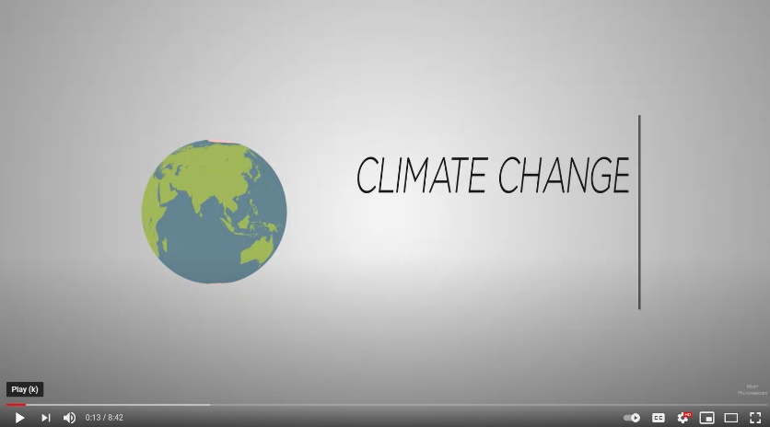
Cry of the earth - Climate change
Watch the video but stop at 6:20 and complete your own research to answer the following questions.
Present your answers in a format that suits your strengths. (infographic, video clip, fact sheet, flyer etc)
What is climate change?
What is causing climate change?
What are some of the predicted impacts if we don’t act now?
Who is the most affected by, or vulnerable to, climate change?
Are we listening to the people most directly affected?
How do you contribute to climate change?
Who are the decision-makers?
What are Australia’s targets for greenhouse gas emissions?
How do we compare to other developed countries?
Where do the majority of greenhouse gas emissions come from?
WATCH

Slide 13
Cry of the earth - Climate change
More resources to help ‘See’ the issue of Climate Change
Cool Australia Climate Change Fact Sheets
Australian Greenhouse Calculator
ABC Education climate change resources
UN Sustainable Development Goal 13: Climate Action
NASA Global Climate Change

Slide 14
We are the problem. but also the solution!
WATCH
Continue watching the clip starting from 6:20 min
Discuss possible solutions to the issue.
Reflect
Who are driving the solutions?
What solution do you find most interesting?
Choose one solution and identify the positive and negative impacts this solution has on people and the planet.

Slide 15
Cry of the earth - biodiversity
Scientists and many governments agree that we are facing an environmental crisis, we are losing species at a rate 1,000 times greater than at any other time in recorded human history.
We depend on healthy ecosystems and biodiversity for survival. Global health crises like the COVID-19 pandemic will happen more often if we fail to protect natural ecosystem buffers globally.*
It is urgent to limit global warming to prevent further loss of species.
*Source: World Health Organisation
TASK
View the National Geogrpahic photo gallery showing the diversity of living things.
Which image did you find most interesting?
Read the information under the image.
What impacts are humans having?

Slide 16
diseasE
Excerpt from the Australian Catholic Bishops Conference Social Justice Statement 2021-22, CRY OF THE EARTH CRY OF THE POOR
Our “interference with the intricate balance of natural ecosystems” is contributing to the outbreak and spread of zoonotic diseases which are caused by pathogens jumping from animals to humans.
Nearly 70% of zoonotic infections are linked to human environmental changes. Both COVID-19 and the Hendra virus are zoonotic.
Fr Joshtrom Kureethadam, of the Vatican Dicastery for the Promotion of Integral Human Development says, “the COVID-19 crisis is part and parcel of recent warnings from the natural world.”
Source
Photo by CDC on Unsplash

Slide 17
Cry of the earth - consumerism
We live in a disposable culture where consumer goods are produced in their millions, usually powered by fossil fuels and with a short life span, but at what cost to our environment?
Let’s briefly look at a few examples to understand the impacts of consumerism.
Photo by Dustan Woodhouse on Unsplash

Slide 18
Cry of the earth - consumerism
Plastic Humans use lots of plastic. Did you know plastic never breaks down? It can only be physically broken into smaller pieces or recycled.
Task
Read The Problem - Our Throwaway Lifestyle.
List the impacts.
Food The 2021 Food Waste Index report showed that 17% of available food in the world is wasted.
Task
Read Humanity’s penchant to waste food is trashing the planet.
List 3 facts you learned. Learn more about Food Security here.
E-Waste Millions of electronic devices like televisions, computers and mobile phones are discarded in Australia every year.
Task
Read E-Waste.
List 4 facts you learned.

Slide 19
FOSSIL FUEL / ENERGY
Find out what renewable and non-renewable energy means.
Fossil fuels are non-renewable and when burnt, they produce greenhouse gases which trap heat in our atmosphere and cause climate change. Extracting coal, oil and gas from our natural environment can have impacts on land use, traditional owners, water bodies, air quality and the landscape.
We will eventually run out of fossil fuels, so countries need to use alternative energy sources more widely. Australia relies on coal and gas for 79% of its electricity.
Source: energy.gov.au
Photo by Chris LeBoutillier on Unsplash
Plastic packaging accounts for 50% of waste –I couldn’t find the source for this.

Slide 20
FOSSIL FUEL / ENERGY
Each Australian state uses various energy sources. The Australian Energy Market Operator website shows which types of energy each state uses in real time! How cool is that?
Which states are having the least impact on climate change?
Which states are having the most impact on climate change?​
Recently, Australia has been using more renewable types of energy such as solar, hydro and wind. They accounted for 24% of the energy used in the last quarter of 2020. This meant we had the lowest emissions from electricity on record.​ Source
Write a short informative and persuasive piece on energy use in Australia and what we should do to care for creation.
Good News!
Australian homes and businesses are installing and using more solar energy. ​Source ​
Why is this good news?

Slide 21
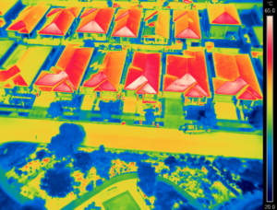
Rising temperatures
The way in which we have built our cities has also resulted in urban heat islands. In places like western Sydney, it is becoming more difficult for children to play outdoors, or to learn, because it is just too hot.
Dr. Sebastian Pfautsch says: “… looking at Bureau of Meteorology data we know that ambient heat during school days in summer is rising. This means if you have no air conditioning, you see more days of high classroom temperatures too. You learn less in these classrooms.”
Source: Australian Catholic Bishops Conference Social Justice Statement 2021-22 p. 5
Reflect: Can you think of a time when extreme heat impacted your ability to learn, play, rest? Have you noticed any changes in the climate during your lifetime?
The summer 2019/20 temperatures in Jordan Springs, near Penrith, an area suffering from the urban heat island effect. Image: Dr Sebastian Pfautsch. Source
Plastic packaging accounts for 50% of waste –I couldn’t find the source for this.

Slide 22
transport
There are over a billion cars in the world now! Source
Most cars run on fossil fuels and produce a large amount of emissions such as carbon dioxide, methane and nitrous oxide which all contribute to warming our planet.
Learn about electric cars and hydrogen vehicles here.
What are the advantages and disadvantages of using electric cars?
How do you get to school/sport training/shops?
How can you reduce your carbon emissions?
Read ‘Meet your bicycle: the transportation incarnation of Catholic Social Teaching’ (April 2021)
Photo by CHUTTERSNAP on Unsplash

Slide 23
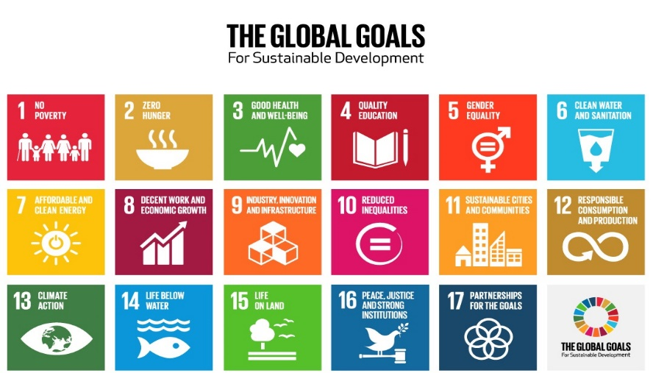
Sustainable development goals
In 2015, the Sustainable Development Goals (SDGs) were released by the United Nations.
17 goals to achieve 3 extraordinary things in the next 15 years:
End extreme poverty.
Fight inequality and injustice.
Fix climate change.
TASK
Learn more about the SDG's at:
UN SDGs
Caritas Australia – SDGs
Write a paragraph explaining how the topic "Care for our Common Home" fits into the objectives of each goal.
Include:
How the state of the environment affects the achievement of each goal.
How the goals are interconnected.

Slide 24
Caritas Australia’s RESPONSE
Caritas Australia and Catholic Earthcare believe that our common home is a common good for our one human family. We work in partnership with communities to mitigate the effects of climate change and implement sustainable agricultural methods.
Our approach draws upon several principles of Catholic Social Teaching including:
The Common Good
Care for our common home
Human dignity
Solidarity
Nguyet growing rice sustainably in Vietnam. Credit: Nguyen Minh Duc

Slide 25
Caritas australia's response
The communities Caritas Australia work with tell us how their farming seasons are more unpredictable, making it more difficult to grow crops for food and other purposes.
Cyclones and extreme weather events have become more intense and damaging.
Sea levels are rising, flooding homes, contaminating water wells and forcing communities to relocate. In many ways, climate change is hurting the people we support.
This is why we work in solidarity with these communities for action on climate change. We can move towards an “ecological conversion” in which we can listen to the “cry of the earth and the cry of the poor”.
Phany working in one of her gardens with newly planted vegetables at their home in Western Cambodia. By using the drip irrigation system and other techniques learnt through the program, she can now grow vegetables during the dry hot summer Credit: Richard Wainwright

Slide 26
Caritas Australia’s work in communities
Peter, Solomon Islands. Photo Credit Cassandra Hill
Tati, Indonesia. Photo Credit Richard Wainwright
Thandolwayo, Zimbabwe. Photo Credit:
As sea levels rise in low lying areas and countries, people may have to move away. Our neighbours in the Pacific Islands are already suffering the impacts of rising sea levels and natural disasters. The Solomon Islands are surrounded by water but are suffering from drought.
Read about Peter in the Solomon Islands.
Removing people from ancestral lands removes livelihoods, food, shelter and ways of life as well as “breaking down” culture and traditional knowledge. Learn about Tati’s community in Indonesia where they managed to protect their natural environment and maintain traditional knowledge and culture.
In Zimbabwe, Caritas Australia installed solar panels to power a water pump in Thandolwayo’s village.

Slide 27
CASE STUDY
ABORIGINAL CARBON FOUNDATION
The Aboriginal Carbon Foundation’s vision is to catalyse life-changing, community prosperity through carbon farming. It achieves this by supporting the ethical trade of carbon credits between communities, large corporations and government organisations across Australia that are seeking to be carbon neutral.
Caritas Australia joined forces with the Foundation to amplify their efforts in supporting communities to utilise their skills to generate income and revitalise cultural practices.
Ranger Sarah Barkley interviewing senior Elder John Clark. Photo Credit: Aboriginal Carbon Fund
Notes:
‘A partnership that pays-off’ article first published in Aurora Magazine, August 2021.
https://issuu.com/diomn/docs/aurora_august_2021_web

Slide 28
Through carbon farming, local communities carry out traditional fire and land management practices and earn an income by generating carbon credits.
One of the most common forms of carbon farming projects across northern Australia is the savanna burning method. This approach uses traditional burning practices, early in the dry season, to reduce the severity of bushfires and the large-scale emission of greenhouse gases generated by severe fires.
As a result of the ‘cool’ burning more wildlife returns, increased bush foods are available and sacred sites are protected.
Photo Credit: Richard Wainwright
Notes:
‘A partnership that pays-off’ article first published in Aurora Magazine, August 2021.
https://issuu.com/diomn/docs/aurora_august_2021_web

Slide 29
Chief Executive Officer of the Aboriginal Carbon Foundation, Rowan Foley explained the course enables Aboriginal people to own the whole process, from the beginning to end, and generate income for their specialised expertise and knowledge of the land.
"The communities we work with are very proud of the work they're doing in terms of looking after Country, but also knowing that it's a viable carbon economy," Mr Foley said.
Read the full article ‘A partnership that pays-off’ published in Aurora Magazine, August 2021.
Photo Credit: Richard Wainwright
Notes:
‘A partnership that pays-off’ article first published in Aurora Magazine, August 2021.
https://issuu.com/diomn/docs/aurora_august_2021_web

Slide 30
CASE STUDY
LAT AND EM, CAMBODIA
Lat and Em are rice and poultry farmers living in rural Cambodia. They also grow vegetables to feed themselves.
Cambodia is experiencing more floods and droughts due to a changing climate.
During times of drought their rice crop was damaged and many of their chickens and ducks contracted diseases and died due to a lack of water.
Lat and Em with their daily long bean harvest Credit: Sam Rinang

Slide 31
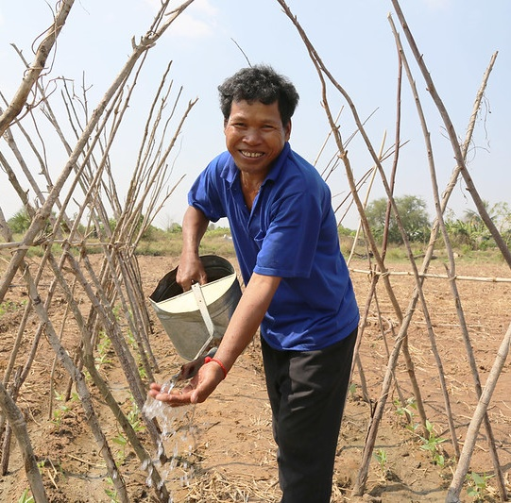
Lat and Em joined the Caritas Australia supported Upholding Community Dignity Together program which aims to help people adapt to climate change, by providing training in sustainable farming techniques and improving access to water. This increases resilience to droughts and floods.
Lat and Em co-invested with other villagers and their adult children to restore two ponds which has provided reliable water for their family and for farming.
In countries like Cambodia, more than 3.4 million people do not have access to safe water*.
More than 2 million Cambodians live below the poverty line, with approximately 90% of people living in rural areas*.
In 2020, the global extreme poverty rate rose for the first time in two decades.
Source: World Bank
Lat watering his beans Credit: Sam Rinang

Slide 32
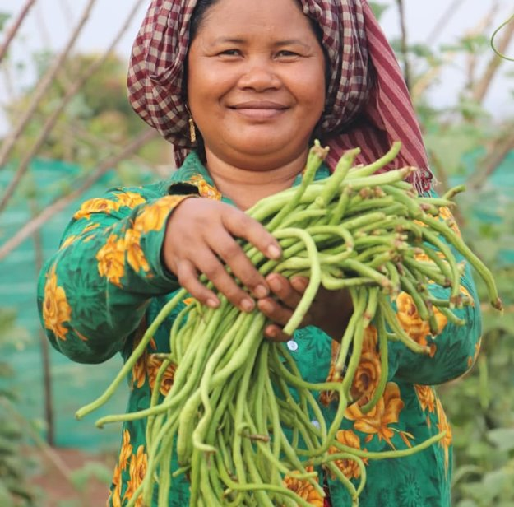
Now Lat and Em’s farm is thriving and their income has increased, their new skills have changed their lives.
Em is also now an active member of a community development committee, leading the way in mobilising resources that has enabled the community to build a classroom.
Over 2000 farmers in this program have increased their knowledge of sustainable agricultural practices, small business development and climate change adaptation, using their knowledge to improve their livelihood activities.
Em with their long bean harvest Credit Sam Rinang

Slide 33
Part 2: JUDGE
Photo by Paweł Fijałkowski from Pexels

Slide 34
Indigenous spirituality
Gay’wumirr Miyalk Mala (Source: Bawaka Collective Songspirals)
Connect to this statement using the Colour, Symbol, Image thinking tool.
• Choose a colour that you feel best represents or captures the essence of the ideas in this statement.
• Choose a symbol that you feel best represents or captures the essence of the ideas in this statement.
• Choose an image that you feel best represents or captures the essence of the ideas in this statement

Slide 35
Scripture analysis
Love for creation is a theme throughout both the Old and New Testaments. Jesus showed an appreciation of the natural environment and taught us to care for all of creation.
The Sabbath was a day of rest for work animals as well as humans.
TASK
Read Genesis 1: 26-30. God entrusted all of creation to our responsibility, where we were asked to be stewards. What do you think it means to be a steward?
Read Genesis 2:15. How do you interpret “till and keep”?
Read section 67 of Laudato Si’ – how does Pope Francis interpret “dominion” as well as “till and keep”?
Discuss Genesis 8: 1-14 and/or Genesis 9:8-17
Photo by Brett Jordan from Pexels
Notes:
Our faith provides wisdom sources that can help us to take our next steps now.

Slide 36
Scripture analysis
Creation is always an object of praise Psalm 104:24 “How many are your works, Lord! In wisdom you made them all; the earth is full of your creatures.”
There are also many examples in the New Testament where the Bible speaks consistently of the goodness and beauty of creation which is called to glorify God. We are reminded to be in awe and wonder of all creation.
TASK
Read, interpret and reflect on the meaning of these verses
Mt 6:25-34 Learning to trust in God as does nature
Rom 1:20 We see God in creation
Rev 21:1-5 Promise of the new creation
Photo by Evgeny Tchebotarev from Pexels

Slide 37
Laudato si"
In 2015, Pope Francis published his second encyclical titled Laudato Si’, translated as ‘Praise be to you!’.
Watch this video on Laudato Si’.
What is Pope Francis asking us to do?
What has happened to our common home?
Describe how the common good is illustrated?
Can you see any connections between the main messages of Laudato Si’ and Fratelli Tutti?
What do you think Pope Francis means by injustices?
Notes:
What do you think Pope Francis means by injustices?

Slide 38
LAUDATO SI’ & INTEGRAL ECOLOGY
Laudato Si’ highlights the Catholic Social Teaching principle of Care For Our Common Home and the concept of ‘Integral Ecology’. It emphasises that our concern for the environment cannot be separated from areas of Catholic Social Teachings.
Pope Francis unpacks this concept by explaining that caring for the environment is not separate from caring for the poor and marginalised. Through taking action to care for creation, we are simultaneously protecting and maintaining both the land and sea in which poor communities around the world depend on as a means of food security.
Aloma and community members from Baranguy Pag-Asa in the Philippines, clean seaweed from recently planted mangroves that were raised in the Mangrove Nursery. Photo Credit: Richard Wainwright/Caritas Australia

Slide 40
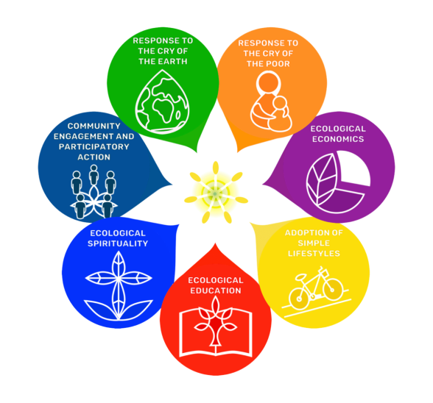
LAUDATO SI' action platform
The 7 goals for the Laudato Si' Action Plan
On the 24 May, 2020, the 5th anniversary of Laudato Si’, Pope Francis declared an Anniversary Year of Laudato Si’.
He outlined a 7 year plan for action, which encompasses seven sectors in the community: families, dioceses, schools, universities, hospitals/healthcare centres, business/agricultural farms and religious orders.
He outlined seven Laudato Si’ goals or ways of measuring ecology in the spirit of Laudato Si’, which are shown in the diagram opposite.
Laudato Si’ Goals
Learn more at laudatosiactionplatform.org

Slide 41
Fratelli tutti
Fratelli Tutti is Pope Francis’ third encyclical and was published on the day of the feast of St Francis in October 2020. It is an invitation to renewed social friendship and universal fraternity, a call to come together in solidarity.
Fratelli Tutti provides a starting point for renewing our commitment to caring for our neighbour and for a global society built on justice and the common good.
If we love our neighbour, should we be acting for climate justice?
Community members dance and sing about water next to the new water pipe. Caritas Hwange, installed a solar powered piped water system into their village bringing fresh clean drinking water to the population for the first time. Photo Credit: Richard Wainwright/Caritas Australia
Notes:
Sources:
https://www.vatican.va/content/francesco/it/encyclicals/documents/papa-francesco_20201003_enciclica-fratelli-tutti.html
https://www.vaticannews.va/en/pope/news/2020-10/fratelli-tutti-pope-fraternity-social-friendship-short-summary.html

Slide 42
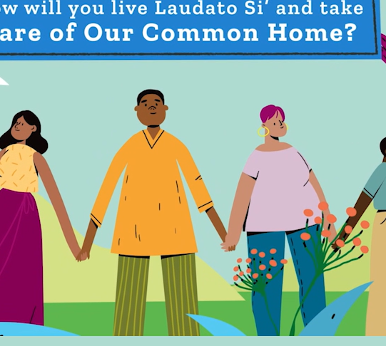
Catholic social teaching Activity
TASK
Care for our Common Home is a Catholic Social Teaching Principle.
Watch the Care for Our Common Home clip.
Write a short paragraph answering the following:
How does climate change and environmental degradation affect the conditions necessary to live a life with dignity?
How can we demonstrate our preferential option for people experiencing poverty?
Why is caring for creation working for the common good?
Solidarity is highlighted in Laudato Si’ and Fratelli Tutti - What is meant by intergenerational solidarity?
Are we listening to those most impacted by a change in climate and rising sea levels?
Familiarise yourself with the other Catholic Social Teaching Principles here.
Notes:
GO FURTHER:
Study the Catholic Social Teachings (CST) in the CST Toolkit. https://www.caritas.org.au/learn/cst-toolkit/
As you learn about each CST think about our common home.

Slide 43
Part three: act
Photo Credit: Caritas Australia

Slide 44
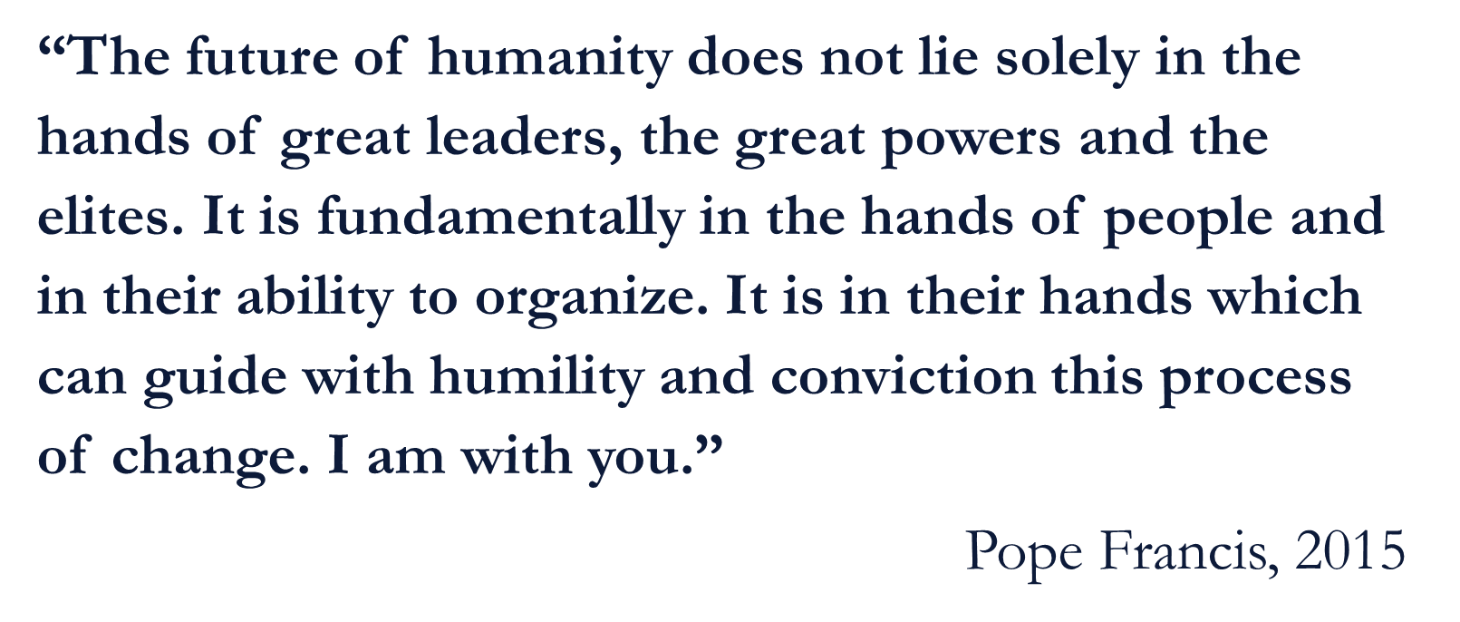
Source

Slide 45
Indigenous CONNECTION TO LAND
Our First Nations peoples in Australia have a complex totem system that connects them spiritually to country. When you are born, you are given one or more totems. These can be an animal, plant or part of the landscape, usually from your country or your parent’s country. You are responsible to care for this particular plant, animal and their habitat.
Reflect: What would our natural environment look like, if every Australian took on the responsibility of caring for at least one plant and one animal in their local area?
Choose one plant or animal in your local area to focus on and learn about it. Take action to protect it.
Research which plants and animals are indigenous to your school grounds or region.
Find or plant some indigenous plants in your school grounds to attract indigenous animals.
Grevillea plant. Photo Credit: Credit David Conser

Slide 46
act
Spirituality
Water
How could you change your daily actions to care for creation?
You can engage at some of these levels now, and possibly at others in their future.
Teachers, see the ‘Notes’ section for details of this activity.
Waste
Transport
Food
Biodiversity
Energy
Notes:
Explain to students that they can engage at some of these levels now, and possibly at others in their future.
Write the following headings on 7 pieces of Butchers paper: Spirituality, Water, Waste, Transport, Biodiversity, Food, Energy.
Hand out "post it notes" of 6 different colours to each student, to "write and poste" an action under each heading.
Each colour represents a sector such as yellow for the school sector, blue for the diocese sector and so on.
For example, under Waste a school could start a whole school, organic composting system; as a family you could choose to eat less meat under the Food heading.
Based on student responses; Have a positive class discussion about what each person/class/school etc. can influence within their locus of control. See next slide for diagram.

Slide 47
Locus of control
A healthy planet depends on all of us.
Use the template (on the right) to create your own action plan
Write in:
What actions are in your control?
Who can help you influence the actions of others?
What are your areas of concern?
Discuss what each person/class/school etc. can influence within their locus of control.
Circles of Influence
Who do I know?
What actions are within my control?
Areas of Concern
What am I worried about?

Slide 48
act
ACT Choose a number of suggested actions to implement and make them a reality.
You may want to use the social justice action planner template
 | Spirituality | Water | Waste | Transport | Biodiversity | Food | Energy
Individual
Class
School |  |  | Compost
Family |  |  |  |  |  | Less meat
Church
Diocese

Slide 49
Act - Play your part
We can all play our part!
Some ideas to get you started:
Become a Catholic Earthcare School
Organise a Ride/Scoot/Walk Day, write a prayer for creation, have a special liturgy in the garden or bush reserve.
Raise awareness by presenting on an issue at an assembly, create posters to display around the school or hold an information stall at a school event. Ask for permission to post some information on your school website or in social media.
Students taking action regarding our Future Fund. Photo Credit: Caritas Australia

Slide 50
Act - Play your part
Advocacy
Write to the Minister for Energy, asking to provide more incentives for the research and implementation of renewable energy sources.
Write to the Minister for Immigration and Citizenship, to call on the Australian Government to develop an integrated strategy to assist people displaced by climate change.
Support activities such as "Fridays for the Future" and School Climate Strikes.
When you reach 18, vote for politicians with strong environmental policies, lobby governments to do more about climate change and sign petitions such as those that call for an end to fossil fuel use.
Please note there are advocacy resource links on the ‘Further resources’ slide.
Project Compassion 2020. Catholic Regional College, Caroline Springs. Photo Credit: Caritas Australia

Slide 51
prayer
Creator God,
Praise be to you, who sustains and governs us.
We are in awe and wonder of your magnificent creation; our common home. Help us to accept the world as a sacrament of communion, and be in right relationship with you, each other and all of creation.
We are sorry for the way we have mistreated the earth and each other and the impact climate change is already having on communities in Australia and around the world.
You have gifted us with the power of sun, wind and water. We pray for a just transition away from fossil fuels to renewable energy to ensure a future can be shared by everyone.
Praise be to you! Amen
Photo by Pelipoer Lara from Pexels

Slide 52
FURTHER RESOURCES
For more Caritas Australia resources
Visit www.caritas.org.au/resources/school-resources/
Use the filter for Secondary with the key words: Laudato Si’, Climate Change, Water, Food etc. and you will find plenty of resources! For example:
Water in Zimbabwe
Prayer Service for the Season of Creation
About Advocacy
Advocacy toolkit
Catholic Social Teaching Principles toolkit
Other sources:
A #NatureNow message from Greta (Film clip, 3:39)
Information on Biodiversity from Australian Museum
Articles on Consumerism from Consumers Federation of Australia
Projections on the effects of climate change in Australia from the CSIRO
Health impacts of climate change on various countries from the World Health

Slide 53
Thank you

