Slide 1
Caring for Creation One family, one common home Parish

Slide 2
About This Resource
This resource has been created to provide information, reflections and action ideas to help parishes address the issue of caring for creation (our common home) through a Catholic worldview. It will explore the theological imperative we have to take care of creation and offer ideas on how the parish community can take action.
Use and adapt the information, reflections and action ideas in each section to share them in your parish groups and networks, or follow the suggested ‘See, Judge, Act’ sequence.
It is our hope that you will find all or some of this resource useful and use it in a way that best suits your purposes.
For more resources on a variety of topics, please visit www.caritas.org.au/resources/parish-materials.
To learn more about ecological justice, including information on how to become an Earthcare Parish, visit Catholic Earthcare Australia.
We would love to hear from you!
To send feedback, enquiries or comments, please email us as education@caritas.org.au.
Stay up to date with events and resources! Subscribe to Caritas Australia’s Education e-newsletter
(previous page) Tati walks through part of her community’s preserved forest to collect vegetables and traditional medicines. Photo: Richard Wainwright/Caritas Australia
This resource was last updated in September 2021.

Slide 3
Copyright
Use of website materials
Use of material on this site for educational purposes is encouraged. Caritas Australia gives permission for articles, illustrations and other materials to be reproduced for educational purposes or personal use, provided the information is not changed, and that the source is acknowledged appropriately. Use of material on this website for purposes other than educational or personal use must have prior authorisation from Caritas Australia’s Web Team: webteam@caritas.org.au.
Permissions
In some cases the copyright for text or images on this site may held by someone other than Caritas Australia. All rights are reserved on such material and permission to use them must be requested from the copyright owner. The source of this material is indicated on the relevant sections of the site.
Photos without a specified photo credit are the property of Caritas Australia or the international partners of the Caritas network.
Our logo
The Caritas Australia logo must not be downloaded, copied and or used for any purpose without the expressed permission of Caritas Australia. Please contact Caritas Australia's web team [mailto:webteam@caritas.org.au] for any further information that you may require about using content from this website.
Links to external sites
This site contains links to external web sites. Caritas Australia takes no responsibility for the content of such sites, nor do links to such sites imply endorsement of the views expressed therein. External links are provided for informational purposes only.

Slide 4
Contents
Click to navigate to section
The Learning Process – See, Judge, Act
Aboriginal Perspectives
Catholic Tradition of Caring for Creation
Part 1: See Acknowledging Country Climate Change Biodiversity Consumerism Fossil Fuels / Energy Transport Sustainable Development Goals Caritas Australia's Response Case Studies | Part 2: Judge Indigenous Spirituality Scripture Analysis Laudato Si’ Integral Ecology Fratelli Tutti Catholic Social Teaching | Part 3: Act Indigenous Connection to Land “Little Daily Actions” Locus of Control Play your Part Prayer Further Resources

Slide 5
THE LEARNING PROCESS – SEE, JUDGE, ACT
This resource has been created using the ‘See, Judge, Act’ model.
This is a reflection–action process and was first used by a Belgian Catholic priest, Joseph Cardijn (who later became a Cardinal) with young Christian workers prior to the first World War. This approach was also recommended in the 1961 encyclical letter written by Pope John XXIII called Mater et Magistra (Mother and Teacher).
This resource provides information, reflections and action ideas to help address environmental issues through a Catholic worldview. It will explore the theological imperative we have to take care of creation and offers ideas on how individuals and the parish community can take action.
Objectives
See | Individuals and parish groups will be able to explain what climate change is, its causes and the impact it is having on our environment and our global family. Extension: What are the economic, political, social, historic and cultural factors of climate change?
Judge | Individuals and parish groups will reflect on what they know about climate change and its effects on humanity in light of Catholic teaching. They will be able to cite evidence from certain encyclicals as well as the Holy Scriptures to support their actions in caring for our common home.
Act | Individuals and parish groups with an understanding of climate change and in light of a Catholic faith will determine what action they can take.

Slide 6
ABORIGINAL PERSPECTIVES
Aboriginal perspectives are fundamental to learning more about caring for our common home.
Below is information about ‘Eight Aboriginal Ways of Learning’ from 8 Ways. It is about “relational responsiveness, a protocol of attending to relational obligations to the field you're working in, relating and responding holistically to people, land, culture, language, spirit and the relationships between these with integrity and intellectual rigour.” Source
We have intended to integrate some of these ways of learning into this resource.
8 Ways
Story Sharing: Approaching learning through narrative.
Learning Maps: Explicitly mapping/visualising processes. Picturing pathways of knowledge.
Non-verbal: Applying intra-personal and kinaesthetic skills to thinking and learning. See, think, act, make and share without words.
Symbols and Images: Using images and metaphors to understand concepts and content.
Land Links: Place-based learning, linking content to local land and place.
Non-linear: Producing innovations and understanding by thinking laterally or combining systems.
Deconstruct/Reconstruct: Modelling and scaffolding, working from wholes to parts (watch then do).
Community Links: Centering local viewpoints, applying learning for community benefit.
8 Aboriginal Ways of Learning
Image: 8 ways

Slide 7
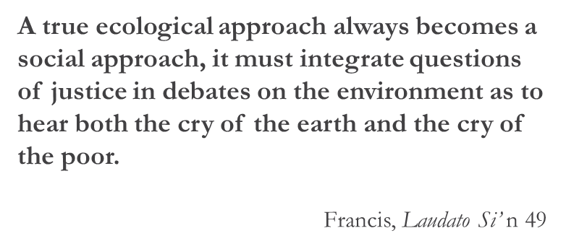
CATHOLIC TRADITION OF CARING FOR CREATION
There has always been a strong Catholic tradition of caring for our common home. In the 13th century, St Francis of Assisi’s Canticle of Creation and many popes since have discussed the natural environment in their encyclicals.
In a General Audience in Rome in 2001, Pope John Paul II called for the world’s people to undergo a ‘conversion’ to protect the environment and make the earth a place where all life is valued and can grow in harmony. Pope Benedict XVI spoke of an economy that didn’t respect the environment.
Pope Francis released Laudato Si’, meaning "Praise be to you”, in June 2015. It is clear from Pope Francis' encyclical – Laudato Si’: On Care for Our Common Home – that, as Catholics, we are called to take action for climate justice.
It is the Church’s most profound clarion call yet: for us all to be protectors of creation and the poor. The Holy Father has called for a new global solidarity, where all individuals, communities and governments play an essential part in taking care of our earth and global family.
In our region, the Federation of Oceania Catholic Bishops (including the Australian Catholic Bishops Conference) have spoken robustly about climate change and the need to be more active in reducing emissions.
Within the global Caritas confederation, cardinals, bishops and lay Caritas leaders at the 2018 Caritas Oceania forum also reinforced this theme, and have made caring for creation one of their top priorities. Caritas Internationalis has made climate change an overarching theme in its strategic plan.
As a program of Caritas, Catholic Earthcare Australia is an ecological advisory agency to the Church and has been mandated through the activities of education, research and advocacy to give leadership in responding to Laudato Si’ to “stimulate and sustain the ecological conversion and implement integral ecology in Catholic institutions in Australia.”
The Australian Catholic Bishops Social Justice Statement for 2021-22, ‘Cry of the earth cry of the poor’, further supports our call to care for all creation and invites us to take action.
To support this statement and the seven year Laudato Si’ Action Platform, Catholic Earthcare Australia has developed a certification process for Catholic Earthcare schools, parishes and families.

Slide 8
PArt 1: SEE
Photo: Richard Wainwright/Caritas Australia

Slide 9
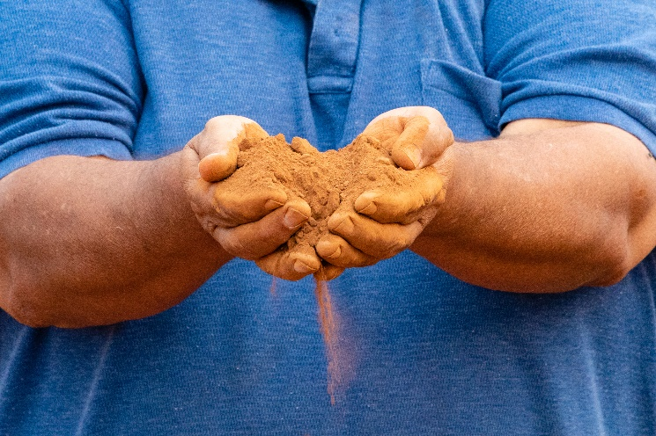
MY PLACE
Pause for a moment and consider your surroundings. What kind of environment do you live, learn and grow in? Is it alpine, coastal, desert, savannah or riverine plains country?
‘Country’ is the term often used by Aboriginal people to describe the lands, waterways and seas to which they are connected. Source
Acknowledge Country before you start your formal meeting or group event today. You can use the following template:
I begin today by acknowledging the Traditional Custodians of Country throughout Australia and their connections to land, sea and community. We pay our respect to their Elders past, present and emerging and extend that respect to all Aboriginal and Torres Strait Islander peoples today.
Tom holds red dust near his home town of Narromine, Australia. Tom is the founder of Red Dust Healing, a specific cultural healing program written from an Indigenous perspective. Photo: Richard Wainwright
Do you know whose Country you are on? If not, use the Map of Indigenous Australia to find out.
For a moment, reflect on how people in the past lived, learned and grew in your local area.
What is your special connection to your local environment? If you can, share a story of how you are connected to your local environment.

Slide 10
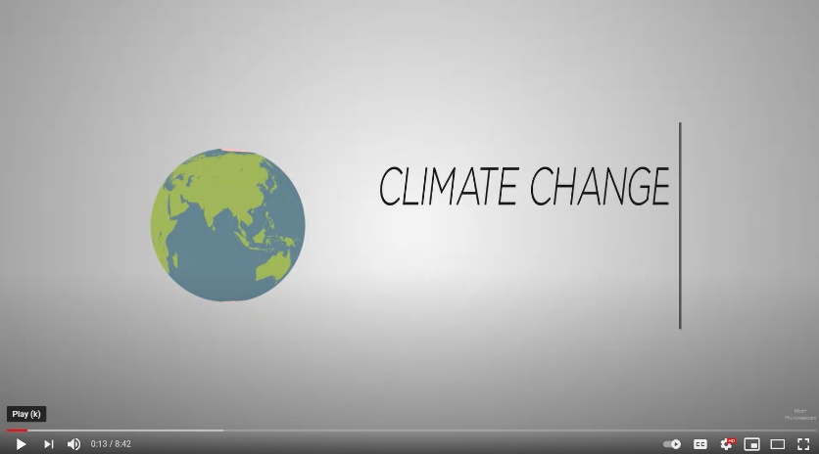
Cry of the earth – Climate change
DISCUSS
What is climate change?
What is causing climate change?
What are some of the predicted impacts if we don’t act now?
Who is the most affected by, or vulnerable to, climate change?
Are we listening to the people most directly affected?
Who are the decision-makers?
What are Australia’s targets for greenhouse gas emissions?
How do we compare to other developed countries?
How do you contribute to climate change?
What will help solve the problem of climate change? Consider government, industry, community and personal possibilities.
WATCH the video and complete your own research to answer the following questions, individually or as a group.

Slide 11
Cry of the earth – biodiversity
Scientists and many governments agree that we are facing an environmental crisis; we are losing species at a rate 1,000 times greater than at any other time in recorded human history.
We depend on healthy ecosystems and biodiversity for survival. Global health crises like the COVID-19 pandemic will happen more often if we fail to protect natural ecosystem buffers globally. Source
It is urgent that we limit global warming to prevent further loss of species.
REFLECT
View the National Geographic photo gallery showing the diversity of living things.
Which image did you find most interesting?
Read the information under the image.
What impacts are humans having?
Pray – Visio Divina
Praying With Your Eyes: How to Get Started With Visio Divina
Choose one of the photos from the National Geographic gallery, one of your own images of nature or sit in a quiet space outside to pray using Visio Divina.

Slide 12
CRY OF THE EARTH – disease
Excerpt from the Australian Catholic Bishops Conference Social Justice Statement 2021-22, CRY OF THE EARTH CRY OF THE POOR
Our “interference with the intricate balance of natural ecosystems” is contributing to the outbreak and spread of zoonotic diseases which are caused by pathogens jumping from animals to humans.
Nearly 70% of zoonotic infections are linked to human environmental changes. Both COVID-19 and the Hendra virus are zoonotic.
Fr Joshtrom Kureethadam, of the Vatican Dicastery for the Promotion of Integral Human Development says, “the COVID-19 crisis is part and parcel of recent warnings from the natural world.” Source
REFLECT
Reflect on what the global experience of pandemic indicates about: how connected we are; the difference relative wealth or poverty makes to people’s experiences of it; the kinds of human behaviours that might help restore “the intricate balance of natural ecosystems”. Discuss with your small group.
Photo: CDC on Unsplash

Slide 13
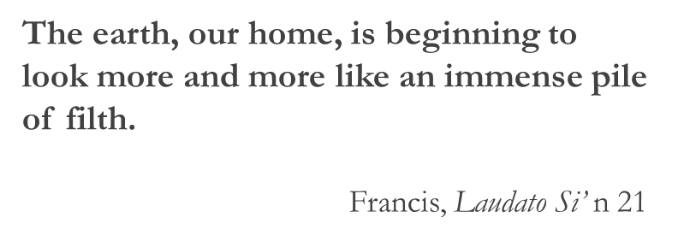
Cry of the earth – consumerism
We live in a disposable culture where consumer goods are produced in their millions, usually powered by fossil fuels and with a short life span, but at what cost to our environment?
Let’s briefly look at a few examples to understand the impacts of consumerism.
Photo: Dustan Woodhouse on Unsplash

Slide 14
Cry of the earth – consumerism
Plastic Humans use lots of plastic. Did you know plastic never breaks down? It can only be physically broken into smaller pieces or recycled.
REFLECT
Read The Problem - Our Throwaway Lifestyle.
List the impacts.
Food The 2021 Food Waste Index report showed that 17% of available food in the world is wasted.
REFLECT
Read How food waste is trashing the planet.
List 3 facts you learned. Learn more about Food Security here.
E-Waste Millions of electronic devices like televisions, computers and mobile phones are discarded in Australia every year.
REFLECT
Read E-Waste.
List 4 facts you learned.

Slide 15
FOSSIL FUEL / ENERGY
LEARN
Find out what renewable and non-renewable energy means.
Fossil fuels are non-renewable and when burnt, they produce greenhouse gases which trap heat in our atmosphere and cause climate change. Extracting coal, oil and gas from our natural environment can have impacts on land use, traditional owners, water bodies, air quality and the landscape.
We will eventually run out of fossil fuels, so countries need to use alternative energy sources more widely. Australia relies on coal and gas for 79% of its electricity. Source
Photo: Chris LeBoutillier on Unsplash

Slide 16
Fossil Fuel / Energy
Each Australian state uses various energy sources. The Australian Energy Market Operator website shows which types of energy each state uses in real time! How cool is that?!
Which states are having the least impact on climate change?
Which states are having the most impact on climate change?​
Recently, Australia has been using more renewable types of energy such as solar, hydro and wind. They accounted for 24% of the energy used in the last quarter of 2020. This meant we had the lowest emissions from electricity on record.​ Source
DISCUSS
Consider energy use in Australia and what we should do to care for creation.
Good News!
Australian homes and businesses are installing and using more solar energy. ​Source ​
REFLECT
Why is this good news?

Slide 17
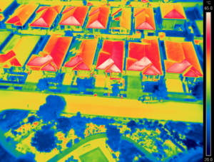
Rising temperatures
The way in which we have built our cities has also resulted in urban heat islands. In places like western Sydney, it is becoming more difficult for children to play outdoors, or to learn, because it is just too hot.
Dr. Sebastian Pfautsch says: “… looking at Bureau of Meteorology data we know that ambient heat during school days in summer is rising. This means if you have no air conditioning, you see more days of high classroom temperatures too. You learn less in these classrooms.”
Source: Australian Catholic Bishops Conference Social Justice Statement 2021-22 p. 5
REFLECT
Can you think of a time when extreme heat impacted your ability to learn, work, play, rest? Have you noticed any changes in the climate during your lifetime?
The summer 2019/20 temperatures in Jordan Springs, near Penrith, an area suffering from the urban heat island effect. Image: Dr Sebastian Pfautsch Source

Slide 18
transport
There are over a billion cars in the world now! Source
Most cars run on fossil fuels and produce a large amount of emissions such as carbon dioxide, methane and nitrous oxide which all contribute to warming our planet.
LEARN
Learn about electric cars and hydrogen vehicles here.
What are the advantages and disadvantages of using electric cars?
How do you get to work/Church/shops?
How can you reduce your carbon emissions?
Read ‘Meet your bicycle: the transportation incarnation of Catholic Social Teaching’ (April 2021)
Photo: CHUTTERSNAP on Unsplash

Slide 19
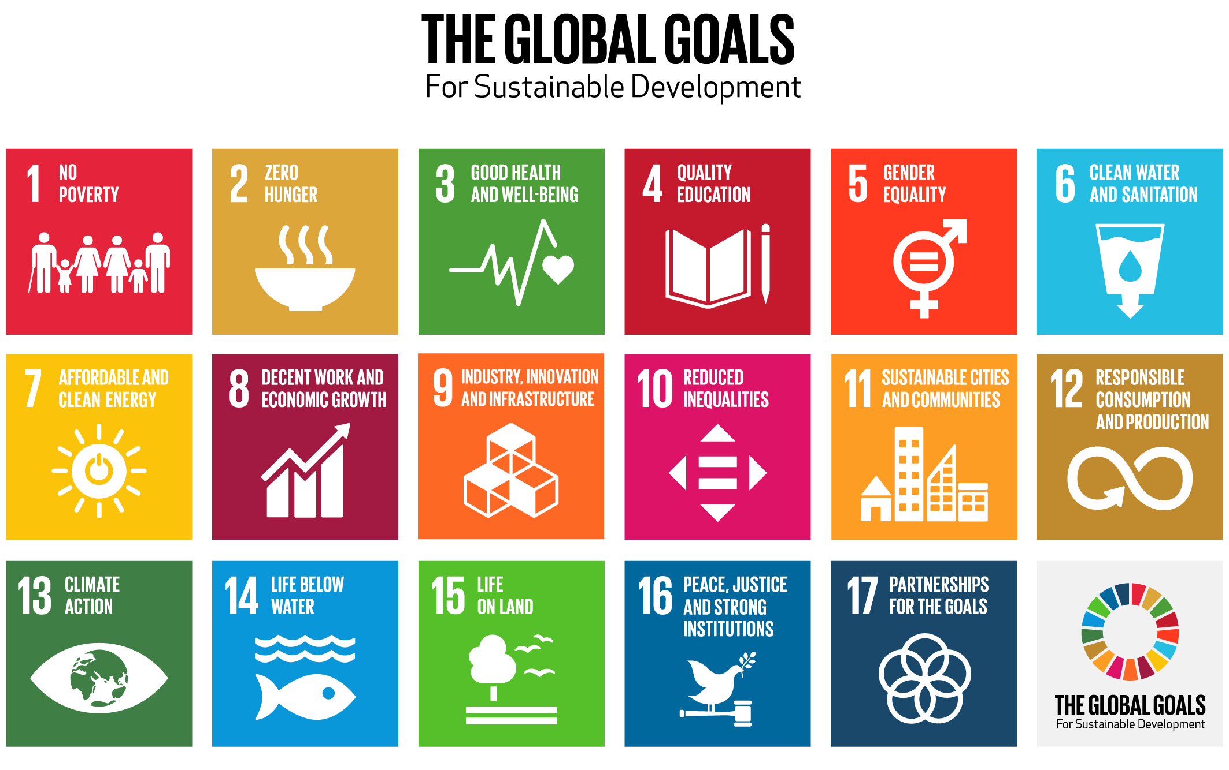
SUSTAINABLE DEVELOPMENT GOALS
LEARN
Learn more about the SDGs at:
UN SDGs
Caritas Australia - SDGs
DISCUSS
Consider how the topic "Care for our Common Home" fits into the objectives of each goal.
REFLECT
In particular, think about:
How the state of the environment affects the achievement of each goal.
How the goals are interconnected.
Source
In 2015, the Sustainable Development Goals (SDGs) were released by the United Nations.
17 goals to achieve 3 extraordinary things in the next 15 years:
End extreme poverty.
Fight inequality and injustice.
Fix climate change.
Plastic packaging accounts for 50% of waste –I couldn’t find the source for this.

Slide 20
Caritas Australia’s RESPONSE
Caritas Australia and Catholic Earthcare believe that our common home is a common good for our one human family. We work in partnership with communities to mitigate the effects of climate change and implement sustainable agricultural methods.
Our approach draws upon several principles of Catholic Social Teaching including:
Human Dignity
The Common Good
Solidarity
Care for Our Common Home
Promotion of Peace
Subsidiarity / Participation
Preferential Option for the Poor
Economic Justice
Nguyet growing rice sustainably in Vietnam. Photo: Nguyen Minh Duc

Slide 21
Caritas australia's response
The communities Caritas Australia work with tell us how their farming seasons are more unpredictable, making it more difficult to grow crops for food and other purposes.
Cyclones and extreme weather events have become more intense and damaging.
Sea levels are rising, flooding homes, contaminating water wells and forcing communities to relocate. In many ways, climate change is hurting the people we support.
This is why we work in solidarity with these communities for action on climate change. We can move towards an “ecological conversion” in which we can listen to the “cry of the earth and the cry of the poor”.
Phany working in one of her gardens with newly planted vegetables at their home in Western Cambodia. By using the drip irrigation system and other techniques learnt through the program, she can now grow vegetables during the dry hot summer. Photo: Richard Wainwright/Caritas Australia

Slide 22
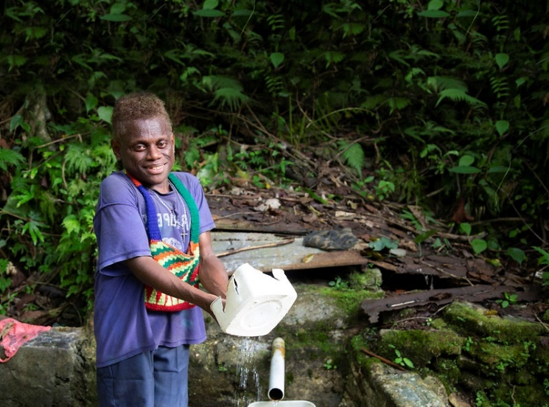
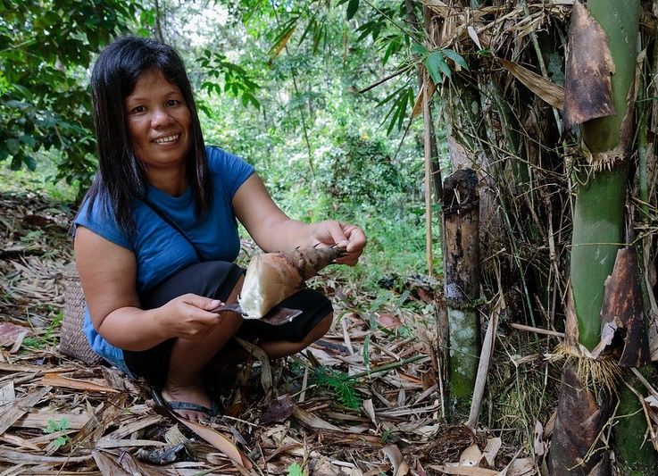
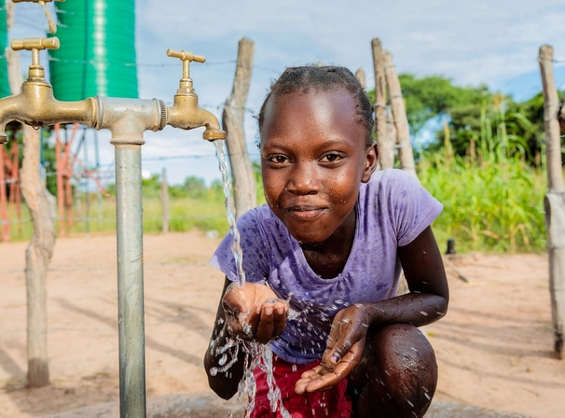
Caritas australia’s WORK IN COMMUNITIES
As sea levels rise in low lying areas and countries, people may have to move away. When people are made to move away from their ancestral lands, they are also taken away from their livelihoods, food, shelter and ways of life. This also leads to the ‘breaking down’ of culture and traditional knowledge. Our neighbours in the Pacific Islands are already suffering the impacts of rising sea levels and natural disasters. The Solomon Islands are surrounded by water but are suffering from drought.
Peter, Solomon Islands. Photo: Cassandra Hill
Tati, Indonesia. Photo: Richard Wainwright
Thandolwayo, Zimbabwe. Photo: Richard Wainwright
Watch Peter’s story and how, with the support of Caritas Australia, Peter’s school in the Solomon Islands created a new, reliable water system.
Watch Tati’s story and how Caritas Australia is supporting her community in Indonesia as they work to preserve their traditional forest and generate income through tourism.
Watch Thandolwayo’s story and how Caritas Australia installed solar panels to power a water pump in her village in Zimbabwe.

Slide 23
CASE STUDY
ABORIGINAL CARBON FOUNDATION
The Aboriginal Carbon Foundation’s vision is to catalyse life-changing community prosperity through carbon farming. It achieves this by supporting the ethical trade of carbon credits between communities, large corporations and government organisations across Australia that are seeking to be carbon neutral.
Caritas Australia joined forces with the Foundation to amplify their efforts in supporting communities to utilise their skills to generate income and revitalise cultural practices.
Ranger Sarah Barkley interviewing senior Elder John Clark. Photo: Aboriginal Carbon Fund

Slide 24
Through carbon farming, local communities carry out traditional fire and land management practices and earn an income by generating carbon credits.
One of the most common forms of carbon farming projects across northern Australia is the savanna burning method. This approach uses traditional burning practices, early in the dry season, to reduce the severity of bushfires and the large-scale emission of greenhouse gases generated by severe fires.
As a result of the ‘cool’ burning, more wildlife returns, increased bush foods are available and sacred sites are protected.
Photo: Richard Wainwright/Caritas Australia

Slide 25
Chief Executive Officer of the Aboriginal Carbon Foundation, Rowan Foley explained that the course enables Aboriginal people to own the whole process, from the beginning to end, and generate income for their specialised expertise and knowledge of the land.
"The communities we work with are very proud of the work they're doing in terms of looking after Country, but also knowing that it's a viable carbon economy," Mr Foley said.
Read the full article ‘A partnership that pays-off’ by Jessica Stone in Aurora Magazine, August 2021.
Photo: Richard Wainwright/Caritas Australia

Slide 26
CASE STUDY
LAT AND EM, CAMBODIA
Lat and Em are rice and poultry farmers living in rural Cambodia. They also grow vegetables to feed themselves.
Cambodia is experiencing more floods and droughts due to a changing climate.
During times of drought, their rice crop has been damaged and many of their chickens and ducks have contracted diseases and died due to a lack of water.
Lat and Em with their daily long bean harvest. Photo: Sam Rinang

Slide 27
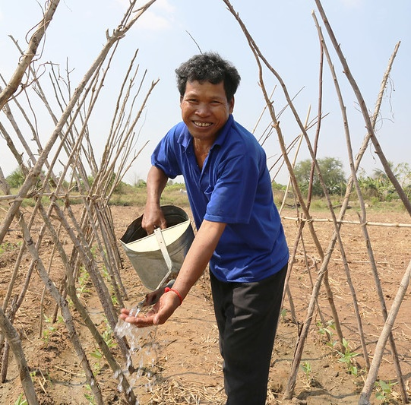
Lat and Em joined the Caritas Australia supported Upholding Community Dignity Together program, which aims to help people adapt to climate change by providing training in sustainable farming techniques and improving access to water. This increases resilience to droughts and floods.
Lat and Em co-invested with other villagers and their adult children to restore two ponds, which has provided reliable water for their family and for farming.
In countries like Cambodia, more than 3.4 million people do not have access to safe water*.
More than 2 million Cambodians live below the poverty line, with approximately 90% of people living in rural areas*.
In 2020, the global extreme poverty rate rose for the first time in two decades.
*Source: World Bank
Lat watering his beans. Photo: Sam Rinang

Slide 28
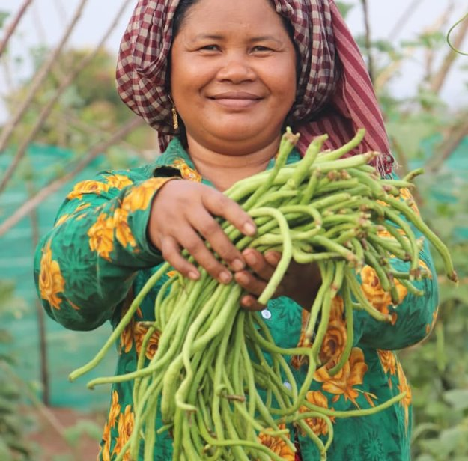
Now Lat and Em’s farm is thriving and their income has increased, their new skills have changed their lives.
Em is also now an active member of a community development committee, leading the way in mobilising resources that has enabled the community to build a classroom.
Over 2000 farmers in this program have increased their knowledge of sustainable agricultural practices, small business development and climate change adaptation, using their knowledge to improve their livelihood activities.
*Along with your generous support, this program is supported by the Australian Government through the Australian NGO Cooperation Program (ANCP).
Em with their long bean harvest. Photo: Sam Rinang

Slide 29
Part 2: JUDGE
Photo: Paweł Fijałkowski from Pexels

Slide 30
Indigenous spirituality
REFLECT
Connect to this statement using the Colour, Symbol, Image thinking tool.
Choose a colour that you feel best represents or captures the essence of the ideas in this statement.
Choose a symbol that you feel best represents or captures the essence of the ideas in this statement.
Choose an image that you feel best represents or captures the essence of the ideas in this statement.
Notes:
Quote Source https://bawakacollective.com/audio-visual-songspirals/

Slide 31
Scripture analysis
Love for creation is a theme throughout both the Old and New Testaments. Jesus showed an appreciation of the natural environment and taught us to care for all of creation.
The Sabbath was a day of rest for work animals as well as humans.
DISCUSS
Read Genesis 1:26-30. God entrusted all of creation to our responsibility, where we were asked to be stewards. What do you think it means to be a steward?
Read Genesis 2:15. How do you interpret “till and keep”?
Read section 67 of Laudato Si’ . How does Pope Francis interpret “dominion” as well as “till and keep”?
Discuss Genesis 8:1-14 and/or Genesis 9:8-17.
Photo: Brett Jordan from Pexels

Slide 32
Scripture analysis
Creation is always an object of praise: “How many are your works, Lord! In wisdom you made them all; the earth is full of your creatures.” (Psalm 104:24)
There are also many examples in the New Testament where the Bible speaks consistently of the goodness and beauty of creation, itself called to glorify God. We are reminded to be in awe and wonder of all creation.
DISCUSS
Read, interpret and discuss the meaning of these verses:
Matthew 6:25-34 Learning to trust in God as nature does
Romans 1:20 We see God in creation
Revelation 21:1-5 Promise of the new creation
Photo: Evgeny Tchebotarev from Pexels

Slide 33
Laudato si’
In 2015, Pope Francis published his second encyclical titled Laudato Si’, translated as ‘Praise be to you!’.
WATCH this video on Laudato Si’.
REFLECT
What is Pope Francis asking us to do?
What has happened to our common home?
Describe how the common good is illustrated?
Can you see any connections between the main messages of Laudato Si’ and Fratelli Tutti?
What do you think Pope Francis means by injustices?

Slide 34
LAUDATO SI’ & INTEGRAL ECOLOGY
Laudato Si’ highlights the Catholic Social Teaching principle of Care For Our Common Home and the concept of ‘Integral Ecology’. It emphasises that our concern for the environment cannot be separated from areas of Catholic Social Teachings.
Pope Francis unpacks this concept by explaining that caring for the environment is not separate from caring for the poor and marginalised. Through taking action to care for creation, we are simultaneously protecting and maintaining both the land and sea in which poor communities around the world depend on as a means of food security.
Aloma and community members from Baranguy Pag-Asa in the Philippines, clean seaweed from recently planted mangroves that were raised in the Mangrove Nursery. Photo: Richard Wainwright/Caritas Australia

Slide 36
LAUDATO SI' action platform
RESPONSE TO THE CRY OF THE EARTH
RESPONSE TO THE CRY OF THE POOR
ECOLOGICAL ECONOMICS
THE
LAUDATO SI’
GOALS
THE 7 GOALS OF THE LAUDATO SI’ ACTION PLAN
On the 24 May, 2020, the 5th anniversary of Laudato Si’, Pope Francis declared an Anniversary Year of Laudato Si’.
He outlined a 7 year plan for action, which encompasses seven sectors in the community: families, dioceses, schools, universities, hospitals/healthcare centres, business/agricultural farms and religious orders.
He outlined seven Laudato Si’ goals or ways of measuring ecology in the spirit of Laudato Si’, which are shown in the diagram opposite.
ADOPTION OF SUSTAINABLE LIFESTYLES
ECOLOGICAL EDUCATION
ECOLOGICAL SPIRITUALITY
COMMUNITY ENGAGEMENT AND PARTICIPATORY ACTION
Learn more at laudatosiactionplatform.org

Slide 37
Fratelli tutti
Fratelli Tutti is Pope Francis’ third encyclical and was published on the day of the feast of St Francis in October 2020. It is an invitation to renewed social friendship and universal fraternity, a call to come together in solidarity.
Fratelli Tutti provides a starting point for renewing our commitment to caring for our neighbour and for a global society built on justice and the common good.
If we love our neighbour, should we be acting for climate justice?
Community members dance and sing about water next to the new water pipe. Caritas Hwange, installed a solar powered piped water system into their village bringing fresh clean drinking water to the population for the first time. Photo: Richard Wainwright/Caritas Australia

Slide 38
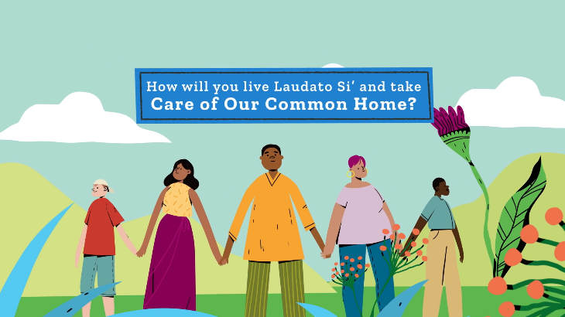
Catholic social teaching
REFLECT
Consider the following questions:
How does climate change and environmental degradation affect the conditions necessary to live a life with dignity?
How can we demonstrate our preferential option for people experiencing poverty?
Why is caring for creation working for the common good?
Solidarity is highlighted in Laudato Si’ and Fratelli Tutti. What is meant by intergenerational solidarity?
Are we listening to those most impacted by a change in climate and rising sea levels?
Familiarise yourself with the other Catholic Social Teaching Principles here.
Care for our Common Home is a Catholic Social Teaching Principle.
WATCH the Care for Our Common Home clip.

Slide 39
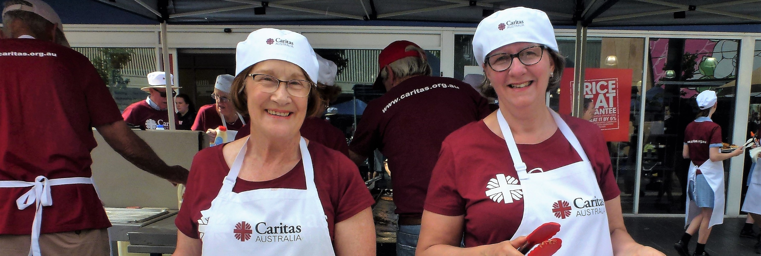
Part 3: ACT
Photo: Caritas Australia

Slide 41
Indigenous CONNECTION TO LAND
Our First Nations peoples in Australia have a complex totem system that connects them spiritually to Country. When you are born, you are given one or more totems. These can be an animal, plant or part of the landscape, usually from your Country or your parent’s Country. You are responsible to care for this particular plant, animal and their habitat.
LEARN
Find out plants and animals are indigenous to your Church grounds or region.
Choose one plant or animal in your local area to focus on and learn about it. Take action to protect it.
Find or plant some indigenous plants in your Church grounds to attract indigenous animals.
REFLECT
What would our natural environment look like if every Australian took on the responsibility of caring for at least one plant and one animal in their local area?
Grevillea plant. Photo: David Conser

Slide 42
“LITTLE DAILY ACTIONS”
REFLECT
Pope Francis says, “there is a nobility in the duty to care for creation through little daily actions” (Laudato Si’ n 211). How could you change your daily actions to care for creation?
Consider the 7 headings listed here and think about how you might care for creation in each of these areas, now or in the future.
Make this a small group activity by writing the headings on Butchers paper, with each heading on a separate piece.
Hand out Post-it Notes in 6 different colours to each person. Make each colour represent a sector, for example, yellow for church, blue for diocese, green for family or household, etc.
Invite people to ‘write and post’ an action under each heading. For example, under ‘Waste’, a parish could start an organic composting system for managing its own garden and kitchen scraps; under the ‘Food’, a family could choose to eat less meat.
Based on responses, discuss what each person/family/household/church/diocese etc. can influence within their ‘locus of control’ (see next slide).
Spirituality
Water
Waste
Transport
Food
Biodiversity
Energy

Slide 43
Locus of control
Circles of Influence
Who do I know?
What actions are within my control?
REFLECT
A healthy planet depends on all of us. Use the template (on the left) to create your own action plan.
Write in:
What actions are in your control?
Who can help you influence the actions of others?
What are your areas of concern?
Discuss what each person/group/church etc. can influence within their locus of control.
Areas of Concern
What am I worried about?

Slide 44
“LITTLE DAILY ACTIONS”
Choose a number of suggested actions to implement and make them a reality.
You may want to use the social justice action planner template
 | Spirituality | Water | Waste | Transport | Biodiversity | Food | Energy
Individual
Class
School
Family |  |  |  |  |  | Less meat
Church |  |  | Compost
Diocese

Slide 45
PLAY YOUR PART
ACT
Whatever age, we can all play our part! Here are some ideas to get you started:
Become a Catholic Earthcare Parish
Organise a Ride/Scoot/Walk Day, write a prayer for creation, have a special liturgy in the garden or bush reserve.
Raise awareness by presenting on an issue during a parish service or small group gathering, create posters to display around the church or hold an information stall at a parish event. Ask for permission to post some information on your church website or in social media.

Slide 46
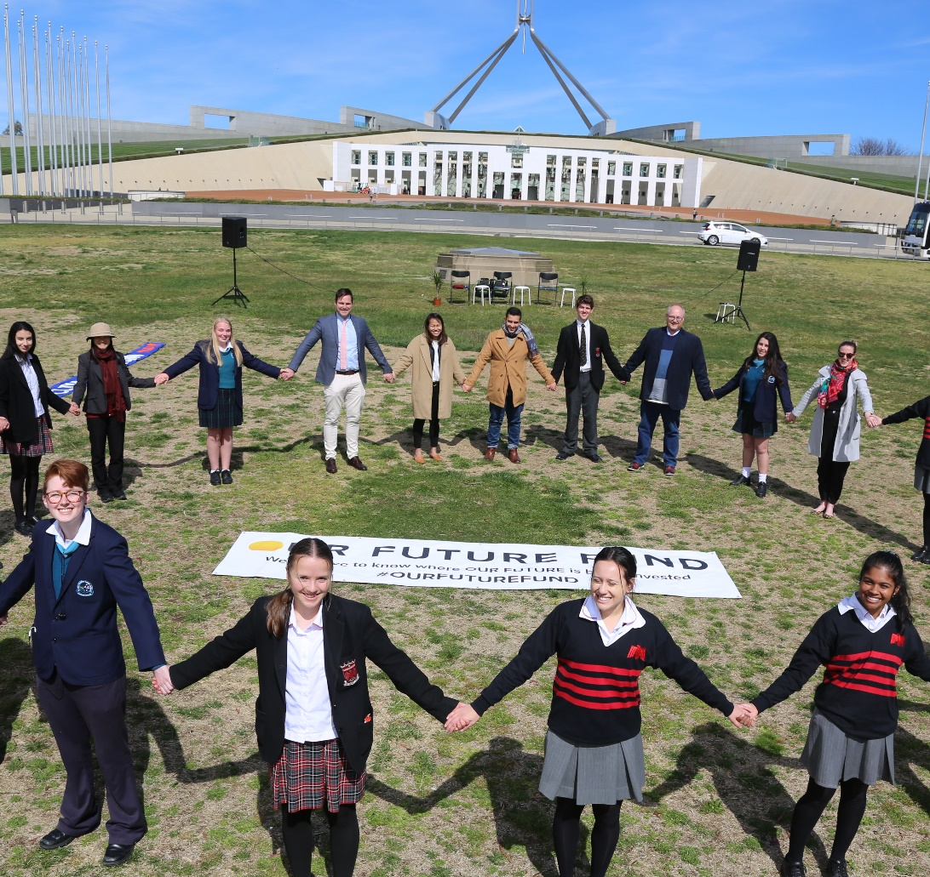
Play your part
ADVOCATE
Write to the Minister for Energy and Emissions Reduction, asking to provide more incentives for the research and implementation of renewable energy sources.
Write to the Minister for Immigration, Citizenship, Migrant Services and Multicultural Affairs, to call on the Australian Government to develop an integrated strategy to assist people displaced by climate change.
Support activities such as Fridays for the Future, local School Climate Strikes and the global Laudato Si’ Movement.
Vote for politicians with strong environmental policies, lobby governments to do more about climate change and sign petitions such as those that call for an end to fossil fuel use.
Find further advocacy-related links on the slide titled FURTHER RESOURCES.
Students taking action regarding out Future Fund. Photo: Caritas Australia

Slide 47
prayer
Creator God,
Praise be to you, who sustains and governs us.
We are in awe and wonder of your magnificent creation; our common home. Help us to accept the world as a sacrament of communion, and be in right relationship with you, each other and all of creation.
We are sorry for the way we have mistreated the earth and each other and the impact climate change is already having on communities in Australia and around the world.
You have gifted us with the power of sun, wind and water. We pray for a just transition away from fossil fuels to renewable energy to ensure a future can be shared by everyone.
Praise be to you! Amen
Photo: Pelipoer Lara from Pexels

Slide 48
FURTHER RESOURCES
For more Caritas Australia resources visit www.caritas.org.au/resources/parish-materials/
Use the filter with the key words: Laudato Si’, Climate Change, Water, Food etc. and you will find plenty of resources! For example:
Water in Zimbabwe
Prayer Service for the Season of Creation
About Advocacy
Advocacy toolkit
Catholic Social Teaching Principles toolkit
7 Questions to Guide Reflection on Integral Ecology
For further commentary on Laudato Si’, read Dr Sandie Cornish’s paper ‘Who are we before God and in Creation?’.
Other sources:
A #NatureNow message from Greta (film clip, 3:39)
Information on Biodiversity from Australian Museum
Articles on Consumerism from Consumers Federation of Australia
Projections on the effects of climate change in Australia from the CSIRO
Health impacts of climate change on various countries from the World Health

Slide 49
Thank you

