Slide 1
SECONDARY
CATECHIST RESOURCE

Slide 2
CONTENTS
Resources Guide​ | 3
Introduction​ | 4
About the Theme​ | 5
Curriculum: Religious Education and Beyond​ | 6
Catholic Social Teaching (CST) Guide​ | 7
Project Compassion Introduction Film | 8
Project Compassion Prayer | 9
Lent Link | 10
CST Film Study Guide​ | 11
Stories and Learning Tasks
Ronita’s Story (Philippines) and Learning Tasks​ | 12
Leaia’s Story (Samoa) and Learning Tasks​ | 16
Memory’s Story (Malawi) and Learning Tasks​ | 20
IMPORTANT – STUDENT WELLBEING
At Caritas Australia, we believe that all people should be treated with respect and dignity. Everyone has the right to feel safe, especially children and vulnerable adults. Please consider your audience when selecting which stories and activities to share with your class.
Our new Safeguarding animation recognises that learning about challenges to the health, wellbeing and safety of others and our earth can be hard. It encourages young people to talk to their teacher or trusted adult if they’re feeling worried or upset about anything they have learnt through our resources or activities. The animation also acknowledges Caritas Australia’s commitment for children and vulnerable adults to feel valued and heard by encouraging them to share their great ideas with us.
Watch Caritas Australia’s Safeguarding Animation
Please note: This resource contains links to external web sites. Caritas Australia takes no responsibility for the content of such sites, nor do links to such sites imply endorsement of the views expressed therein. External links are provided for informational purposes only. Access the full policy here: Caritas Australia’s Copyright Policy

Slide 3
RESOURCES GUIDE
All our resources are online! Access the films and written stories, teaching materials and our fundraising and awareness raising ideas at caritas.org.au/project-compassion. Below is a list and short description of all the resources you can download, as well as suggestions for use.
 | Resource | Description/Suggested Use
For Students | Student Workbook | A fillable PDF students can complete and submit back to their teacher. Use weekly to ‘see, judge and act’. Dedicate 20–30 mins of weekly Religious Education classes. Go beyond RE and share tasks or sections of the research with teachers from other subject areas.
 | Secondary Deep Dive | An interactive Thinglink image designed as a central location for students to access information about each of the stories, as well as to help them complete activities throughout the workbook.
 | AD Stories | Audio described versions of each story.
For Teachers | School’s Guide | A guide for the REC, APRE or Social Justice Leader. Includes tips to plan Project Compassion for the whole school.
 | Teacher Handbook | Briefly explores the curriculum and learning opportunities for Project Compassion 2024. Send to subject learning area teachers. Use as PD reading if seeking to integrate global education from a Catholic perspective across curriculum areas.
Media | Weekly Films | Watch in homeroom, assembly or as stimulus for learning tasks in the classroom. There are five films: Introduction to Project Compassion 2024, Ronita’s Story (Philippines), Leaia’s Story (Samoa) and Memory’s Story (Malawi), and a Thank you film.
 | Photo Galleries | View photos from the field. The photos are available through the Deep Dive (interactive image) for each week. Use these photos to promote rich discussion about the 3 stories.
 | Resource | Description/Suggested Use
All Purpose | Introducing Project Compassion (PPT) | Overview of all 3 stories and the work of Caritas Australia. Share in homeroom or assembly.
 | Fundraising Booklet | Ideas to inspire fundraising and awareness raising activities that are linked to the Project Compassion stories.
Prayer and Reflection | Ash Wednesday Liturgy | Liturgy of the Word, including distribution of the ashes.
 | Prayer (PPT) | Reflection using the Project Compassion prayer and images. Use as a daily or weekly prayer for students or staff, or at an assembly.
 | Weekly Reflections | Weekly reflections linking the Project Compassion stories to the Sunday Scripture readings. Use for weekly staff prayer/reflections during Lent or in RE lessons with students.
 | Way of the Cross (PPT) | A reflection following the traditional Way of the Cross, to use during Holy Week. Comes with Leaders’ Notes.
Telling Others | Newsletter Notices | A brief insert for your weekly school newsletter, explaining the week’s Project Compassion story. Include in print/online school communications. Use on school social media and website.
 | Social Media Toolkit | Content and assets to share your support of Project Compassion through your social media channels.

Slide 4
INTRODUCTION
WELCOME TO PROJECT COMPASSION 2024!
Caritas Australia is the international aid and development organisation of the Catholic Church in Australia and is part of one of the largest aid and development networks in the world – Caritas Internationalis – working in over 200 countries and territories.
Each year, Project Compassion runs during the six weeks of the Church season of Lent. We invite people across Australia to help us raise funds AND act in solidarity with the millions of people across the world with whom we work. We ask you to join us in building a more just and fairer world: a world in balance, at peace and free of poverty.
Project Compassion is an opportunity for students to learn about life in different countries through the personal stories of people who have participated in Caritas Australia-supported programs. The notions of our interconnectedness as one human family are embedded throughout the content and suggested learning tasks.
We understand that the curriculum leaves little room for additional content, so we endeavour to offer compelling and interactive content that can be unpacked with high impact teaching strategies, higher order thinking and collaborative learning tasks that capture your students’ imagination, intellect, compassion and will to act for social justice.
We endeavour to support the integration of a Catholic worldview. Catholicism is a comprehensive way of life that should animate every aspect of how we, as Catholics, view the world.
Since the Project Compassion stories and learning tasks relate to a wide range of Curriculum Areas, Cross-Curriculum Priorities and General Capabilities, we encourage you to use them beyond the Religious Education classroom.
RESOURCES 2024
The bulk of the learning tasks for each story are arranged in a ‘See, Judge, Act’ sequence.
See
Students encounter stories of participants involved in Caritas Australia supported projects through the text, films and photographs. Students witness the challenges and positive changes of people who experience extreme poverty and injustice.
Judge
The Catholic Social Teaching (CST) reflection tasks provide students with a framework to ‘judge’.
Act
Students, in response to what they have learnt and in light of Catholic Social Teaching practise planning personal and collective responses and start to see how their local action can have a global impact.
LENT LINK: PRAYER, FASTING, ALMSGIVING
This is a focused Religious Education task for each week that deepens the link between the Project Compassion stories, the Lenten traditions, themes and Scripture.
By making explicit links, students are encouraged to see how their actions to learn and support the work of the church, through Caritas Australia, are an extension of their faith.

Slide 5
ABOUT THE THEME
The theme of Project Compassion 2024 is ‘For All Future Generations’. It is an expression of hope and reminds us that the good we do today will extend and impact the lives of generations to come. It invites us to make the world a better place by working together now and finding long-term solutions to global issues.
This year, the theme For all Future Generations is inspired by the story of the burning bush in the book of Exodus (Exodus 3:1–20).
In this story, God tells Moses that he has heard the cry of his people. God responds to injustice and chooses Moses to speak to Pharaoh. Though Moses is afraid, God promises to be with him. Thus, God says, ‘By this name I shall be invoked for all future generations.’
As God called Moses, so now God calls us to work ‘for all future generations.’
Project Compassion 2024 shares the stories of three resilient women from different corners of the world. Though they face vastly different challenges in their day-to-day lives, they are all united by their dream of creating a better tomorrow for all future generations.
We encourage students to discover the power of giving and the impact that their contribution, however big or small, can have in the lives of others. When we lend a hand to someone in need, they will go on to help others and make better opportunities for future generations. Compassion is contagious and creates a ripple effect of kindness and prosperity.
Project Compassion acts as a timely reminder during Lent that by putting our faith and compassion in action today, we have the power to create lasting change for generations to come.
INTRODUCING THE THEME, FOR ALL FUTURE GENERATIONS
Explore the story of the burning bush, where God appears to Moses.
Students think about God being in unexpected places. God can be found (perhaps surprisingly, but not really!) even in the darkest, most challenging of times (see Psalm 139:7–12). Discuss as a class.
Reflection Activity: Students are encouraged to look for God in the every day interactions with others and the natural environment and complete the following sentence starters.:
I saw God when…
For a moment it looked like…
But I knew it was God by the way…
For example: I saw God when I saw a person stop and talk to someone sleeping beside the street. For a moment it looked like two people talking. But I knew it was God by the way they smiled warmly at each other.
Display: Create a tree in student’s home room or Religious Education classroom.
On the trunk of the tree write ‘For all future generations.’
Students write their reflections from the activity above on leaves to add to the tree display.
Continue to add to the tree over the season of Lent, with a particular focus on drawing closer to God through intentionally finding God in unexpected places or encounters.
God said,
“This is my name for all time; by this name I shall be invoked for all generations to come.”
Exodus 3:15

Slide 6
CURRICULUM: RELIGIOUS EDUCATION AND BEYOND
PROJECT COMPASSION AND THE AUSTRALIAN CURRICULUM
Linking the themes of Project Compassion with the curriculum is an opportunity for students to engage more deeply with justice and the work of Caritas Australia. The stories and learning tasks featured can relate broadly to the following Australian Curriculum areas.
RELIGIOUS EDUCATION
There are many Religious Education Curricula around the country, however it is not surprising that there are many common themes. We have drawn on these common themes:
Church and community
Prayer
Living the mission of Jesus
Morality and justice
Catholic Social Teachings: Human Dignity, Preferential Option for the Poor, Solidarity, Subsidiarity and Participation, Care for our Common Home and the Common Good.
CROSS-CURRICULUM PRIORITIES
Asia and Australia’s Engagement with Asia
Collaboration and engagement with the peoples of Asia support effective regional and global citizenship. Australians play a significant role in social, cultural, political and economic developments in the Asia region. Look for Ronita’s Story (Philippines).
Sustainability
World views that recognise the dependence of living things on healthy ecosystems, and value diversity and social justice, are essential for achieving sustainability. Look for Leaia’s Story (Samoa).
GENERAL CAPABILITIES KEY IDEAS
Intercultural Understanding
Intercultural understanding stimulates students’ interest in the lives of others. It cultivates values and dispositions such as curiosity, care, empathy, reciprocity, respect and responsibility, open-mindedness and critical awareness, and supports new and positive intercultural behaviours.
Personal and Social Capability
Students gain an understanding of the role of advocacy in contemporary society and build their capacity to critique societal constructs and forms of discrimination, such as racism and sexism. In developing and acting with personal and social capability, students are encouraged to appreciate diverse perspectives, contribute to civil society and understand relationships. Look for Memory’s Story (Malawi).
Ethical Understanding
In developing and acting with ethical understanding, students examine values (see Catholic Social Teaching Guide on page 7), explore rights and responsibilities and consider other points of view.

Slide 7
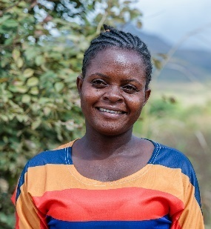
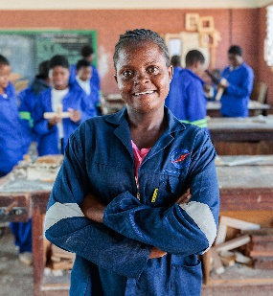
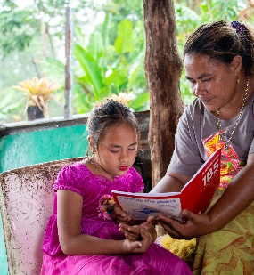
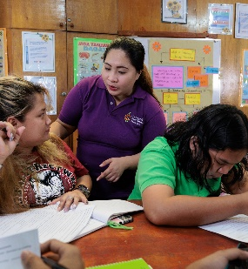
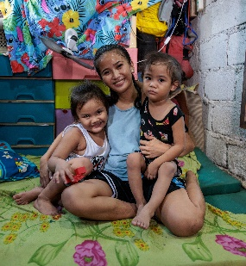
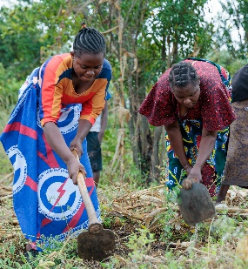
CATHOLIC SOCIAL TEACHING (CST) GUIDE
Catholic Social Teaching (CST) principles cover all spheres of life – the economic, political, ecological, personal and spiritual. The principles are inspired by Scripture and the writings of the Pope and other Catholic leaders about social issues.
Caritas Australia’s work is shaped by the tradition of Catholic Social Teaching.
HUMAN DIGNITY
SUBSIDIARITY AND PARTICIPATION
We believe every human being is created in the image and likeness of God and therefore has inherent dignity that should always celebrated be safeguarded.
We believe all people have the right to participate in decisions that affect their lives. Subsidiarity requires that decisions are made by people closest and most affected by the issues and concerns of the community.
SOLIDARITY
THE COMMON GOOD
We believe we are part of one human family and have a responsibility to help each person achieve their full potential.
We believe the good of each human person is intimately related to the good of the whole community. We are all responsible for each other.
PREFERENTIAL OPTION FOR THE POOR
CARE FOR OUR COMMON HOME
We believe in prioritising the women, men and children most vulnerable to extreme poverty and injustice.
We believe that care for our common home is vital for the common good of all people. We believe a true ecological approach is a social approach. We are to be protectors of creation and of one another.
For more on Catholic Social Teaching, including classroom activities, short films and other resources, visit our CST Toolkit.
Photo credits: Tim Lam/Caritas Australia (top left, top right, bottom right), Richard Wainwright/Caritas Australia (middle right, bottom left), Laura Womersley/Caritas Australia (middle left)

Slide 8
PROJECT COMPASSION – Primary Film

Slide 9
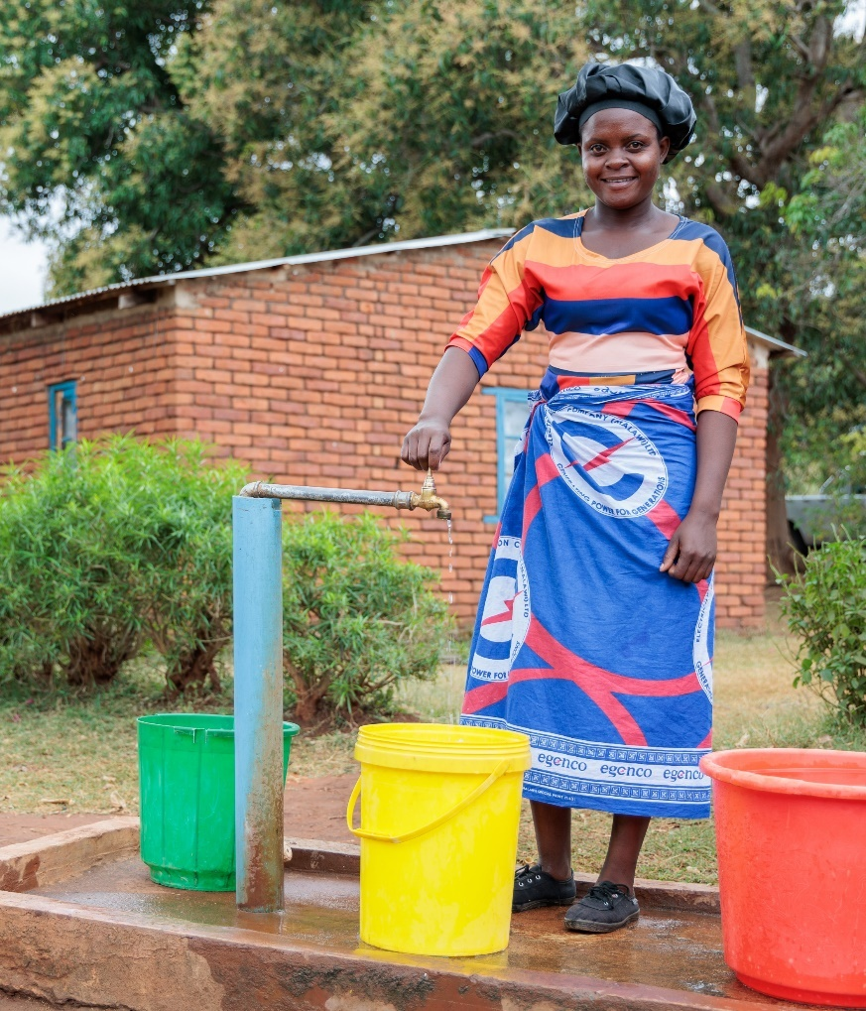
PROJECT COMPASSION PRAYER
God of all hope, we pray for our world with all its beauty and need.
We thank you for the love in our lives that is a mirror of your unending love.
May all creation know your compassion this Lent and may we take courage to share it, especially with those who don’t have what they need.
In our time, we hear the same words you spoke to Moses: ‘I will be with you,’ when you ask us to do courageous things.
Through our prayer, fasting and almsgiving, move us to act in the company of your Spirit, showing compassion and acting for justice to renew the face of the Earth, now and for all future generations.
We ask this in the name of Christ.
Amen.

Slide 10
LENT LINK
WHAT DOES LENT MEAN TO YOU?
Do you observe Lent regularly? Why/Why not?
What do you know about Lent?
What significance does it have for you?
Throughout Lent, we commit to strengthening our faith through the three pillars: prayer, fasting and almsgiving.
Pope Francis explains, ​“Lent is a time of grace to the extent that we listen to him [Jesus] as he speaks to us. And how does he speak to us? First, in the word of God, which the Church offers us in the liturgy. May that word not fall on deaf ears; if we cannot always attend Mass, let us study its daily biblical readings, even with the help of the internet. In addition to the Scriptures, the Lord speaks to us through our brothers and sisters, especially in the faces and the stories of those who are in need.”
(Pope Francis’s Lenten Message 2023)
During Lent, we take time to reflect and be strengthened by the Holy Spirit so that we are not indifferent to each other or global poverty. Through Project Compassion, we can stand in solidarity with our neighbours around the world. We can celebrate Caritas Australia’s partnerships with other agencies around the world, which support those most vulnerable to extreme poverty and injustice. Your donations help to strengthen their lives, their families and their communities.
Over the next six weeks of Lent, through Project Compassion, we will explore stories of hope in the Philippines, Samoa and Malawi. Let’s focus on how we can enrich our connectedness as a global community.
PRAYER
Traditionally, Christians pray for themselves and others during this time of Lent. Project Compassion encourages you to pray for the people and communities you encounter through the Project Compassion stories.
FASTING
Fasting is one of the most ancient practices linked to Lent. It can be an aid to prayer, as the pangs of hunger remind us of our hunger for God. Fasting can be linked to our concern for those who are forced to fast by their poverty, those who suffer from the injustices of our economic and political structures, and those who are in need for any reason. Traditionally, abstaining from meat was one way of remembering people who did not have enough to meet their daily needs. Some people also choose other ways to ‘fast’ such as from social media.
ALMSGIVING
Almsgiving is a sign of our care for others and an expression of our gratitude for all that God has given us. Caring for others is part of many faiths. Almsgiving by Christians is illustrated in the Bible, in Acts 4:33–37. During Project Compassion, reflect on ways you can care for others out of what you have.
This Lent, how can you respond courageously to the call for social and ecological justice for all future generations?

Slide 11
CST FILM STUDY GUIDE
Ronita – Philippines
OVERARCHING QUESTION
How are the principles of Catholic Social Teaching evident in the work of Caritas Australia?
• Human Dignity • Preferential Option for the Poor • Care for Our Common Home
• Solidarity • The Common Good • Subsidiarity and Participation
GUIDED REFLECTION QUESTIONS:
Human Dignity – How is the Caritas Australia supported program working to upholding the dignity of the people in the community?
Common Good – How are individual and social rights and responsibilities being fulfilled? How is the program benefiting the whole community?
Preferential Option for the Poor – How is Caritas Australia demonstrating their commitment to working with the most vulnerable and marginalised?
Solidarity – How are the Caritas Australia supported programs an example of solidarity? How is supporting Caritas Australia one way we can act in solidarity?
Subsidiarity and Participation – How are the Caritas Australia supported programs enabling people to participate in their own development and in their community? How are the participants empowered to make decisions that affect them and their community?
Care for Our Common Home – How are the programs encouraging environmental sustainability and equity, and respect for the environment?
Leaia – Samoa
Memory – Malawi

Slide 12
RONITA’S STORY (PHILIPPINES)
Watch Ronita’s Story
22-year-old Ronita lives in a barangay (Filipino term for a local district), in Quezon City, the Philippines. She lives with her husband Lean and their two children Egzy Grey, who is 3 years old, and Clark, who is 5 years old.
Ronita’s husband works seven days a week in waste disposal, from 3 am to 9 pm each day. It is exhausting, laborious work, made harder by the very hot climate. Despite this amount of work, Ronita and her husband are only able to rent a very small brick room (measuring around 10 square metres).
Ronita described their resulting living conditions: “We will carry a pail [from a neighbour] and we will put it in our drums so we can have water. But the electricity, we paid for that and the house. And it's very difficult because it's too small. When you come to our house, when you open the door, that's it. We don't have room. We don't have anything. When you open it, the kitchen, the living room, the room, it's already in one place.”
Ronita left school when she became pregnant as a teenager. She was at risk of never re-entering the education system when she had her first child, Clark, at 17. Without completing secondary education, Ronita faced life-long implications for family earnings and, in turn, the ability to overcome the cycle of poverty.
Thankfully, Ronita heard about an Alternative Learning System (ALS) program run by Caritas Australia’s partner in the Philippines, the Faithful Companions of Jesus (FCJ).
Ronita (22) smiles as she holds her sons, Egzy Grey (3) and Clark (5), in their small home in Quezon City, Philippines. Photo: Richard Wainwright/Caritas Australia

Slide 13
RONITA’S STORY (PHILIPPINES)
For over 20 years, the Faithful Companions of Jesus has supported the local community and will be serving approximately 2,000 participants over the next three years. The area FCJ works in is an urban slum, built next to a local dumpsite and on top of a fault line. Many of the houses are in poor condition and some don’t have sanitation. The residents face low income and low educational levels, and many have poor health.
In addition to the ALS program, FCJ also runs programs that include house renovating, food processing, basic literacy skills, urban gardening, upcycling and income generating activities. They run a seniors group, children's sport and play groups, and technical education and skills development program. They also have a clinic visited weekly by a doctor and community nurse.
When her first son Clark was just 2 years old, Ronita enrolled in the ALS program to continue learning in a safe and flexible environment. The ALS classes allow young mothers to bring their children to class if they cannot obtain or afford childcare. This made it possible for Ronita to continue her studies, even following the arrival of her second child, Egzy Grey.
She remarked, “I need to study. I need to work hard for my kids. I need to find a good job to be inspiration to them. The ALS in there was so very nice. The teachers, they inspire us and they give us the best so that we could graduate. Mum Jen is a very good teacher to us. She always laughs with us and when she teaches us, she always looking at us, focusing on us.”
Ronita also attends a young mothers' group regularly, which is facilitated by FCJ staff member Nurse Lyn. The group runs informal sessions with local mums who face financial and other difficulties. Here they learn about family planning, pediatric and maternal health, and are encouraged to support other mums.
Ronita said: “When I'm with young mums I feel confident because they're like me. They're young with children. I know that they understand my situation."
After completing her ALS class, Ronita was then able to go back to senior high school. But it was difficult. Often, she wouldn’t get enough sleep as she was caring for her children and then studying into the early hours of the morning. She even skipped lunch at school as she was unable to afford it.
Despite the challenges, Ronita persevered with her studies in this environment and went on to earn her Senior High School Diploma! Ronita has now secured a job at a call centre, which she hopes will allow her to support her mother, husband and two young children.
She said, “I am so thankful for FCJ. One day I hope I will be school teacher. I have now graduated senior school and I am so proud of myself. I feel hopeful for the future… Now it's not impossible for me to achieve my dream... Thank you for that.”

Slide 14
RONITA’S STORY
RE LINK
Solidarity noun
a firm and persevering commitment to the common good, which reminds us that everything is related
the act of standing shoulder to shoulder with others
a way of saying, ‘I’m here with you’
A. How is solidarity demonstrated in Ronita’s story?
B. How is supporting Project Compassion an act of solidarity?
Read the ‘The Parable of the Good Samaritan’ (Luke 10:25–37)
1. Who is our neighbour?
2. Explain how supporting Caritas Australia is one way we can love our neighbour.

Slide 15
RONITA’S STORY
LENT LINK
Write a prayer inspired by Ronita’s story.
Ronita often skipped lunch at school as she was unable to afford it. For many people around the world, fasting is a daily reality.
In solidarity with people experiencing a lack of food, consider what food you could fast from during Lent.
Could you fast from your favourite food for 5 days? For all of Lent? How would this make you feel?
How might you raise awareness in response to what you read and thought about in Ronita’s story? What are you compelled to do?
It might be a personal, group or community action. Write your thoughts and plan below.
For inspiration!
$25 can support one community member with a vertical garden where the harvest can be eaten or sold in the Philippines.
$250 can help repair homes and build toilets for households in need in the Philippines

Slide 16
LEAIA’S STORY (SAMOA)
Watch Leaia’s Story
Samoa may be a country surrounded by water, but access to clean drinking water is scarce in some areas, with many families facing extreme hardship as a result.
Leaia is a mother of five children aged 8 to 13. During the week, Leaia completes daily tasks with her sister Ene, while their husbands work on a cattle farm on the other side of the island. Their husbands come home each weekend to spend time with the family.
In an incredible act of resourcefulness, Leaia’s family built their home entirely out of recycled scraps collected from a nearby recycling plant, to avoid wasting precious household income.
Leaia’s family only has enough income to pay for her children’s food and necessities. Leaia goes to the local shops to buy ingredients and, where she can, harvests fruits from her own garden. The family relies on solar power for lighting and a gas and a wood burner for cooking. Their home is not connected to a piped water system, so they used to rely solely on rainwater collected in old fridges.
When their water ran out, Leaia had to walk with her young children to collect water in buckets and containers from a neighbour down the street. Before being able to rely on her neighbour, she would walk a 40-minute round trip each day with her young children to fetch water in hot, humid conditions. The children would have to take several breaks, as the buckets were very heavy for them to lift.
Leaia (right) stands with her family in front of their home which is now connected to a rainwater tank. Photo: Laura Womersley/Caritas Australia

Slide 17
LEAIA’S STORY (SAMOA)
Leaia explained, “When it was very hot, there was not much water. It became difficult for me to collect, and this would mean we had very little water, plus it was far. Without water, we can’t do any of our daily activities. We rely heavily on water to live.”
In recent years, the uncertainty in rainfall has become an increasing worry for Leaia; as a result of climate change, they face longer dry seasons and briefer rainy seasons. She said, “It makes me feel worried for my family and I, especially my kids, because of the lack of water supply we have access to. We really need the water all the time. It seems like the days are hotter and the weather has become drier than in previous years. Sometimes, we don’t know where to get the water from because where I am, it’s like the taps are becoming dead and dry due to the weather.”
With the support of Caritas Australia’s local partner Caritas Samoa, a 3,000 litre water tank was installed at Leaia’s home to harvest rainwater. This means that her family can now have access to clean water to drink and bathe in. The time that was previously used to collect drinking water can now be used for other essential tasks and, most importantly, her children don’t have to miss out on school.
Prior to having the water tank, Leaia’s children would sometimes miss school during the dry season. The school water supply was also unclean.
“If there isn’t enough water, the kids can’t go to school because the water supply at school isn’t clean,” Leaia said.
In rural areas of Samoa, poverty rates are strongly linked to lower levels of education. Caritas Samoa is installing water tanks in crucial areas of communities, such as schools and family homes, to prevent children from missing out on their right to an education.
During the next phase of the program, Caritas Samoa will work to provide homes like Leaia’s with hygienic toilets connected to septic tanks, which will improve the health of rural communities. This will only be possible with the generosity of Australians supporting Caritas Australia’s partnership with Caritas Samoa.
Leaia remarked, “I hope this program helps other families in need, like mine. Thank you, Caritas, for the water tank and the opportunity. It has helped us so much and made our daily life easier. Thank you for helping my family, we are grateful.”

Slide 18
LEAIA’S STORY
RE LINK
Human Dignity
noun
a belief that every person is made in the image of God and is intrinsically valuable and worthy of respect, simply because they are human
a quality of being human, independent of ethnicity, creed, gender, sexuality, age or ability
a reality challenged by poverty, hunger, lack of water and injustice
A. How is human dignity demonstrated in Leaia’s story?
B. How is supporting Project Compassion one way you can uphold the dignity of others?
How marvellously human!
Fratelli Tutti is an encyclical, or open letter, written by Pope Francis asking us to reach out to our sisters and brothers in need. We are challenged to turn outwards and think of ourselves as one global family, becoming neighbours to all. Fratelli Tutti calls us to put human dignity at the centre.
1. Read paragraph 117 of Fratelli Tutti.
2. What words or phrases stood out to you? Why?
3. How can you be ‘marvelously human’ and conserve water for the sake of others at school and at home?

Slide 19
LEAIA’S STORY
LENT LINK
Write a prayer inspired by Leaia’s story.
When the rainwater they collected in old fridges ran out, Leaia and her children would need to walk to collect water in containers from a neighbour down the street.
Fast from ‘easy’ access to clean water. Every time you need to use tap water, such as filling your drink bottle, walk to the furthest tap in your school or home.
Tapitas
The word ‘Tapitas’ is just a play on the word ‘Caritas’ and used to help people consider how their donations can support communities around the world to have ready access to clean water – at the turn of a tap!
If you are in a position to do so, donate to Project Compassion to help families like Leaia’s have reliable access to clean water.
And always remember your refillable water bottle so you don’t need to buy bottles water when you are out of the house.

Slide 20
MEMORY’S STORY (MALAWI)
Watch Memory’s Story
Memory is 26 years old and lives in rural Malawi. Her parents are subsistence farmers who depend on their crops for survival. Climate shocks and low agricultural productivity mean that poverty levels remain high in Malawi, particularly in rural areas. Nearly 70 per cent of the population live on less than $2.15 a day – one of the highest rates worldwide.¹
As the eldest of 5 children, Memory had to support her family with domestic chores such as farming, carrying water, cooking and cleaning, while also attending school.
“Growing up in the village was not easy. My parents don’t have a job, so they depend on farming. When the season goes wrong, we suffer a lot and become food insecure. Sometimes we need to bathe without soap. Sometimes we need to walk without shoes,” Memory said. “When I was in primary school, I went to school barefooted because my parents didn’t have money to buy shoes for me.”
Economic opportunities for girls in Malawi are constrained by high levels of early school leavers and women typically tend to work in lower paying jobs or stay at home.
“Many women in my community drop out of school because they can’t afford school fees, which leads to early marriage and early pregnancy and more poverty,” Memory said. “But I told myself I can’t stop going to school because this is the only way I can get a better life.”
Memory stands in a workshop at the technical college where she completed her three-year carpentry course. Photo: Tim Lam/Caritas Australia

Slide 21
MEMORY’S STORY (MALAWI)
Memory worked hard to secure her dream. After being identified by local leaders in her village as a capable candidate for a vocational skills course, Memory was referred to a technical college with support from CADECOM, Caritas Australia’s local partner in Malawi.
“It was my dream to go to college, so I was very excited to get that opportunity. My parents also were very excited to see their daughter go to college,” Memory said.
Through the A+ program, CADECOM supported Memory with the provision of logistical support like tuition and boarding fees with funding from Caritas Australia. The program has provided opportunities for more than 360 youth to be empowered through vocational skills such as welding, carpentry, tailoring and brick laying.
“In my community, most people think that only men can be carpenters, so I want to prove to my community that women can do it as well,” Memory said.
After three years, Memory graduated with an Advanced Certificate in Carpentry and Joinery. With her newly acquired skills, she secured a job as a carpenter at one of the largest hydroelectric power companies in Malawi.
The A+ program also supported Memory’s family through Village Savings and Loans groups, and provided them with goats, and training in bee keeping and irrigation farming to increase food security.
Since 2016, the A+ program has supported 7,397 households (33,287 people) to improve food security, provide access to basic water and sanitation, and to increase women’s income generation opportunities. The program will soon enter a new phase – the A+ Successor program – and will help 10,184 households (56,096 people) over the next 5 years.
With the income from her carpentry job, Memory can now provide some financial support to her parents.
“Because I studied carpentry, my siblings admire me and want to get educated so they can get a job and assist my parents,” Memory said. “In the future, I want to build a house for my parents because the one they are using now is in a bad condition. I also want to own my own workshop so I can help the community and employ others in the community.”
Along with your generous support, this program is also supported by the Australian Government, through Australian NGO Cooperation Program (ANCP).
¹ World Bank

Slide 22
MEMORY’S STORY
RE LINK
SUBSIDIARITY
noun
from the Latin word subsidium, meaning support or assistance
the idea that people and groups have the right to participate in decisions that affect them and, when they can't meet their own needs, other parts of society (e.g. the government) act according to their duty to assist with resources and support
an approach to common life that promotes participation and ensures people are architects of their own development
How is subsidiarity and participation demonstrated in Memory’s story?
How is supporting Project Compassion one way you can demonstrate a commitment to subsidiarity and participation?
LEADERSHIP
Memory has demonstrated leadership by: working hard to secure her dream of going to college and getting a job; proving women can become carpenters too; being a good role model for her siblings; and sharing her commitment to her community with the hope that one day she will own her own workshop so she can employ others in her community.
Explore the theme of leadership in Scripture.
Moses – Read the story of the Burning Bush (Exodus 3:1-20) where this year’s Project Compassion theme is drawn from. God has to be very convincing in order for Moses to take action. How did Moses demonstrate leadership?
Jesus – One of the most powerful events in the life of Jesus is when he washes his disciples’ feet in John 13:1–16. Explain servant leadership.

Slide 23
MEMORY’S STORY
LENT LINK
Write a prayer inspired by Memory’s story.
Fasting can be linked to our concern for those who are forced to fast by their poverty, those who suffer from the injustices of our economic and political structures, and those who are in need for any reason. Traditionally, abstaining from meat was one way of remembering people who did not have enough to meet their daily needs. Some people also choose other ways to ‘fast’ such as from social media.
Reflecting on Memory’s story, how will you ‘fast’ this week?
Memory is putting her skills as a carpenter to good use. How can you put your time, talents or treasure towards helping others this Lent?

Slide 24
THANK YOU
PHOTO CREDITS
Ronita’s Story (Philippines) – Richard Wainwright/Caritas Australia
Leaia’s Story (Samoa) – Laura Womersley/Caritas Australia
Memory’s Story (Malawi) – Tim Lam/Caritas Australia
CATECHISTS
For more school resources, please visit: caritas.org.au/resources/school-resources/
Stay up to date with events and resources!
Subscribe to Caritas Australia’s Education e-newsletter.
COMMUNITY ENGAGEMENT ANIMATORS
QLD/NT – Andrew.Knife@caritas.org.au ​
NSW/ACT – ProjectCompassion@caritas.org.au
VIC/TAS – Gwen.Michener@caritas.org.au ​
WA/SA – Paul.Reid@caritas.org.au ​
​
JUSTICE RESOURCES TEAM
Nicole.Dobrohotoff@caritas.org.au ​
​
GENERAL ENQUIRIES
education@caritas.org.au ​
Caritas Australia gratefully acknowledges the support of the Australian Government through the Australian NGO Cooperation Program. ​

