Slide 1
Caring for Creation One family, one common home PRIMARY
Notes:
Cartoon credit: James Foley

Slide 2
A note to teachers
This resource has been created to provide information, classroom learning tasks and action ideas to help teachers address the issue of caring for creation, our common home, through a Catholic worldview. It will explore the theological imperative we have to take care of creation and offer ideas on how the school community can take action. It is written for students from years 4 to 6.
Use and adapt the information and tasks in each section as individual lessons in your own units, or follow the suggested ‘See, Judge, Act’ sequence.
It is our hope that you will find all or some of this resource useful and use it in a way that best suits your purposes.
Tip: Check the ‘Notes’ sections of the slides for more information.
For more resources on a variety of topics, please visit www.caritas.org.au/schools
Please see the Copyright notice in the ‘Notes’ section of this slide.
We would love to hear from you!
To send feedback, enquiries or comments, please email us as education@caritas.org.au
Stay up to date with events and resources!
Teachers - Subscribe to Caritas Australia’s Education e-newsletter by emailing your request to: education@caritas.org.au
This resource was last updated in July 2021
Notes:
Copyright notice:
Use of website materials
Use of material on this site for educational purposes is encouraged. Caritas Australia gives permission for articles, illustrations and other materials to be reproduced for educational purposes or personal use, provided the information is not changed, and that the source is acknowledged appropriately. Use of material on this website for purposes other than educational or personal use must have prior authorisation from Caritas Australia's webteam (webteam@caritas.org.au)
Permissions
In some cases the copyright for text or images on this site may held by someone other than Caritas Australia. All rights are reserved on such material and permission to use them must be requested from the copyright owner. The source of this material is indicated on the relevant sections of the site.
Photos without a specified photo credit are the property of Caritas Australia or the international partners of the Caritas network.
Our logo
The Caritas Australia logo must not be downloaded, copied and or used for any purpose without the expressed permission of Caritas Australia. Please contact Caritas Australia's web team [mailto:webteam@caritas.org.au] for any further information that you may require about using content from this website.
Links to external sites
This site contains links to external web sites. Caritas Australia takes no responsibility for the content of such sites, nor do links to such sites imply endorsement of the views expressed therein. External links are provided for informational purposes only.

Slide 3
contents
Contents – Click to navigate to section
Curriculum Links
Process - See, Judge, Act and Inquiry learning
Indigenous Pedagogies
Notes on teaching about Climate change
Part 1: “See”
Part 2: “Judge”
Part 3: “Act”

Slide 4
curriculum
Catholic School Context
Across all curriculum areas, the religious dimension invites dialogue, challenges worldviews and promotes critical reflection and discernment. As an ecclesial community, the Catholic school is committed to promoting the Kingdom of God, bringing it to life through its action for justice and peace both locally and globally. Its educational project is impelled by the message of Christ to be hope-filled and future-oriented, drawing students into a vision for a just and compassionate world. Source: Catholic Education Melbourne. (2017). Horizons of Hope: Religious Dimension.
The issue of climate change can be explored in all areas of the curriculum and particularly through the cross-curriculum priority of Sustainability.
“Catholic educators draw on the teachings from the Scriptures and papal pronouncements to provide a deep foundation for their teaching…Whichever curriculum areas teachers choose to address, sustainability should always be approached from the perspective of positive action and empowerment… For Catholic schools then, the challenge is to develop life-affirming approaches to learning, teaching and curriculum that invite and support students to discover God’s presence in their lives.” Source: Catholic Education Melbourne. (2016). Education for Sustainability.
Australian Curriculum
The issue of climate change can be explored in all areas of the curriculum and particularly through the cross-curriculum priority of sustainability.
Sustainable patterns of living meet the needs of the present without compromising the ability of future generations to meet their needs.
Actions to improve sustainability are individual and collective endeavours shared across local and global communities. They necessitate a renewed and balanced approach to the way humans interact with each other and the environment.
Sustainability education is futures-oriented, focusing on protecting environments and creating a more ecologically and socially just world through informed action.
Actions that support more sustainable patterns of living require consideration of environmental, social, cultural and economic systems and their interdependence.
(Source: https://www.australiancurriculum.edu.au/)

Slide 5
curriculum
Religious Education
Catholic Social Teaching may remind us that human beings are called to act as stewards safeguarding the integrity of creation, caring for our common home.
God’s spirit calls us to act courageously in the face of injustice.
Thinking is part of acting and acting needs to be thoughtful.
Since the late 1970s Pope John Paul II, Pope Benedict XVI and Pope Francis have sought to stand in solidarity with the poor and marginalised of the world, as well as calling Christians to exercise good, appropriate stewardship of the fragile ecosystems that support life on earth.
Create simple prayers of thanksgiving for God’s gifts (e.g. the beauty of creation, freedom to choose and people’s role as co-creators).
Students interpret local and global decisions in light of Catholic Social Teaching.
Students reflect on the consequences of their own and others’ decisions and actions.
Note: The common themes, knowledge and skills listed below have been drawn from the various religious education curriculums around the country.
Students:
Recognise literal and inferred meaning in sacred stories about creation.
Understand the respect people have for the world, for nature and for all people is an expression of our relationship with God.
Explore environmental issues that threaten the sacredness of God’s creation and explore how we can respond appropriately and compassionately.
Identify some ways that they can care for and respect creation.
Recognise the interdependence of all things in creation.
Caring for Our Common Home
Solidarity
Subsidiarity and Participation

Slide 6
Curriculum – Year 4
Humanities and Social Sciences
Geography
The importance of environments, including natural vegetation, to animals and people (ACHASSK088)
explaining how people’s connections with their environment can also be aesthetic, emotional and spiritual
The custodial responsibility Aboriginal and Torres Strait Islander Peoples have for Country/Place, and how this influences views about sustainability (ACHASSK089)
investigating how knowledge and practices shared among Aboriginal and Torres Strait Islander Peoples are linked to sustainable use of resources and environments (such as rotational use and harvesting of resources, mutton-bird harvesting in Tasmania, the use of fire, and the collection of bush food from semi-arid rangelands)
The use and management of natural resources and waste, and the different views on how to do this sustainably (ACHASSK090)
exploring how some natural resources are used and managed in sustainable and non-sustainable ways
identifying renewable and non-renewable resources
exploring the work of groups and organisations which manage natural resources and/or waste
Science
Earth’s surface changes over time as a result of natural processes and human activity (ACSSU075)
considering the effect of events such as floods and extreme weather on the landscape, both in Australia and in the Asia region
considering how different human activities cause erosion of the Earth’s surface
Considering how Aboriginal and Torres Strait Islander Peoples’ fire management practices over tens of thousands of years have changed the distribution of flora and fauna in most regions of Australia

Slide 7
Curriculum – Years 5 & 6
Year 5
Geography
The influence of people, including Aboriginal and Torres Strait Islander Peoples, on the environmental characteristics of Australian places (ACHASSK112)
identifying how Aboriginal and Torres Strait Islander communities altered the environment and sustained ways of living through their methods of land and resource management
The environmental and human influences on the location and characteristics of a place and the management of spaces within them (ACHASSK113)
Types of resources (natural, human, capital) and the ways societies use them to satisfy the needs and wants of present and future generations (ACHASSK120)
Economics and Business
Types of resources (natural, human, capital) and the ways societies use them to satisfy the needs and wants of present and future generations (ACHASSK120) -
Science
Scientific knowledge is used to solve problems and inform personal and community decisions (ACSHE083)
Year 6
Humanities and Social Sciences
Geography
Differences in the economic, demographic and social characteristics of countries across the world (ACHASSK139)
Australia’s connections with other countries and how these change people and places (ACHASSK141)
Civics and Citizenship
The obligations citizens may consider they have beyond their own national borders as active and informed global citizens (ACHASSK148)
Economics and Business
How the concept of opportunity cost involves choices about the alternative use of resources and the need to consider trade-offs (ACHASSK149)
The effect that consumer and financial decisions can have on the individual, the broader community and the environment (ACHASSK150)
Science
Sudden geological changes and extreme weather events can affect Earth’s
surface (ACSSU096)
Electrical energy can be transferred and transformed in electrical circuits and can be generated from a range of sources (ACSSU097)
Science involves testing predictions by gathering data and using evidence to develop explanations of events and phenomena and reflects historical and cultural contributions (ACSHE098)

Slide 8
Introduction- the Learning process
This learning sequence has been created using the ‘See, Judge and Act’ model. This reflection–action process was first used by a Belgian Catholic priest, Joseph Cardijn (who later became a Cardinal) with Young Christian workers prior to the first World War.
This approach was also recommended in the 1961 encyclical letter written by Pope John XXIII called Mater et Magistra (Mother and Teacher).
Inquiry Learning and ‘See, Judge Act’
The See, Judge, Act model aligns well with inquiry learning models.
Broad phases of inquiry
See | Identify the issue, tuning in, framing and focusing questions
 | Investigate, organise, analyse evidence, explain, synthesise
Judge | Make connections, evaluate, reflect
Act | Responding, sharing new learnings, take action, evaluate the action
Objectives
See | Students will be able to explain what climate change is, its causes and the impact it is having on our environment and our global family. Extension: What are the economic, political, social, historic and cultural factors of climate change?
Judge | Students will reflect on what they know about climate change and its effects on humanity in light of Catholic teaching.
Act | Students, with an understanding of climate change and in light of a Catholic faith, will determine what action they can take.

Slide 9
Indigenous pedagogies
Aboriginal perspectives are fundamental to learning more about caring for our common home.
Below is information about ‘Eight Aboriginal Ways of Learning’ from 8 Ways. It is “a pedagogy framework that allows teachers to include Aboriginal perspectives by using Aboriginal learning techniques. In this way, focus can remain on core curriculum content while embedding Aboriginal perspectives in every lesson” (From 8 Ways). We have intended to integrate some of these ways of learning into this resource.
8 Ways
Story Sharing: Approaching learning through narrative.
Learning Maps: Explicitly mapping/visualising processes. Picturing pathways of knowledge.
Non-verbal: Applying intra-personal and kinaesthetic skills to thinking and learning. See, think, act, make and share without words.
Symbols and Images: Using images and metaphors to understand concepts and content.
Land Links: Place-based learning, linking content to local land and place.
Non-linear: Producing innovations and understanding by thinking laterally or combining systems.
Deconstruct/Reconstruct: Modelling and scaffolding, working from wholes to parts (watch then do).
Community Links: Centering local viewpoints, applying learning for community benefit.
8 Aboriginal Ways of Learning graphic from 8 ways
Notes:
About 8 ways:
This is a pedagogy framework that allows teachers to include Aboriginal perspectives by using Aboriginal learning techniques. In this way, focus can remain on core curriculum content while embedding Aboriginal perspectives in every lesson. It came from a research project involving DET staff, James Cook University’s School of Indigenous Studies and the Western New South Wales Regional Aboriginal Education Team between 2007 and 2009. AECG and SERAP approval was granted for the project.
https://www.8ways.online/about

Slide 10
Catholic tradition on caring for creation
There has always been a strong Catholic tradition to care for our common home. In the 13th century St Francis of Assisi’s Canticle of Creation and many Popes since have discussed the natural environment in their encyclicals.
In a General Audience in Rome in 2001, Pope John Paul II called for the worlds people to undergo an ‘conversion’ to protect the environment and make the earth a place where all life is valued and can grow in harmony. Pope Benedict XVI spoke of an economy that didn’t respect the environment.
Pope Francis released Laudato Si’, meaning "Praise be to you”, in June 2015. It is clear from Pope Francis' encyclical - Laudato Si': Caring for our Common Home - that as Catholics, we are called to take action for climate justice.
It is the Church’s most profound clarion call yet, for us all to be protectors of creation and the poor. The Holy Father has called for a new global solidarity, where all individuals, communities and governments play an essential part in taking care of our earth and global family.
In our region, the Federation of Oceania Catholic Bishops (including the Australian Catholic Bishops Conference) have spoken robustly about climate change and the need to be more active in reducing emissions.
“A true ecological approach always becomes a social approach, it must integrate questions of justice in debates on the environment as to hear both the cry of the earth and the cry of the poor.” (Pope Francis, Laudato Si’ n 49)
Within the global Caritas confederation, Cardinals, Bishops and lay Caritas leaders at the 2018 Caritas Oceania forum also reinforced this theme, and have made caring for creation one of their top priorities. Caritas Internationalis has made climate change an overarching theme in its strategic plan.
As a program of Caritas, Catholic Earthcare Australia is an ecological advisory agency to the church and has been mandated through the activities of education, research and advocacy to give leadership in responding to Laudato Si’ to “stimulate and sustain the ecological conversion and implement integral ecology in Catholic institutions in Australia.”
The Australian Catholic Bishops Social Justice Statement for 2021-22, ‘Cry of the earth cry of the poor’, further supports our call to care for all creation and invites us to take action.
To support this statement and the seven year Laudato Si’ action platform, Catholic Earthcare has developed a certification process for Catholic Earthcare schools, parishes and families.
"Living our vocation to be protectors of God’s handiwork is essential to a life of virtue; it is not an optional or a secondary aspect of our Christian experience.” (Pope Francis, Laudato Si’ n 217)
Notes:
Professional Reading:
Who are we before God and in Creation? Dr Sandie Cornish
Laudato Si’ Action Platform

Slide 11
PArt 1: see
Photo Credit: Richard Wainwright/Caritas Australia
Notes:
Teacher notes:
Inquiry Aim: Students will be able to explain what climate change is, its causes and the impact it is having on our environment and our global family.
Extension: What are the economic, political, social, historic and cultural factors of climate change?
Identify the issue, tuning in, framing and focusing questions

Slide 12
See: my place
Pause for a moment and consider your surroundings. What kind of environment do you live, learn and grow in? Is it alpine, coastal, desert, savannah or riverine plains country?
Look around and count how many different living things you can see. Count how many non-living things you can see. These are all gifts from God.
Why do you think we call them gifts?
What do you own that is precious – or treasured – by you? Share your response.
How do you take care of your “ treasures‟ ?
Indigenous peoples consider themselves as caretakers of the Earth, caring for the gifts of earth, water, and creatures.
‘Country’ is the term often used by Aboriginal people to describe the lands, waterways and seas to which they are connected ^{(Source)}.
Do you know whose Country you are on? If not, use the Map of Indigenous Australia to find out.
Acknowledge Country before you start your learning today. You can use the following template:
I begin today by acknowledging the Traditional Custodians of Country throughout Australia and their connections to land, sea and community. We pay our respect to their Elders past, present and emerging and extend that respect to all Aboriginal and Torres Strait Islander peoples today.
Notes:
“It is essential to show special care for indigenous communities and their cultural traditions. For them, land is not a commodity but a gift from God and from their ancestors who rest there, a sacred space with which they need to interact if they are to maintain their identity and values.” Pope Francis, Laudato Si’, n 146

Slide 13
See: our earth
Look at the photograph of Earth from space.
Describe it.
How can we take care of this precious gift?
Photo by NASA on Unsplash
Notes:
Teacher notes:
Inquiry Aim: Students will be able to explain what climate change is, its causes and the impact it is having on our environment and our global family.
Extension: What are the economic, political, social, historic and cultural factors of climate change?
Identify the issue, tuning in, framing and focusing questions

Slide 14
SEE: biodiversity
Pope Francis links all human beings to creation:
“We are part of nature, included in it, and thus in constant interaction with it” (Laudato Si’ n 139)
Look at some of the different kinds of living things we have on our planet at National Geographic.
Which creature did you find the most amazing and interesting?
What did it make you wonder?
Biodiversity (Bio=living things and Diversity=a variety) means having lots of different kinds of plants, animals and natural systems.
Can you think of some reasons why Biodiversity is important?
What do we use from our natural environment?
Have we been looking after our natural environment? What have humans been doing?
Photo by Dmitry Grigoriev on Unsplash
Notes:
Links:
https://www.nationalgeographic.co.uk/photography/2021/05/46-astonishing-wildlife-images-capture-beauty-peril-and-hope?image=16_1
Encourage students to wonder in awe at the variety of the different shapes, sizes, colours, textures and types of animals we have living on planet earth. Develop a sense of appreciation of the natural world. Research has shown we have to love nature before we are willing to protect it.
Why is Biodiversity so important? The more diverse an ecosystem is, the more stable it is. All living forms are interconnected so if one factor changes, it causes a change in all other factors. Therefore, we need keep ecosystems stable.
Humans rely on healthy ecosystems for our survival; clean water, food, fibre, medicines and so on. Plants produce the oxygen we breathe in and plants take in the carbon in carbon dioxide that we may breathe out. We depend on each other.
Healthy soil and plants store carbon which reduces the impact of climate change.

Slide 15
SEE: biodiversity
Mini beast hunt! Venture into your school grounds or your backyard at home and go on a minibeast hunt!
The Backyard Buddies website (and many others) will help you identify what you find.
You could carry out this minibeast hunt once a term to see if anything changes over time and through the seasons.
It is important to be gentle with each creature and place them back exactly where you found them, in their home.
You could draw the creatures you find or record them in a table. E.g.
Name of minibeast | How many did you see? | Where were they living? | Did this change over time?
E.g.Slater (Butcher boy) | 4 | Under a rock | We found 10 in Spring
Dragonfly. Photo Source: https://pxhere.com/en/photo/1593278
Notes:
Teacher Notes:
Students record the name and number of the mini beasts they find, note whether they were living in the soil, on a leaf, under bark etc.
To complete the last column of the table; carry out this hunt at different times of the day, in different seasons and weather to see if there is any impact on the number and kinds of creatures found.

Slide 16
SEE: consumerism
“The earth, our home is beginning to look more and more like an immense pile of filth.”
(Pope Francis, Laudato Si’ n 21)
Many of the things we use are produced using fossil fuels. Some aren’t recyclable.
Plastic: Humans use a lot of plastic. Did you know plastic never breaks down? It can only be physically broken into smaller pieces or recycled
Food waste: The 2021 Food Waste Index report showed that 17% of available food in the world is wasted
E-waste: Millions of electronic devices like televisions, computers and mobile phones are discarded in Australia every year.
v
What is the impact on the environment?
Photo by Dustan Woodhouse on Unsplash

Slide 17
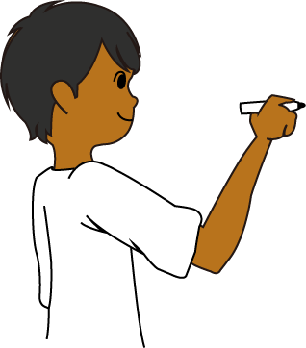
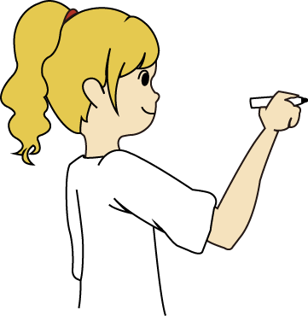
WHAT IS climate change?
What are the first words/images/ideas that come to mind when you think about climate change?
Individually students start a KWL chart on Climate Change.
(What I Know now and What I Want to learn. The last column can be filled in at the end of the unit.)
What I know | What I want to know | What I have learnt
What I know | What I want to know | What I have learnt
Notes:
Teacher Notes:
Ask students to complete a KWL chart on Climate change individually (What I Know now, What I Want to learn, What have I Learnt) The last column can be filled in at the end of the unit, as a form of self-assessment.
When discussing climate change it is important to keep it positive – what can be done to lessen the impacts and how can we act to change the future?
What is a KWL chart? – it is a thinking tool https://www.coolaustralia.org/activity/k-w-h-l-thinking-tool/

Slide 18
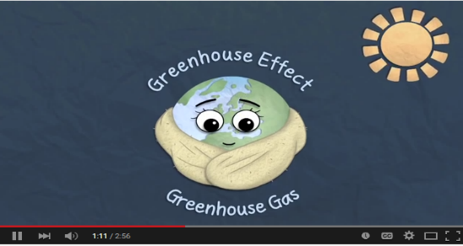
WHAT IS CLIMATE CHANGE?
Z
What is climate?
What is CO2? What is another name for CO2?
Where does it come from?
Where does it go?
What is the Carbon cycle?
What creates a “big blanket” around our earth?
What gets trapped in the “big blanket”?
What has changed very quickly in the last two hundred years?
Where do we get most of our energy from?
Where do fossil fuels come from?
What happens when we burn them?
What is the Greenhouse effect?
What is melting?
What is the impact on people living near the coast?
What is causing the sea to get much warmer?
What is causing more extreme weather? What are some examples?
Who is most affected?
WATCH: A Climate Change Animation for Primary Schools
Produced by CAFOD (Caritas England & Wales): 2.56’’
Notes:
Teacher Notes:
Students may need to watch the clip several times to find the answers to the questions. They may complete the questions independently or in pairs.
When questions have been answered, add to the class Issues-Causes-Impact chart.
CAFOD: Climate Change Animation for Primary Schools
https://www.youtube.com/watch?v=v8unGCTWUWI

Slide 19
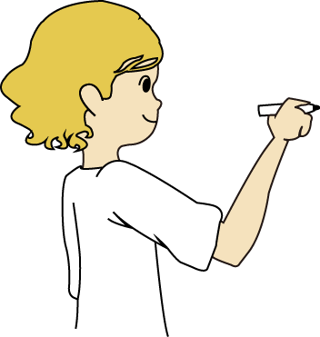
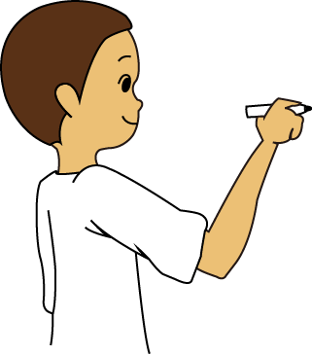
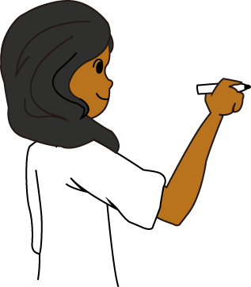
WHAT IS climate change?
As a whole class, using what students learnt from the video, record what students know into what the issue is, the causes and the impacts.
You can come back and add to this table as you learn.
For more information on climate change go to National Geographic Kids
Issue, Cause, Impact Chart
Issue | Causes | Impacts
Notes:
Teacher Notes:
Students could complete group/individual reading tasks with the sections on https://www.natgeokids.com/au/discover/geography/general-geography/what-is-climate-change/

Slide 20
FOSSIL FUEL / ENERGY
Fossil fuels are non-renewable and when burnt, they produce greenhouse gases which trap heat in our atmosphere and cause climate change.
These gasses are called emissions. Emissions from extracting coal, oil and gas from our natural environment can have impacts on land use, traditional owners, water bodies, air quality and the landscape.
We will eventually run out of fossil fuels, so countries need to use alternative energy sources more widely. Australia relies on coal and gas for 79% of its electricity. ^{Source}
Good News!
Recently, Australia has been using more renewable types of energy such as solar, hydro and wind. They accounted for 24% of the energy used in the last quarter of 2020. This meant we had the lowest emissions from electricity on record!
Photo by Chris LeBoutillier on Unsplash
Notes:
Could include information on fast fashion a an extension activity in the teacher handbook.

Slide 21
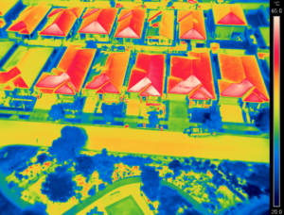
Rising temperatures
The way in which we have built our cities has also resulted in urban heat islands. In places like western Sydney, it is becoming more difficult for children to play outdoors, or to learn, because it is just too hot.
Dr. Sebastian Pfautsch says: “… looking at Bureau of Meteorology data we know that ambient heat during school days in summer is rising. This means if you have no air conditioning, you see more days of high classroom temperatures too. You learn less in these classrooms.”
Source: Australian Catholic Bishops Conference Social Justice Statement 2021-22 p. 5
Reflect: Can you think of a time when extreme heat impacted your ability to learn, play, rest?
Have you noticed any changes in the climate during your lifetime?
The summer 2019/20 temperatures in Jordan Springs, near Penrith, an area suffering from the urban heat island effect. Image: Dr Sebastian Pfautsch. Source

Slide 22
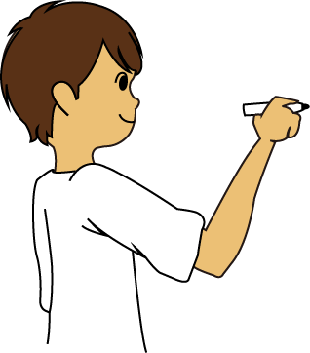
WHAT IS climate change?
What can you add to your Issues, Causes, Impact chart?
As a class, come up with a definition of climate change that can be used throughout the unit.
Climate Change is….
Notes:
Teacher Notes:
Ask students to complete a KWL chart on Climate change individually (What I Know now, What I Want to learn, What have I Learnt) The last column can be filled in at the end of the unit, as a form of self-assessment.
As a whole class, discuss student’s pre-knowledge on Climate change. Classify their responses into what is the issue, the causes and the impacts.
As a class, come up with a definition of climate change that can be used throughout the unit.
Introduce the concept of climate change. Students recall what they already know about climate change. National Geographic Kids https://www.natgeokids.com/au/discover/geography/general-geography/what-is-climate-change/ explains it well.
Find out what is causing climate change, what are some of the causes and effects on creation?
Scientists tell us that some of the effects of global warming will be; rising sea levels, acidic ocean water, health issues for people and changing habitats for our plants and animals but there are things humans can do to change this.

Slide 23
Caritas australia's response
Scientists tell us that some of the effects of global warming will be extreme weather, including more frequent droughts, storms and floods, rising sea levels, health issues for people and changing habitats for our plants and animals.
The people who will be most affected by more extreme weather are those living in poverty. This is because their weather is already extreme, and they don’t have the money or systems in place to help them when there is a flood or a drought.
The communities Caritas Australia work with tell us how their farming seasons are more unpredictable, making it more difficult to grow crops for food and other purposes.
Caritas Australia is also helping communities to adapt to a changing climate and to also be prepared for when natural disasters do occur.
Phany working in one of her gardens with newly planted vegetables at their home in Western Cambodia. By using the drip irrigation system and other techniques learnt through the program, she can now grow vegetables during the dry hot summer. Photo: Richard Wainwright

Slide 24
Caritas Australia’s work in communities
Peter, Solomon Islands. Photo: Cassandra Hill
Tati, Indonesia. Photo: Richard Wainwright
Thandolwayo, Zimbabwe. Photo: Richard Wainwright
As sea levels rise in low lying areas and countries, people may have to move away. Our neighbours in the Pacific Islands are already suffering the impacts of rising sea levels and natural disasters. The Solomon Islands are surrounded by water but are suffering from drought.
Read about Peter in the Solomon Islands.
In Zimbabwe, Caritas Australia installed solar panels to power a water pump in Thandolwayo’s village.
Which story did you find most inspiring? Why?
What new knowledge and understanding can you add to your Issues, Causes, Impact chart?

Slide 25
CASE STUDY
ABORIGINAL CARBON FOUNDATION
Australia’s First Peoples are deeply connected to their traditional lands. But these lands are located in some of the hottest areas of the country. Rising temperatures have increased the risk of devastating bushfires.
Caritas Australia joined forces with the Foundation to amplify their efforts in supporting communities to utilise their skills to generate income and revitalise cultural practices.
Ranger Sarah Barkley interviewing senior Elder John Clark. Photo: Aboriginal Carbon Foundation
Notes:
‘A partnership that pays-off’ article first published in Aurora Magazine, August 2021.
https://issuu.com/diomn/docs/aurora_august_2021_web

Slide 26
Through carbon farming, local communities carry out traditional fire and land management practices and earn an income by generating carbon credits.
One of the most common forms of carbon farming projects across northern Australia is the savanna burning method. This approach uses traditional burning practices, early in the dry season, to reduce the severity of bushfires and the large-scale emission of greenhouse gases generated by severe fires.
As a result of the ‘cool’ burning more wildlife returns, increased bush foods are available and sacred sites are protected.
Photo: Richard Wainwright
Notes:
‘A partnership that pays-off’ article first published in Aurora Magazine, August 2021.
https://issuu.com/diomn/docs/aurora_august_2021_web

Slide 27
Chief Executive Officer of the Aboriginal Carbon Foundation, Rowan Foley explained the course enables Aboriginal people to own the whole process, from the beginning to end, and generate income for their specialised expertise and knowledge of the land.
"The communities we work with are very proud of the work they're doing in terms of looking after Country, but also knowing that it's a viable carbon economy," Mr Foley said.
Read the full article ‘A partnership that pays-off’ published in Aurora Magazine, August 2021.
Photo: Richard Wainwright
Notes:
‘A partnership that pays-off’ article first published in Aurora Magazine, August 2021.
https://issuu.com/diomn/docs/aurora_august_2021_web

Slide 28
CASE STUDY
LAT AND EM, CAMBODIA
Lat and Em are rice and poultry farmers living in rural Cambodia. They also grow vegetables to feed themselves.
Cambodia is experiencing more floods and droughts due to a changing climate.
During times of drought their rice crop was damaged and many of their chickens and ducks contracted diseases and died due to a lack of water.
Lat and Em with their daily long bean harvest. Photo: Sam Rinang

Slide 29
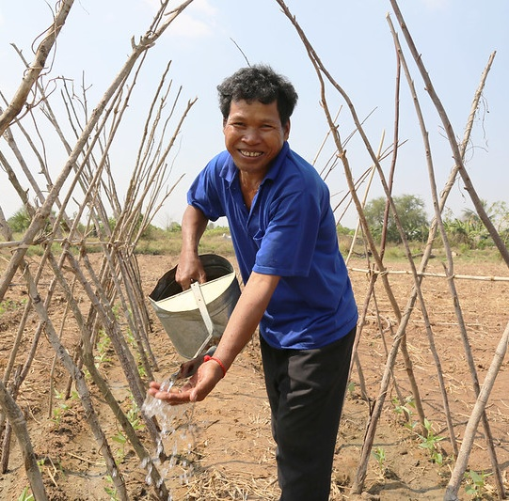
Lat and Em joined the Caritas Australia supported Upholding Community Dignity Together program.
The program teaches people new ways of farming and improving access to water so they can deal with droughts and floods better. Learning to deal with new challenges is called adapting.
Lat and Em co-invested with other villagers and their adult children to restore two ponds which has provided reliable water for their family and for farming.
In countries like Cambodia, more than 3.4 million people do not have access to safe water*.
Now Lat and Em’s farm is thriving and their income has increased, their new skills have changed their lives.
Source: World Bank
Lat watering his beans. Photo: Sam Rinang
*Along with your generous support, this program is supported by the Australian Government through the Australian NGO Cooperation Program (ANCP).
Notes:
Teacher Notes:
Alternatively, ask students to reflect at this point:
Which story did you find most inspiring? Why?
What new knowledge and understanding can you add to your Issues, Causes, Impact chart?

Slide 30
Part 2: JUDGE
Photo by Paweł Fijałkowski from Pexels
Notes:
Form a judgement on the issue in the light of a Catholic faith
Equivalent Inquiry stages:
Going Further and drawing conclusions.
Students will be able to cite evidence from certain encyclicals as well as the Holy Scriptures to support their actions in caring for our common home.
Students will reflect on what they know about environmental issues and the impacts on humanity using the lens of Catholic Social Doctrine.

Slide 31
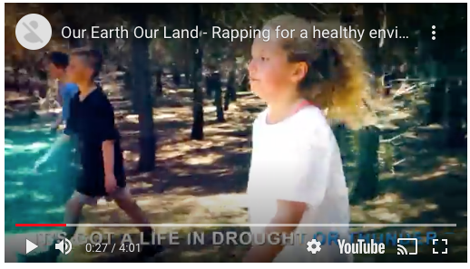
Indigenous spirituality
LISTEN: Our Earth, Our Land: Rapping for a Healthy Environment.
Connect to the music and ideas:
Which lyric is the most memorable to you? Why?
What image was most memorable to you? Why?
How did this song make you feel? Why?
A music video created by local Aboriginal community members. Produced by Wagga Wagga TV.
Notes:
Video clip: “Our Earth Our Land, Rapping for a healthy environment’ New South Wales Government.
https://www.lls.nsw.gov.au/help-and-advice/articles-and-publications/corporate-app/cultural-heritage-videos/aboriginal-communities-earth-land#:~:text=Our%20earth%2C%20our%20land%2C%20is,youth%20about%20connection%20to%20Country.

Slide 32
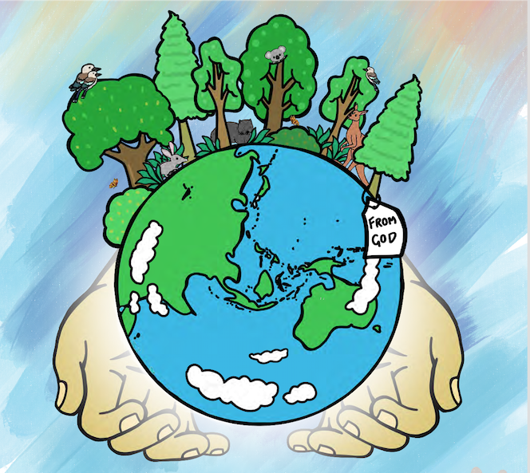
What does our faith tell us?
How do you think God would like us to look after creation?
Why do you think God created a beautiful earth?
What does he want us to do with it?
Read the Scripture Genesis 1:26
What does it suggest?
What does it mean to be responsible for something?
As a class, make a poster or display recording and celebrating some of the things that people do to take care of the earth and animals.
Write a caption to accompany the picture on the right.
Notes:
Teacher Notes:
Students discuss how they think God would like them to look after creation.
Pose the inquiry question/s. E.g. Does God want us to care for creation? Why?
Discuss - Why do you think God created a beautiful earth? What does he want us to do with it?
Read the Scripture Genesis 1:26 Discuss: What does it suggest? What does it mean to be responsible for something? Students list and record some of the things that people do to take care of the earth and animals.
Watch the ‘Laudato Si' animation for children’ by CAFOD (Caritas England & Wales) https://www.youtube.com/watch?v=KOgF2Kgel6k
-

Slide 33
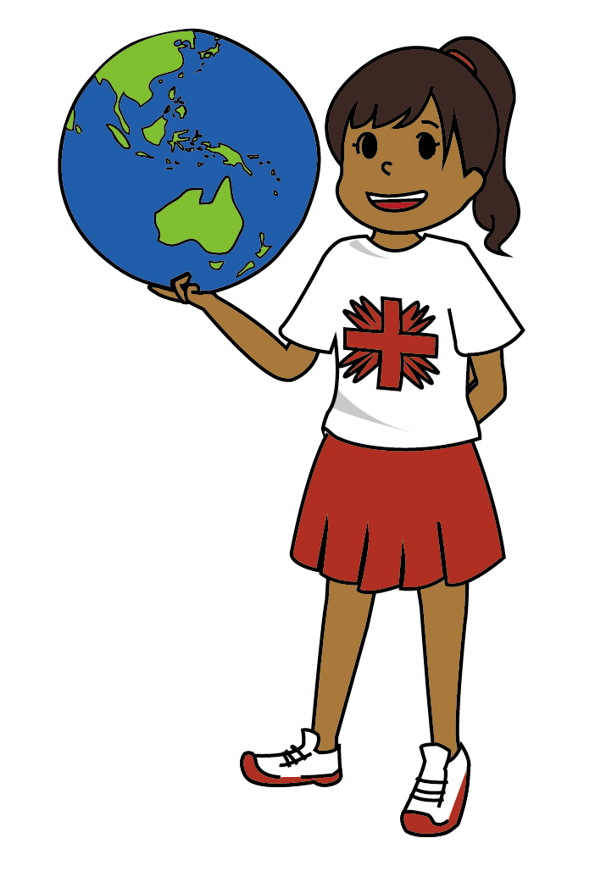
LAUDATO SI’
In the encyclical ‘Laudato Si’’ Pope Francis talks about how:
Nature and people are connected. We are part of nature
Looking after nature is part of looking after each other
We have a responsibility to care for our common home
The little decisions we make in our every day life can have a big impact for a better future
The ways in which we treat others shows how much we love God
We should think about how our decisions will affect the future.
Fratelli Tutti is Pope Francis’ third encyclical and was released on the day of the feast of St Francis in 2020. Its’ main message is a call to solidarity for all people, love for your neighbour and social friendship.
If we love our neighbour, should we be acting for climate justice?
Notes:
Teacher Notes:
See notes on ‘Integral Ecology’ on slide 48.

Slide 34
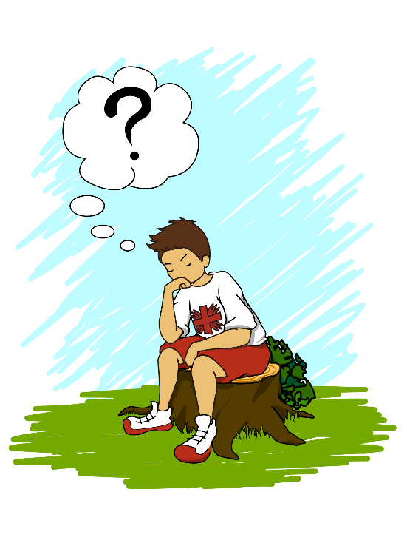
WHERE DO YOU STAND?
Do you agree or disagree?
Nominate one side of the room as ‘agree’, the middle as ‘not sure’, and the other side of the room as ‘disagree’.
Stand in the space that most reflects your opinion on the following statements:
Our natural environment is a common good.
It is not dignified for people to not have access to clean drinking water, food or shelter.
We don’t need beautiful natural areas to walk in, play and pray in.
Australia has a bigger responsibility than other countries to do something about climate change.
Climate change is a natural cycle and we don’t have to worry about it.
People in other countries are suffering the most from changes in climate and weather.
Wealthy countries are causing pollution and climate change.
We don’t need to worry about extreme weather events in other countries.
Extension: Think of some of your own statements.
Notes:
Extension or separate project:
Study the Catholic Social Teachings in the CST Toolkit.
As you learn about each CST think about our common home and our natural environment.
CST Toolkit link: https://www.caritas.org.au/learn/cst-toolkit/
Do you agree or disagree?
Make 3 signs “Agree, Disagree and Not Sure”. Blu-tack these to 3 separate walls of your classroom. Read out each statement one at a time, ask children to decide their response, then students walk over to the sign that matches their answer.
(Remind students to think about why they agree or disagree, they need to be able to explain the reasons for their response.)
Pick 2 children to give reasons for their answer from each of the 3 response categories. Allow for some robust discussion in between!
You can add some of your own statements to this list, according to the interests and knowledge of CST’s of the children you teach.
Image: James Foley

Slide 35
Part three: act
Photo Credit: Caritas Australia

Slide 36
Indigenous CONNECTION TO LAND
Indigenous peoples all over the world have a deep spiritual connection to their ancestral lands, sometimes it is the land they were born and raised on, where they learnt how to survive and protect the natural environment.
Our First Nations people in Australia have a complex totem system that connects them spiritually to Country. When you are born, you are given one or more totems. These can be an animal, plant or part of the landscape. Your totem comes with the responsibility to care for this particular plant, animal and their habitat.
Reflect: What would our natural environment look like, if every Australian took on the responsibility of caring for at least one plant and one animal in their local area?
Find out: which plants and animals live in your school grounds? Are they Australian natives or do they come from another part of the world?
Barry, a proud Gamilaroi man looking at rockpool animals with his daughter. Photo: Richard Wainwright

Slide 37
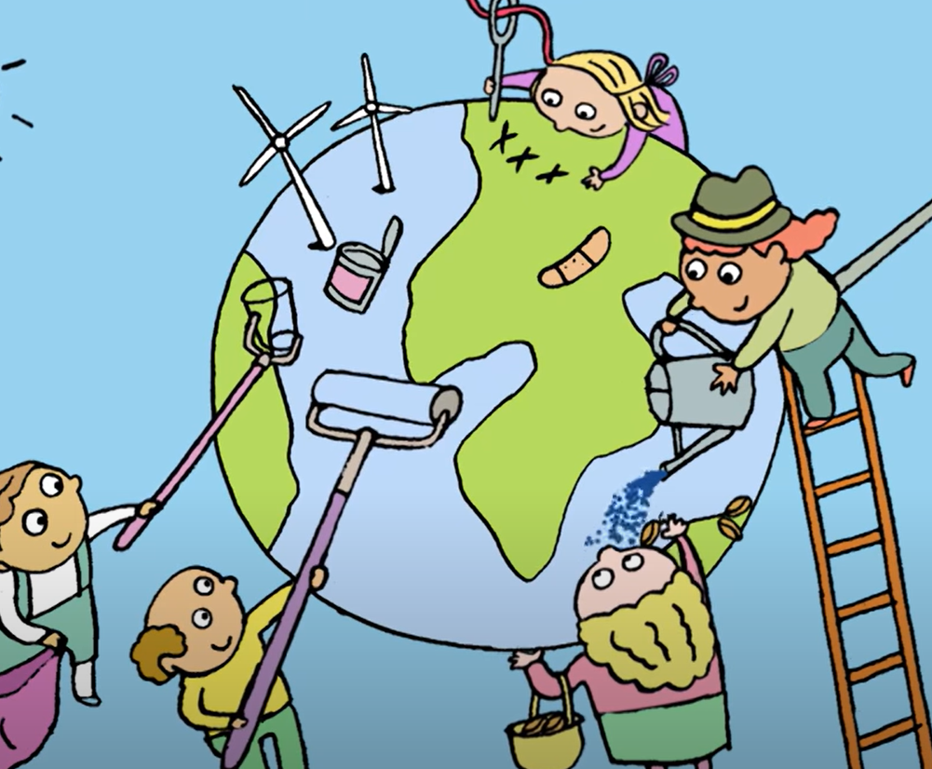
CARE FOR OUR COMMON HOME
Watch the ‘Laudato Si' animation for children’ by CAFOD (Caritas England and Wales)
What is Pope Francis asking us to do in his letter?
What do you think Pope Francis means by ‘common home’?
What are some of the actions suggested in the clip?
Notes:
Teacher Notes:
This clip summarises the information on climate change as well as introducing ideas for action.
CAFOD Laudato Si’ animation link: https://www.youtube.com/watch?v=KOgF2Kgel6k (4’08’’)

Slide 38
act
There are many young people just like you who have done amazing things to care for creation. Find out about some of these students, here is one to get you started!
Have you heard of Molly Steers? Read about her at ‘Straw No More.’
When Caritas Australia works with communities, we always build on peoples’ strengths, because we believe “nobody has nothing”.
Now think about your strengths, your interests, what are you passionate about?
What could you do?
“If you want to change the world, start with yourself”
Mahatma Ghandi
Image: James Foley
Notes:
Straw No More link https://www.strawnomore.org/

Slide 39
act
Take Action!
Write a letter, create a video clip, or send an email message to your Federal Member of Parliament (MP) asking for urgent action on climate change, biodiversity or choose another common home issue that you feel strongly about.
Your local member is your representative in Parliament and you're entitled to ask them to represent your interests.
Image: James Foley

Slide 40
Act
Live Simply
Pope Francis has asked us to be kind to the environment by living simpler lifestyles. We don’t need so much “stuff”, we only need what is necessary to live and be comfortable.
“…approximately a third of all food produced is discarded, and whenever food is thrown out it is as if it were stolen from the table of the poor.”
(Pope Francis, Laudato Si’ n 50)
What can you do at home and at school to be kind to the environment?
Can you live more simply when you go shopping for clothes, toys and food?
What about when you have special celebrations/events at home and at school?
Image: James Foley

Slide 41
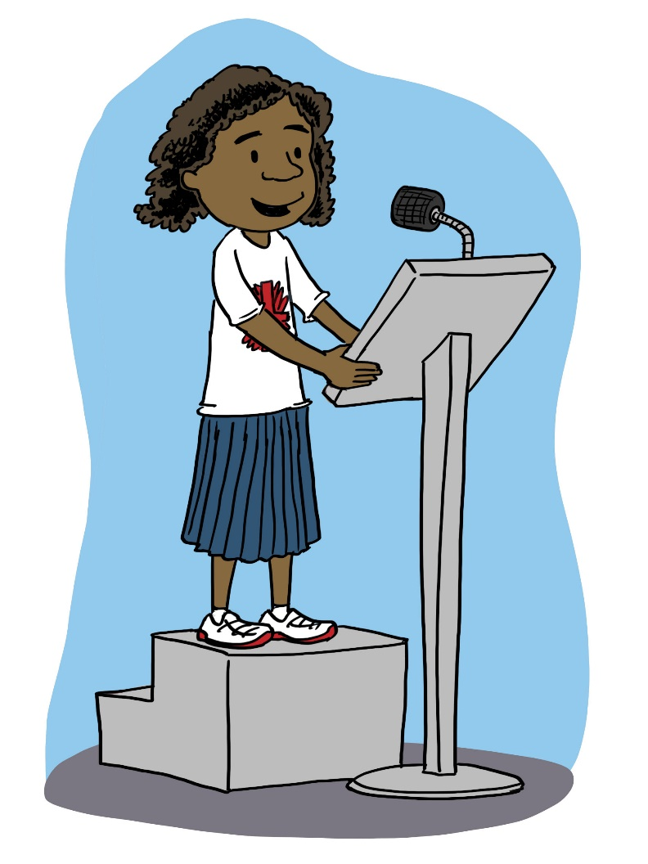
Take action ideas
Become a Catholic Earthcare School.
Take public transport, walk, run, cycle.
Organise a Ride/Scoot/Walk Day or a Waste Free Lunch.
Raise awareness by presenting on an issue at an assembly, create posters to display around the school or hold an information stall at a school event.
Create a vegetable or indigenous garden, provide water for birds and other animals in your school grounds.
Reduce the amount of waste we produce, and make sure to reuse and recycle too.
Switch to renewable energy sources.
Plant trees.
Turn off lights when not in use.
What other things can you think of?
Image: James Foley

Slide 42
“Young people demand change. They wonder how anyone can claim to be building a better future without thinking of the environmental crisis and the sufferings of the excluded”
Pope Francis, Laudato Si’ n 13

Slide 43
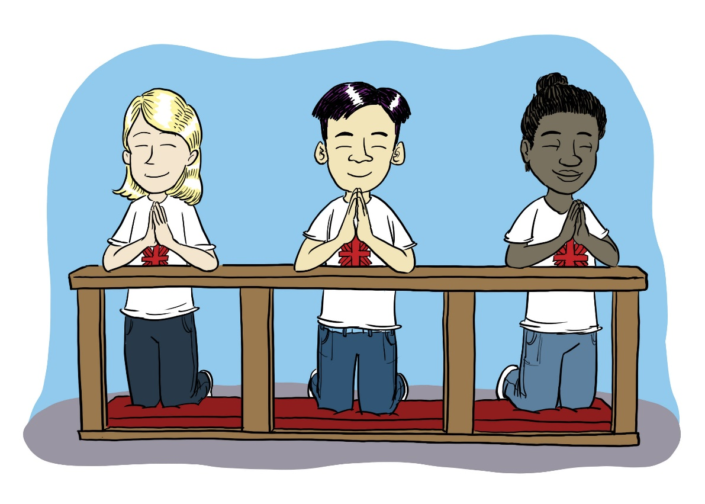
PRAY
Pray using the ‘Caring for our Earth: a prayer for children’ video
Read the creation story from a children’s Bible. This story tells us that “God took the man and settled him in the Garden of Eden to cultivate and take care of it” (Genesis 2:15). This is a way of saying that God wants us to care for the earth.
Have a go at writing your own prayer for creation!
Share these at a whole school assembly.
Image: James Foley
Notes:
Video clip link: CAFOD Caring for our Earth https://www.youtube.com/watch?v=XI50nAPurZs (3’48)

Slide 44
PRAY
Collect objects from creation. Make the sign of the cross then share with each other the beautiful things God has made.
Say, “Thank you God for ____” and place your object in the centre as a focus for prayer.
Finish by praying together:
Creator God,
Thank you for the beautiful world you have given to everyone to share. We pray for people who are living where there are floods or droughts. Help us to take care of the world’s resources so that it can be a place where everyone can live life to the full. Amen
Photo: Pelipoer Lara from Pexels

Slide 45
Additional enquiry questions
What is the difference between weather and climate?
What are some of the ways we see climate change already happening in Australia and around the world?
How do you contribute to climate change?
Who are the decision-makers? What is the lived experience?
Are we listening to the people most directly affected?
What are Australia’s targets for greenhouse gas emissions?
Where do the majority of greenhouse gas emissions come from?
How do different views about the environment influence approaches to sustainability?
How can people use environments more sustainably?

Slide 46
FURTHER RESOURCES
For more Caritas Australia resources
Visit https://www.caritas.org.au/resources/school-resources/
There are prayer services, films, case studies and board games available.
For an comprehensive unit on the Catholic Social Teaching principle of Care for Our Common Home, use our CST Toolkit at: www.caritas.org.au/cst

Slide 47
Thank you

