Slide 1
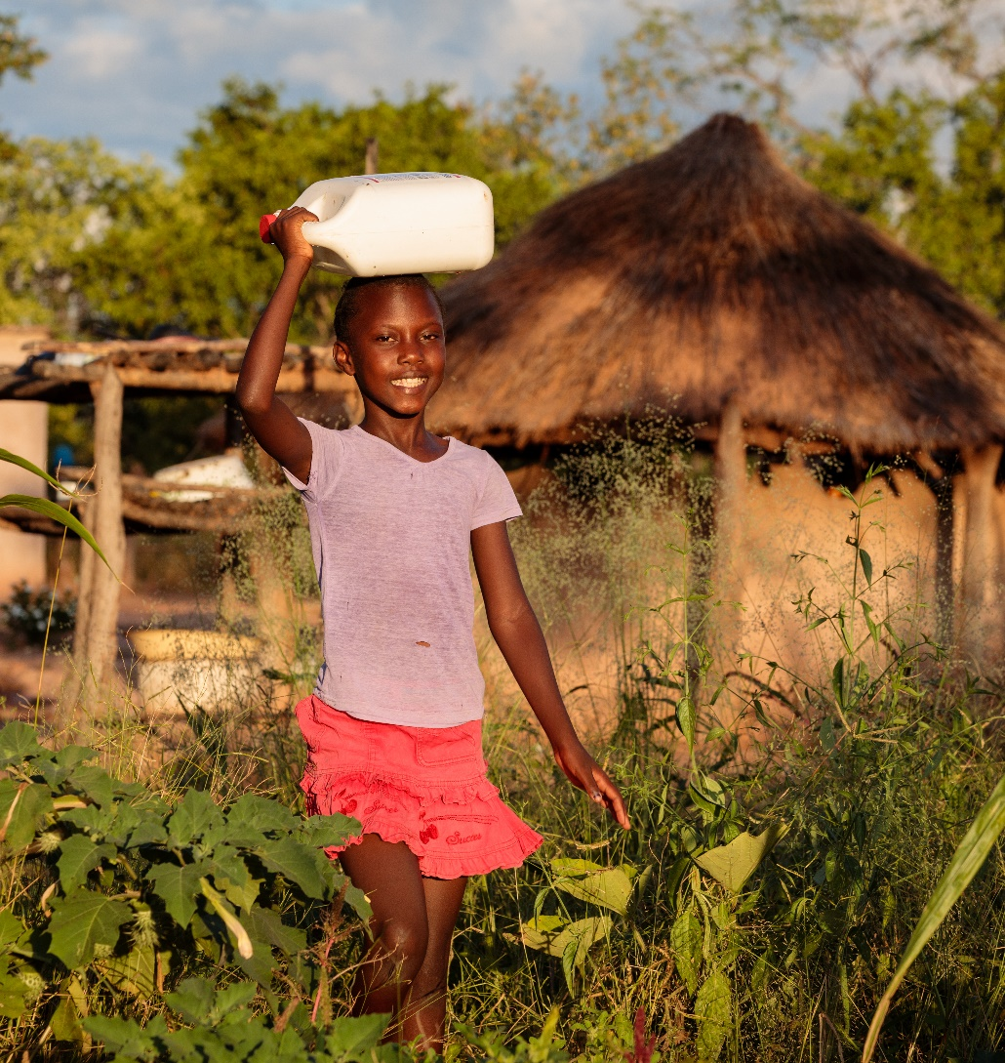
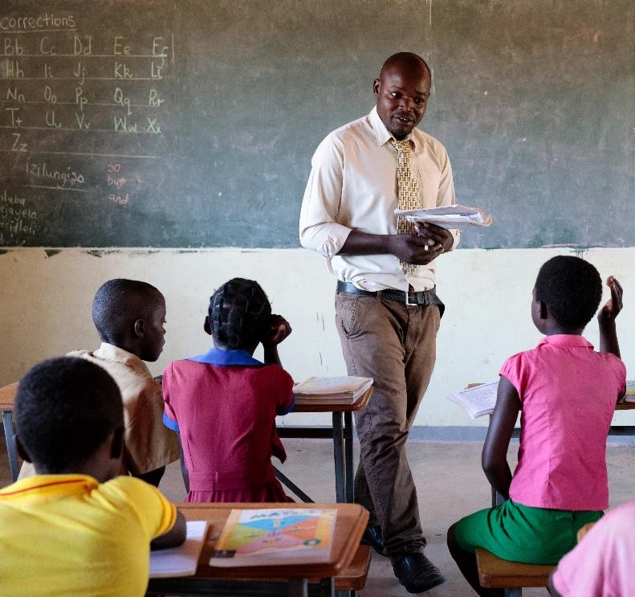
Poverty QUIZ
Updated Feb 2021
Notes:
Images from left to right: Thandolwayo outside her home holding a 5 litre water container she uses to collect water. Caritas Hwange, installed a solar powered piped water system into her village bringing fresh clean drinking water to the population for the first time. . Photo Credit: Richard Wainwright, Caritas Australia
Salma spends quality time with her newborn baby boy Samiul and her daughter Maya. They tell stories and play games. Photo credit: Ashish Peter Gomes
Marvelous, Headmaster at Msuna Primary School is seen teaching Thandolwayo (9) and her classmates. Photo Credit: Richard Wainwright, Caritas Australia

Slide 2
instructions
Click here to play this quiz on the Kahoot interactive learning platform.
This is an interactive resource. As you go through this quiz use your mouse to click on the correct answer for each question.
If you make a mistake, you can go back and try again.
Click on the arrows to take you to the next question.
The source for the information used in this quiz is located in the ‘Notes’ section of the slides.
Good luck!
Note: If you do edit this resource please ensure content and photos remain with the appropriate credit to Caritas Australia and the photographers.
Copyright Policy: Material within our resources comes from a variety of sources and authors, including Caritas Australia staff volunteers, overseas partners and news organisations. Our resources and the information, names, images, pictures, logos are provided “as is”, without warranty. Any mistakes brought to the attention of Caritas Australia will be corrected as soon as possible. To review the full Caritas Copyright Policy, please visit: Caritas Australia​

Slide 3
Question 1
Approximately how many people are experiencing extreme poverty living on less than $1.90 a day?
A. 250 million
B. 689 million
C. 1.5 billion
Credit: flaticon.com
Notes:
Source: 2020 World Bank Poverty Overview
https://www.worldbank.org/en/topic/poverty/overview

Slide 4
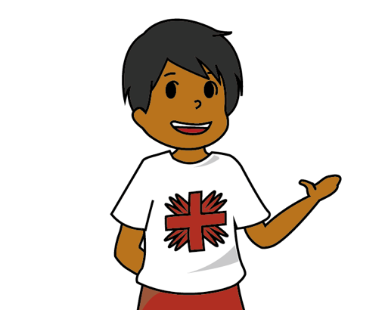
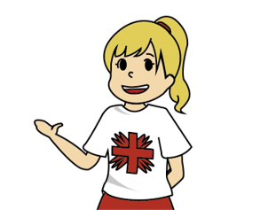
Answer incorrect
TRY AGAIN!

Slide 5
Answer correct!
B. 689 million
CORRECT!
Globally the number of people experiencing extreme poverty declined from 10.1% in 2010 to 9.2% in 2017.
However, due to the COVID-19 pandemic the numbers are expected to rise for the first time in 20 years.
Credit: flaticon.com
Notes:
Source: 2020 World Bank Poverty Overview https://www.worldbank.org/en/topic/poverty/overview

Slide 6
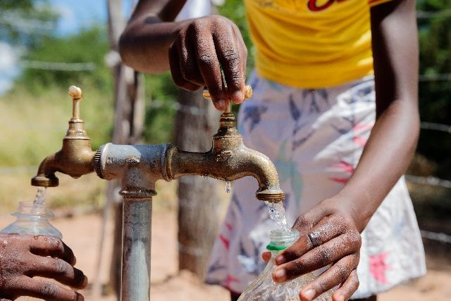
Question 2
How many people do not have access to safely managed drinking water?
A. 2.2 billion
B. 323 million
C. 1.4 billion
Thandolwayo’s (Zimbabwe) collects water from the new water pipe next to her primary school. Caritas assisted to install a solar powered, piped water system into her village bringing fresh clean drinking water. Credit: Richard Wainwright Caritas Australia
Notes:
Source: https://www.unwater.org/water-facts/water-sanitation-and-hygiene/
https://washdata.org/sites/default/files/2020-11/UNICEF-WHO-state-of-the-worlds-sanitation-2020.pdf

Slide 7
Answer incorrect
TRY AGAIN!

Slide 8
Answer correct!
A. 2.2 billion
CORRECT!
In Australia, many of us are fortunate enough to be able to simply turn on a tap in our homes; 2.2 billion other people do not have such easy access.
Thandolwayo’s (Zimbabwe) collects water from the new water pipe next to her primary school. Caritas assisted to install a solar powered, piped water system into her village bringing fresh clean drinking water. Credit: Richard Wainwright Caritas Australia
Notes:
Source: https://www.unwater.org/water-facts/water-sanitation-and-hygiene/
https://washdata.org/sites/default/files/2020-11/UNICEF-WHO-state-of-the-worlds-sanitation-2020.pdf

Slide 9
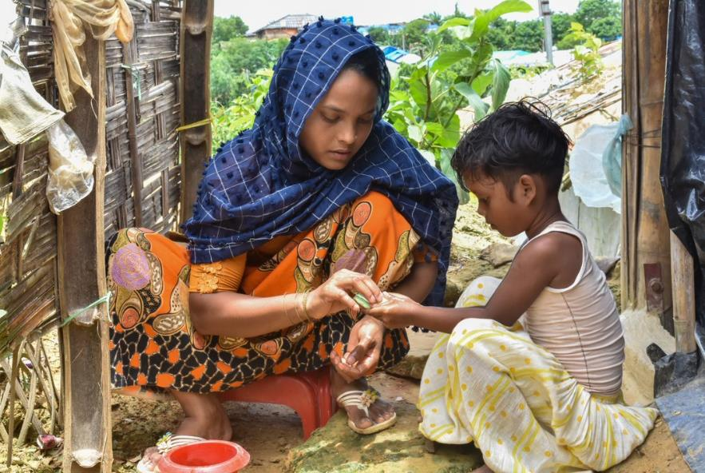
Question 3
How many people do not have access to a decent toilet of their own?
A. 785 million
B. 1.8 billion
C. 2 billion
Halima shows her daughter how to wash her hands correctly outside their shelter in a Rohingya refugee camp. Photo credit: Caritas Bangladesh
Notes:
Source: https://www.wateraid.org/au/why-wateraid/facts-and-statistics

Slide 10
Answer incorrect
TRY AGAIN!

Slide 11
Answer correct!
C. 2 billion
CORRECT!
If you did not have a flushing toilet or a pit latrine, what would you use?
Probably a field, a plastic bag, or a bucket. Lack of sanitation results in disease, and unfortunately death, for millions of people every year.
Halima shows her daughter how to wash her hands correctly outside their shelter in a Rohingya refugee camp. Photo credit: Caritas Bangladesh
Notes:
Source: Water Aid
https://www.wateraid.org/au/why-wateraid/facts-and-statistics

Slide 12
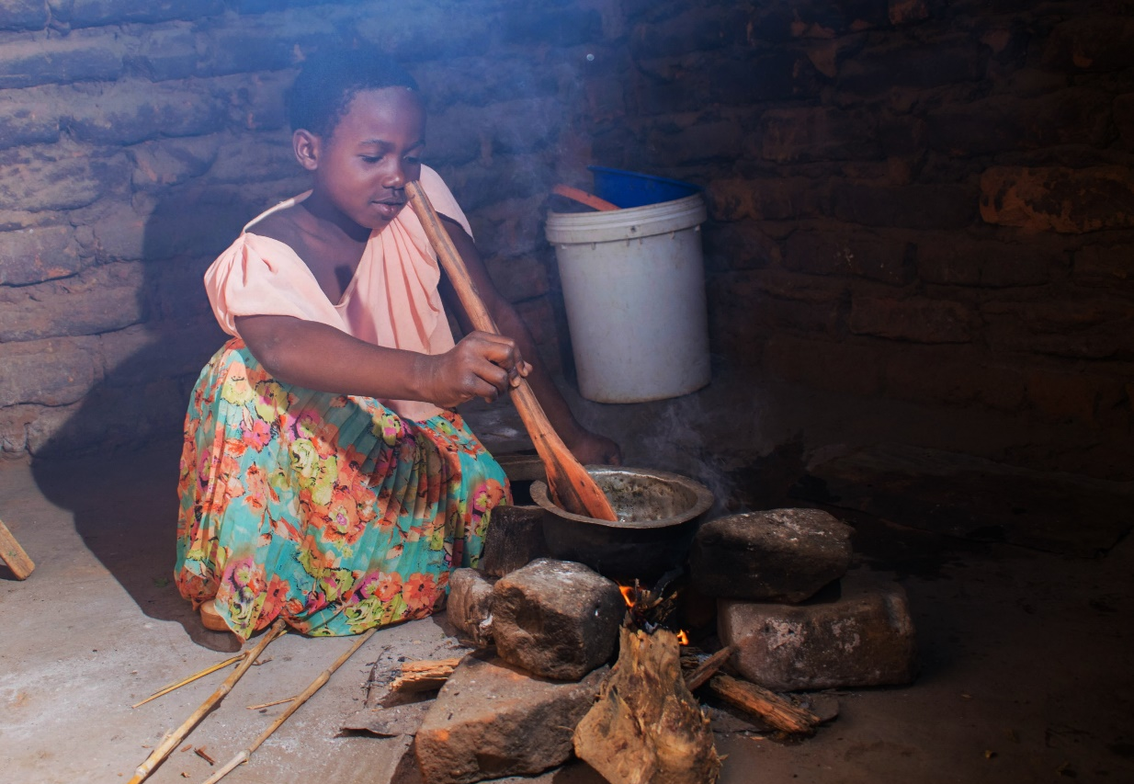
Question 4
Approximately how many people worldwide suffer from malnutrition (not having enough healthy food to eat)?
A. 380 million
B. 670 million
C. 821 million
Tawonga helps prepare a family meal. For most of her life, her parents have struggled to put meals on the table. Tawonga often had to miss school because she was too sick from hunger. Her family now grows enough food to provide three meals a day, ending the struggle of malnutrition. Credit: Pilirani Chimombo
Notes:
Source: FAO
http://www.fao.org/3/I9553EN/i9553en.pdf

Slide 13
Answer incorrect
TRY AGAIN!

Slide 14
Answer correct!
C. 821 million
CORRECT!
In 2017, it was estimated that 821 million – around one person out of every nine in the world – were without adequate nutrition.
The world produces enough food to feed everyone, yet 821 million people do not have enough nutritious food to meet their daily needs.
Tawonga helps prepare a family meal. For most of her life, her parents have struggled to put meals on the table. Tawonga often had to miss school because she was too sick from hunger. Her family now grows enough food to provide three meals a day, ending the struggle of malnutrition. Credit: Pilirani Chimombo
Notes:
Source: http://www.fao.org/3/I9553EN/i9553en.pdf

Slide 15
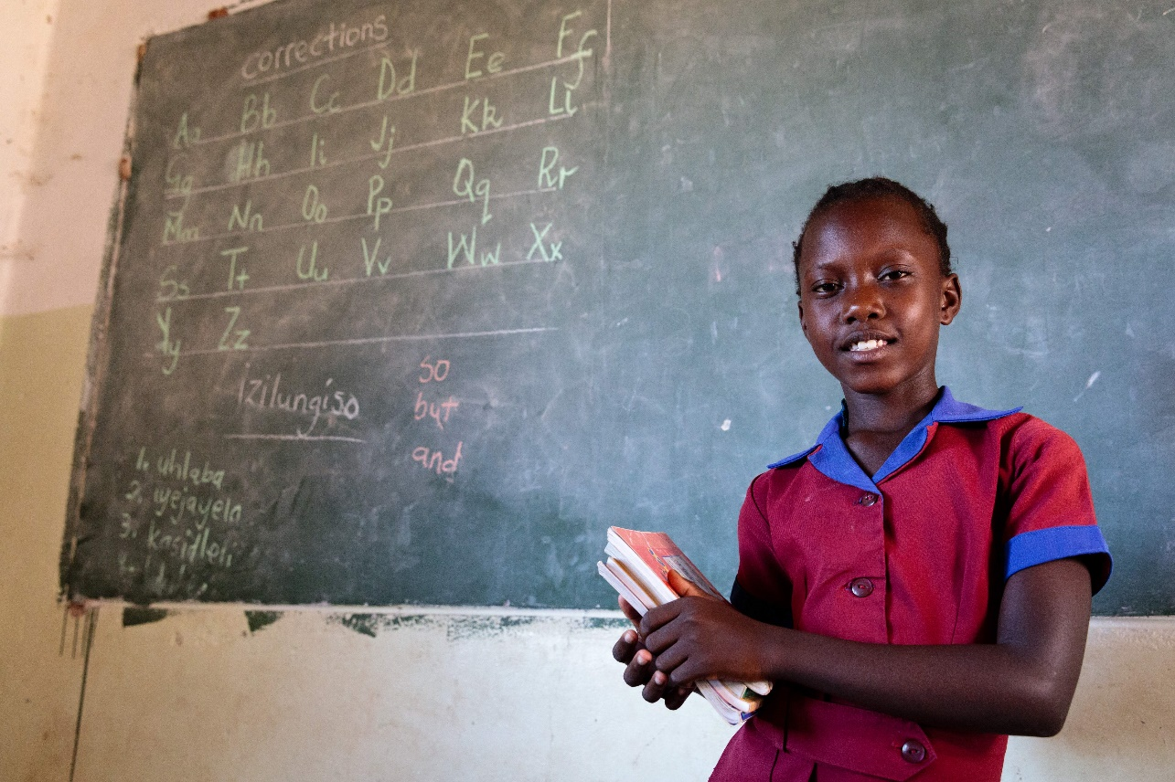
Question 5
How many primary-school-aged children around the world are not going to school?
A. 59 million
B. 118 million
C. 205 million
Thandolwayo poses for a picture in her primary school. Since the installation of a solar powered piped water system into her village bringing fresh clean drinking water, she is now able to spend more time at school and study and lives a healthier life. Photo credit: Richard Wainwright/Caritas Australia
Notes:
Source: http://uis.unesco.org/sites/default/files/documents/new-methodology-shows-258-million-children-adolescents-and-youth-are-out-school.pdf

Slide 16
Answer incorrect
TRY AGAIN!

Slide 17
Answer correct!
A. 59 million
CORRECT!
Girls are more likely than boys never to set foot in a classroom, despite all the efforts and progress made over the past two decades.
There are 259 million school-aged, both primary and secondary, children not going to school.
Thandolwayo poses for a picture in her primary school. Since the installation of a solar powered piped water system into her village bringing fresh clean drinking water, she is now able to spend more time at school and study and lives a healthier life. Photo credit: Richard Wainwright/Caritas Australia
Notes:
Source: http://uis.unesco.org/sites/default/files/documents/new-methodology-shows-258-million-children-adolescents-and-youth-are-out-school.pdf

Slide 18
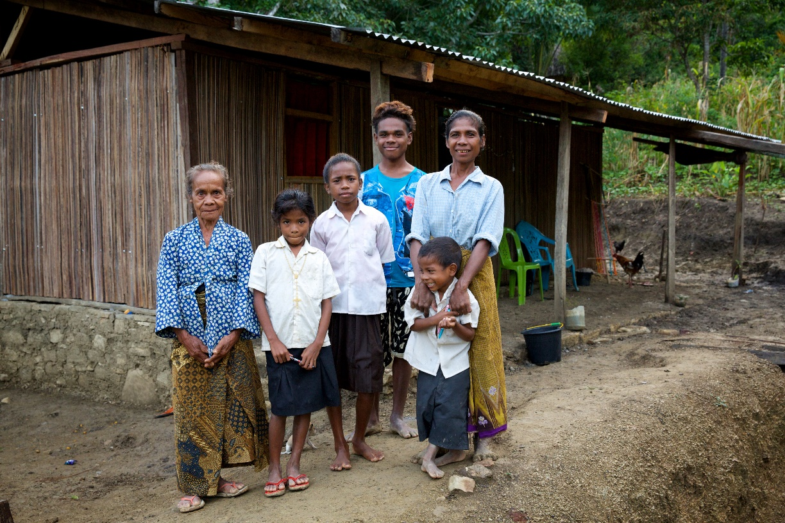
Question 6
How many people do not have adequate shelter?
Adequate shelter means adequate privacy, space, lighting, security, basic facilities, protection against the weather, is structurally safe and a reasonable cost.
A. 756 million
B. 1.6 billion
C. 3.2 billion
Martina (right) with some of her children and mother outside their home. Credit: Richard Wainwright/Caritas Australia
Notes:
The UN Committee has stated that housing must provide adequate shelter, which means adequate privacy, space, security, lighting and ventilation, basic infrastructure and location with regard to work and basic facilities, all at a reasonable cost.
Sources: https://unstats.un.org/sdgs/metadata/files/Metadata-11-01-01.pdf
https://www.ag.gov.au/rights-and-protections/human-rights-and-anti-discrimination/human-rights-scrutiny/public-sector-guidance-sheets/right-adequate-standard-living-including-food-water-and-housing#:~:text=access%20to%20water.-,Housing,all%20at%20a%20reasonable%20cost.

Slide 19
Answer incorrect
TRY AGAIN!

Slide 20
Answer correct!
B. 1.6 billion
CORRECT!
Today, an estimated 1.6 billion people live in inadequate housing globally, of which 1 billion live in slums and informal settlements.
This means that about 1 in 4 people in cities, live in conditions that harm their health, safety, prosperity and opportunities.
Martina (right) with some of her children and mum outside their home.. Credit: Richard Wainwright/Caritas Australia
Notes:
The UN Committee has stated that housing must provide adequate shelter, which means adequate privacy, space, security, lighting and ventilation, basic infrastructure and location with regard to work and basic facilities, all at a reasonable cost. Everyone should have sustainable access to natural and common resources, safe drinking water, energy for cooking, heating and lighting, sanitation and washing facilities, means of food storage, refuse disposal, site drainage and emergency services.
Source: 2020 Report: Levels and Trends in Child Mortality
https://data.unicef.org/wp-content/uploads/2020/09/Levels-and-trends-in-child-mortality-IGME-English_2020.pdf

Slide 21
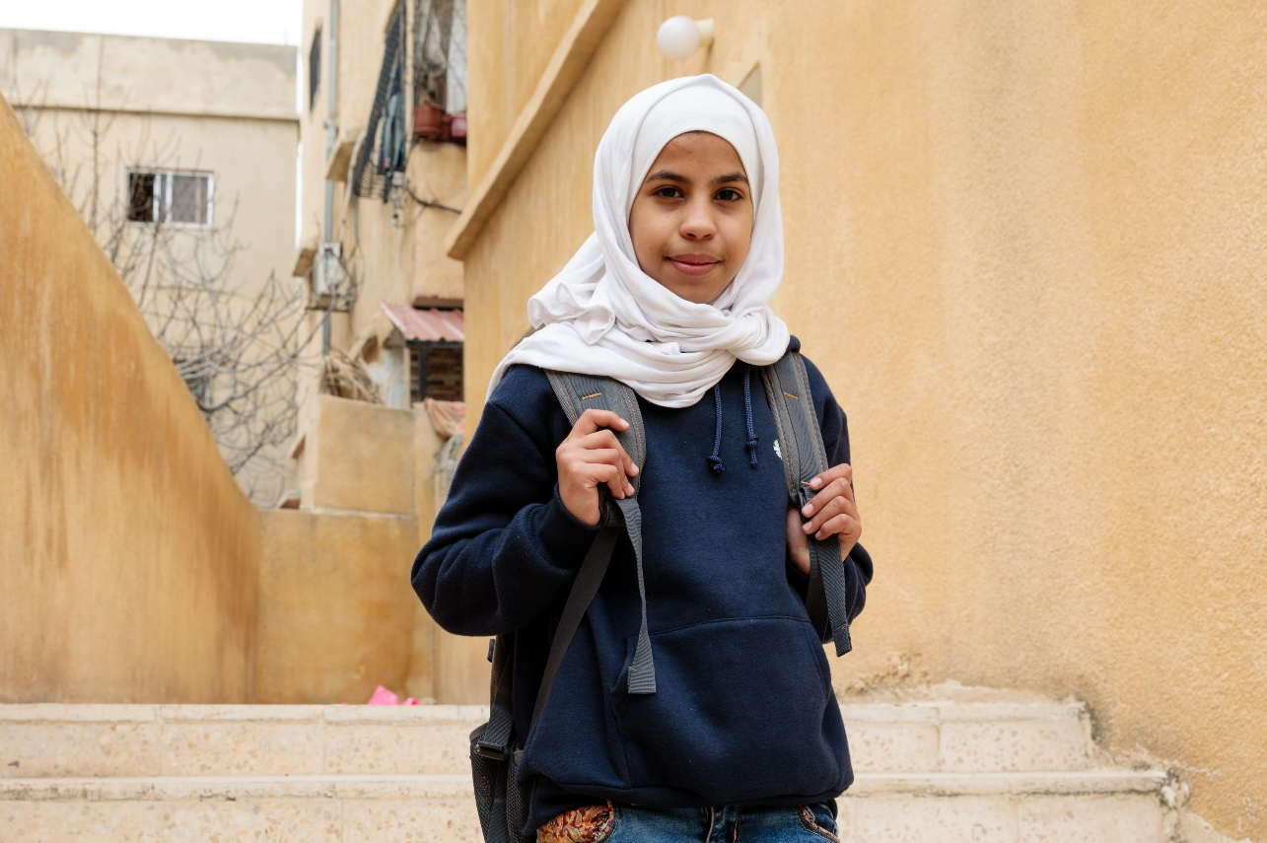
Question 7
How many people have been forcibly displaced from their homes worldwide?
A. 28.1 million
B. 43 million
C. 79.5 million
Bayan (12) fled her home in Damascus, the capital of Syria, with her family when her neighbourhood was bombed in July 2013. She now lives in Amman, the capital of Jordan with her mother Hanan, father Hasan and six siblings. Photo credit: Richard Wainwright/Caritas Australia
Notes:
Source: Global Trends: Forced displacement in 2019
https://www.unhcr.org/5ee200e37.pdf

Slide 22
Answer incorrect
TRY AGAIN!

Slide 23
Answer correct!
C. 79.5 million
CORRECT!
UNHCR’s annual Global Trends report showed an average of one person was displaced every three seconds in 2019.
40% of those displaced are under the age of 18.
People are forcibly displaced as a result of persecution, conflict, violence, or human rights violations.
Bayan (12) fled her home in Damascus, the capital of Syria, with her family when her neighbourhood was bombed in July 2013. She now lives in Amman, the capital of Jordan with her mother Hanan, father Hasan and six siblings. Photo credit: Richard Wainwright/Caritas Australia
Notes:
Source: Global Trends: Forced displacement in 2019
https://www.unhcr.org/5ee200e37.pdf

Slide 24
Question 8
What percentage of Australia’s Gross National Income (GNI) was given in Australian Aid in 2019 - 2020 ?
A. 3.5%
($3.50 per $100 of GNI)
B. 0.21%
(21cents per $100 of GNI)
C. 0.7%
(70 cents per $100 of GNI)
Credit: flaticon.com
Notes:
Source: https://www.micahaustralia.org/agency/australian_aid

Slide 25
Answer incorrect
TRY AGAIN!

Slide 26
Answer correct!
B. 0.21%
CORRECT!
From 2014 – 2019, Australia’s aid program has experienced consistent cuts.
The current rate equates to 21 cents given in aid per $100 of gross national income.
Credit: flaticon.com
Notes:
Source: https://www.micahaustralia.org/agency/australian_aid

Slide 27
Learn more AT: www.caritas.org.au

Slide 28
Thank You

