Slide 1
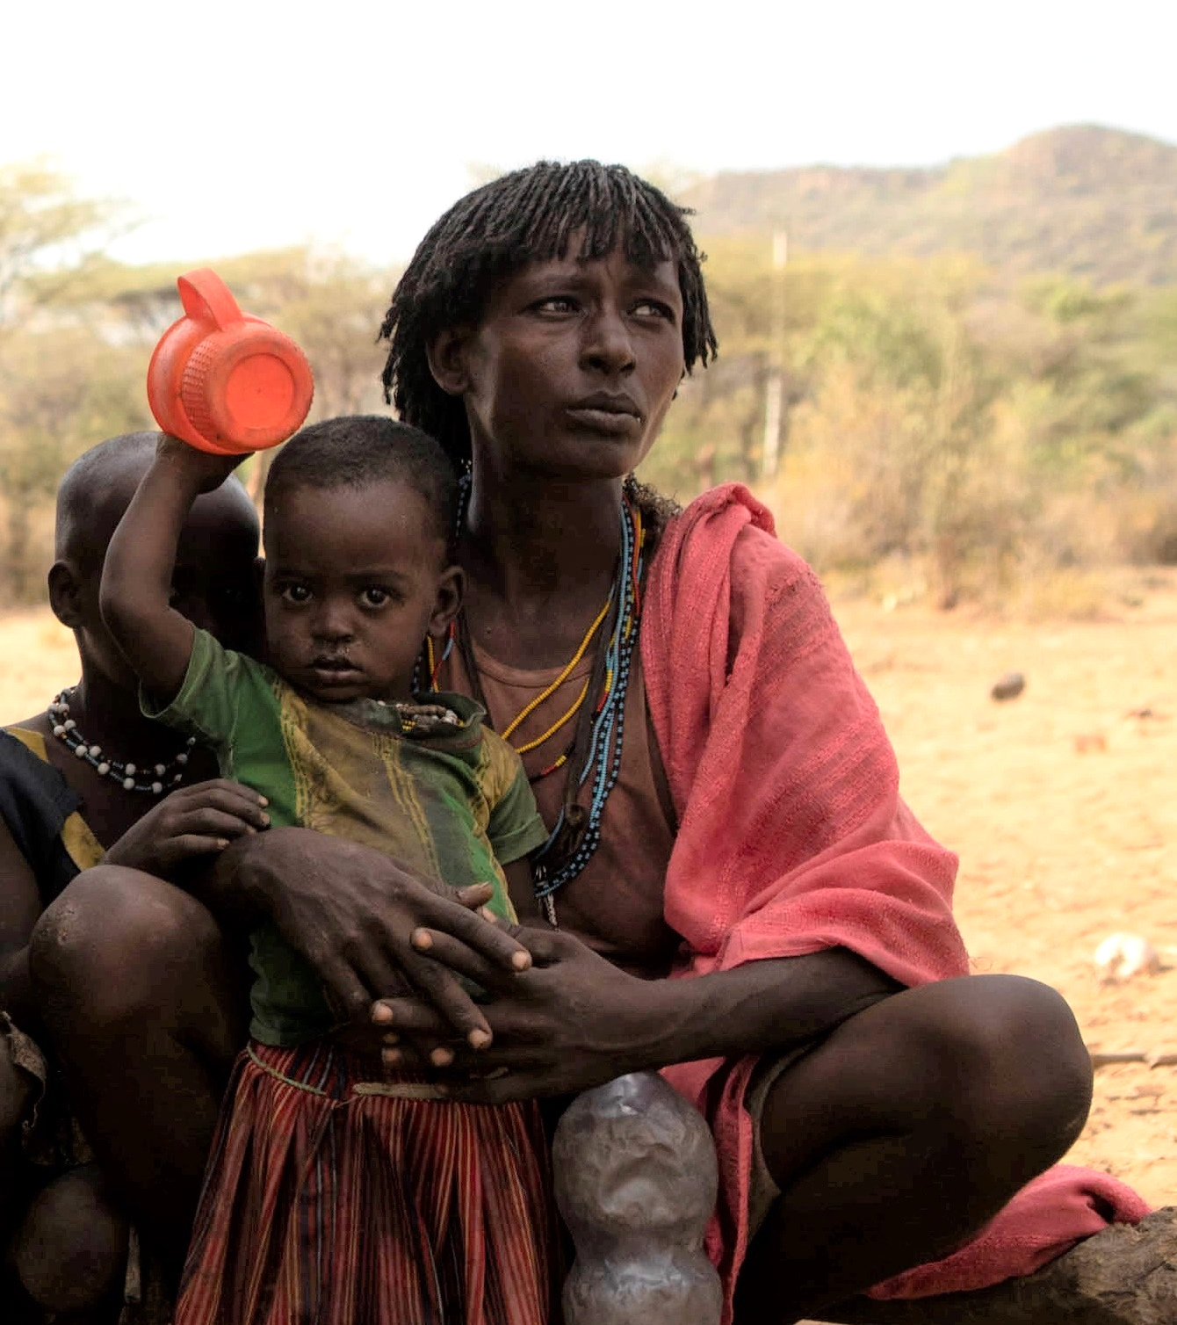
PRAYER

Slide 2
Living God,
You made the earth and everything in it to live to the full.

Slide 3
But today,
in the Horn of Africa,
waterholes run dry,
desert locusts swarm,
crops die and people
go hungry.

Slide 4
Help us bring the world
back to life.
Amen.

Slide 5
Loving Christ,
You walk alongside all people in need.

Slide 6
May Caritas Australia and its local partners help the people in Africa. With our support, may the people and their communities survive, rebuild and recover.

Slide 7
Help us share what we have so that everyone has enough.
Amen.

Slide 8
Inspiring Spirit:
You make all things possible!

Slide 9
May we love and care for
the earth and each other as you do.

Slide 10
Help us to work together and
make hunger history.
Amen.

Slide 11
Photo Captions and Credits
A mother and her children in southwestern Ethiopia. Photo: Zacharias Abubeker/Caritas Australia
A field of maize in the Horn of Africa. Photo: Zacharias Abubeker /Caritas Australia
Caritas Australia’s local partners help communities access supplies in the Horn of Africa. Photo: Caritas Australia
Children smile together inside a tent at an Internally Displaced Persons (IDP) Camp in Ethiopia. Photo: Caritas Australia
Ayoyo, a community leader, works at the cash distribution centre in southwestern Ethiopia. Photo: Zacharias Abubeker/Caritas Australia
International supplies of split peas, vegetable oil and water bring relief to people at an IDP Camp in Ethiopia. Photo: Caritas Australia
A woman cooking injera at an IDP Camp in Ethiopia. Photo: Caritas Australia
A water pump and taps funded by Caritas Germany, in southwestern Ethiopia. Photo: Zacharias Abubeker/Caritas Australia
Community in discussion with Caritas Australia staff and local partners in southwestern Ethiopia. Photo: Zacharias Abubeker/Caritas Australia
A member of the community in southwestern Ethiopia. Photo: Zacharias Abubeker/Caritas Australia
Prayer by Dr Rebekah Pryor/Caritas Australia.
Resource first published on 25 July 2022.

Slide 12
Thank you

