Slide 1
First Nations people are advised that this resource and external links may contain images and names of people who have died.

Slide 2

Teacher Information
This resource is intended as a source of information for teaching and learning about the importance of caring for our Common Home and humanity.
Please refer to the ‘Notes’ section of this presentation for additional information and source references.
It is our hope that you will take part/all of these slides and use them in a way that best suits your purposes. As such, the slides are editable so that the content, case studies and tools included in this resource are flexible for teachers and students to use in classroom instruction, independent student research or presentations.
If you do edit this resource, please ensure content and photos from this resources remain with the appropriate credit to Caritas Australia and the photographers.
For more school resources, please visit: caritas.org.au/resources/school-resources/
Stay up to date with events and resources! Subscribe to Caritas Australia’s Education e-newsletter
Copyright Policy: Material within our resources come from a variety of sources and authors, including Caritas Australia staff, volunteers, overseas partners and news organisations. These resources and the information, names, images, pictures, logos are provided “as is”, without warranty. Any mistakes brought to the attention of Caritas Australia will be corrected as soon as possible. To review the full Caritas Australia Copyright Policy, please visit: Caritas Australia​​
Links to external sites: This site contains links to external web sites. Caritas Australia takes no responsibility for the content of such sites, nor do links to such sites imply endorsement of the views expressed therein. External links are provided for informational purposes only.
Updated January 2025

Slide 3
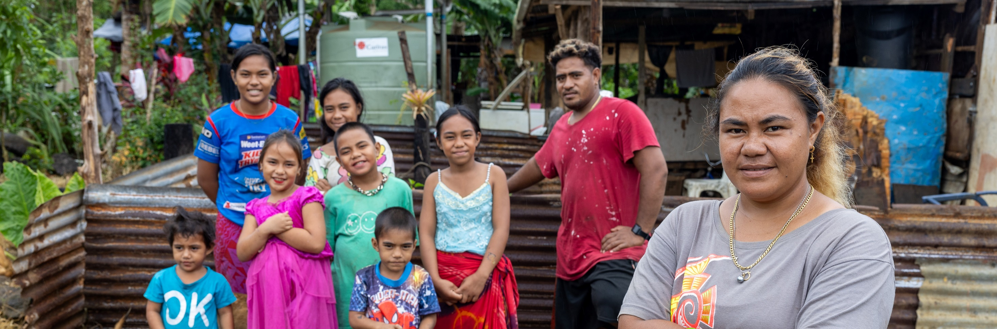
Love Thy Neighbour as Thy Phone
Leaia and her family relied solely on rainwater collected in old fridges and buckets until Caritas Samoa installed a water tank at their home. Photo: Caritas Australia

Slide 4
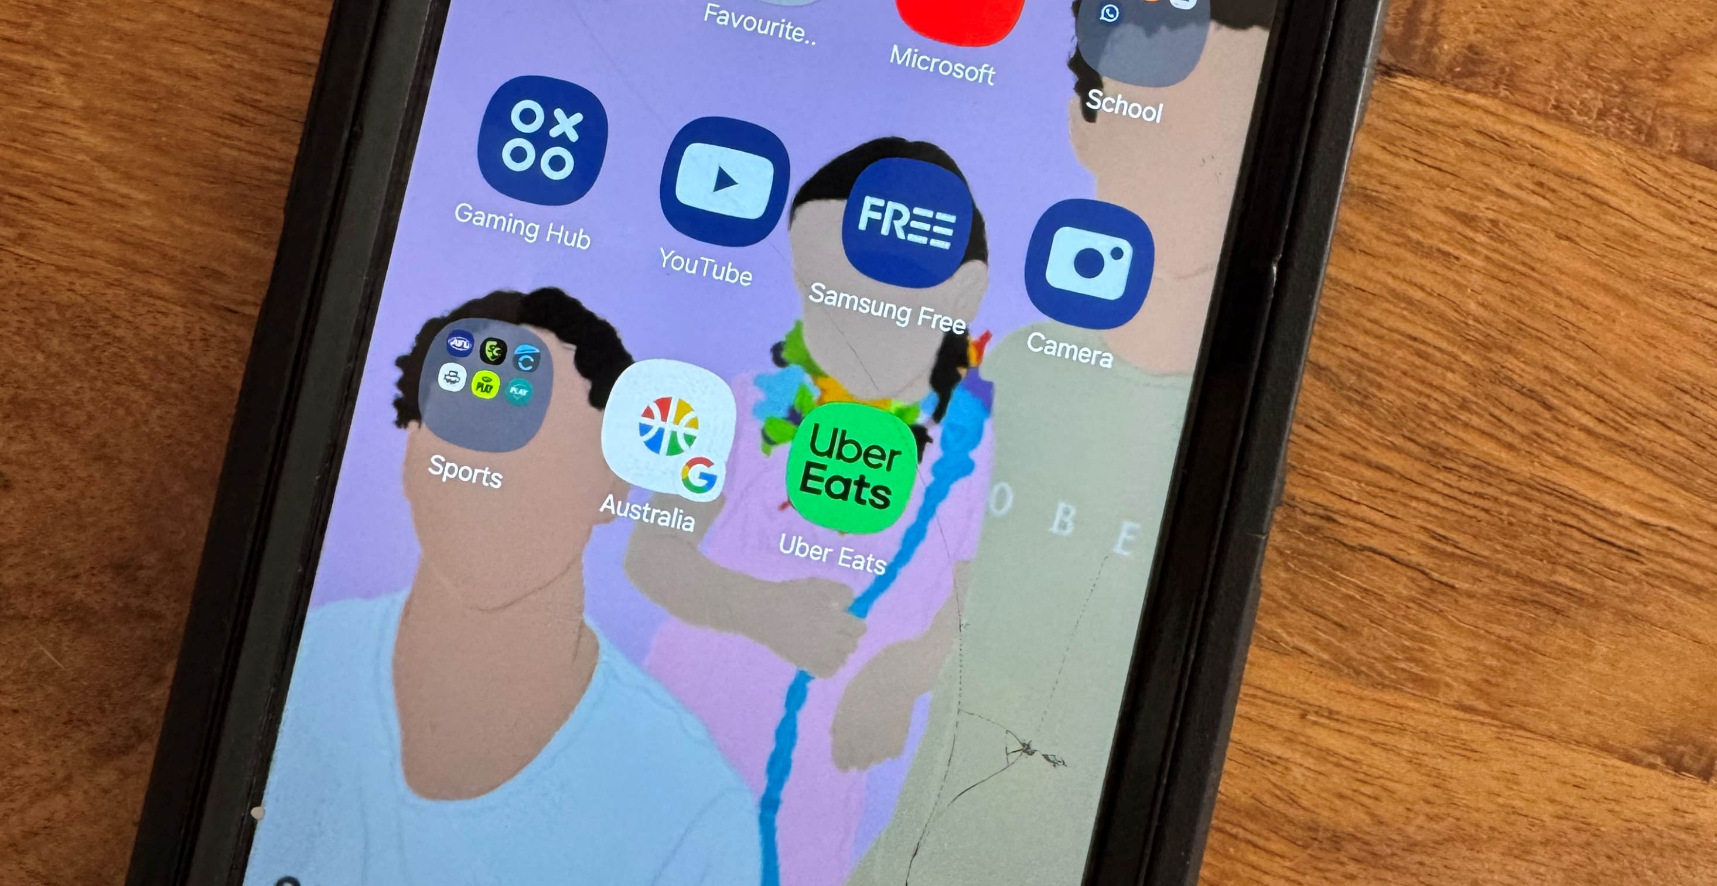
Globally, 1.3 billion smartphones were sold in 2023.
I know that I would be completely lost if I misplaced mine.
Photo: Caritas Australia
Notes:
Source: https://www.statista.com/statistics/263437/global-smartphone-sales-to-end-users-since-2007/

Slide 5
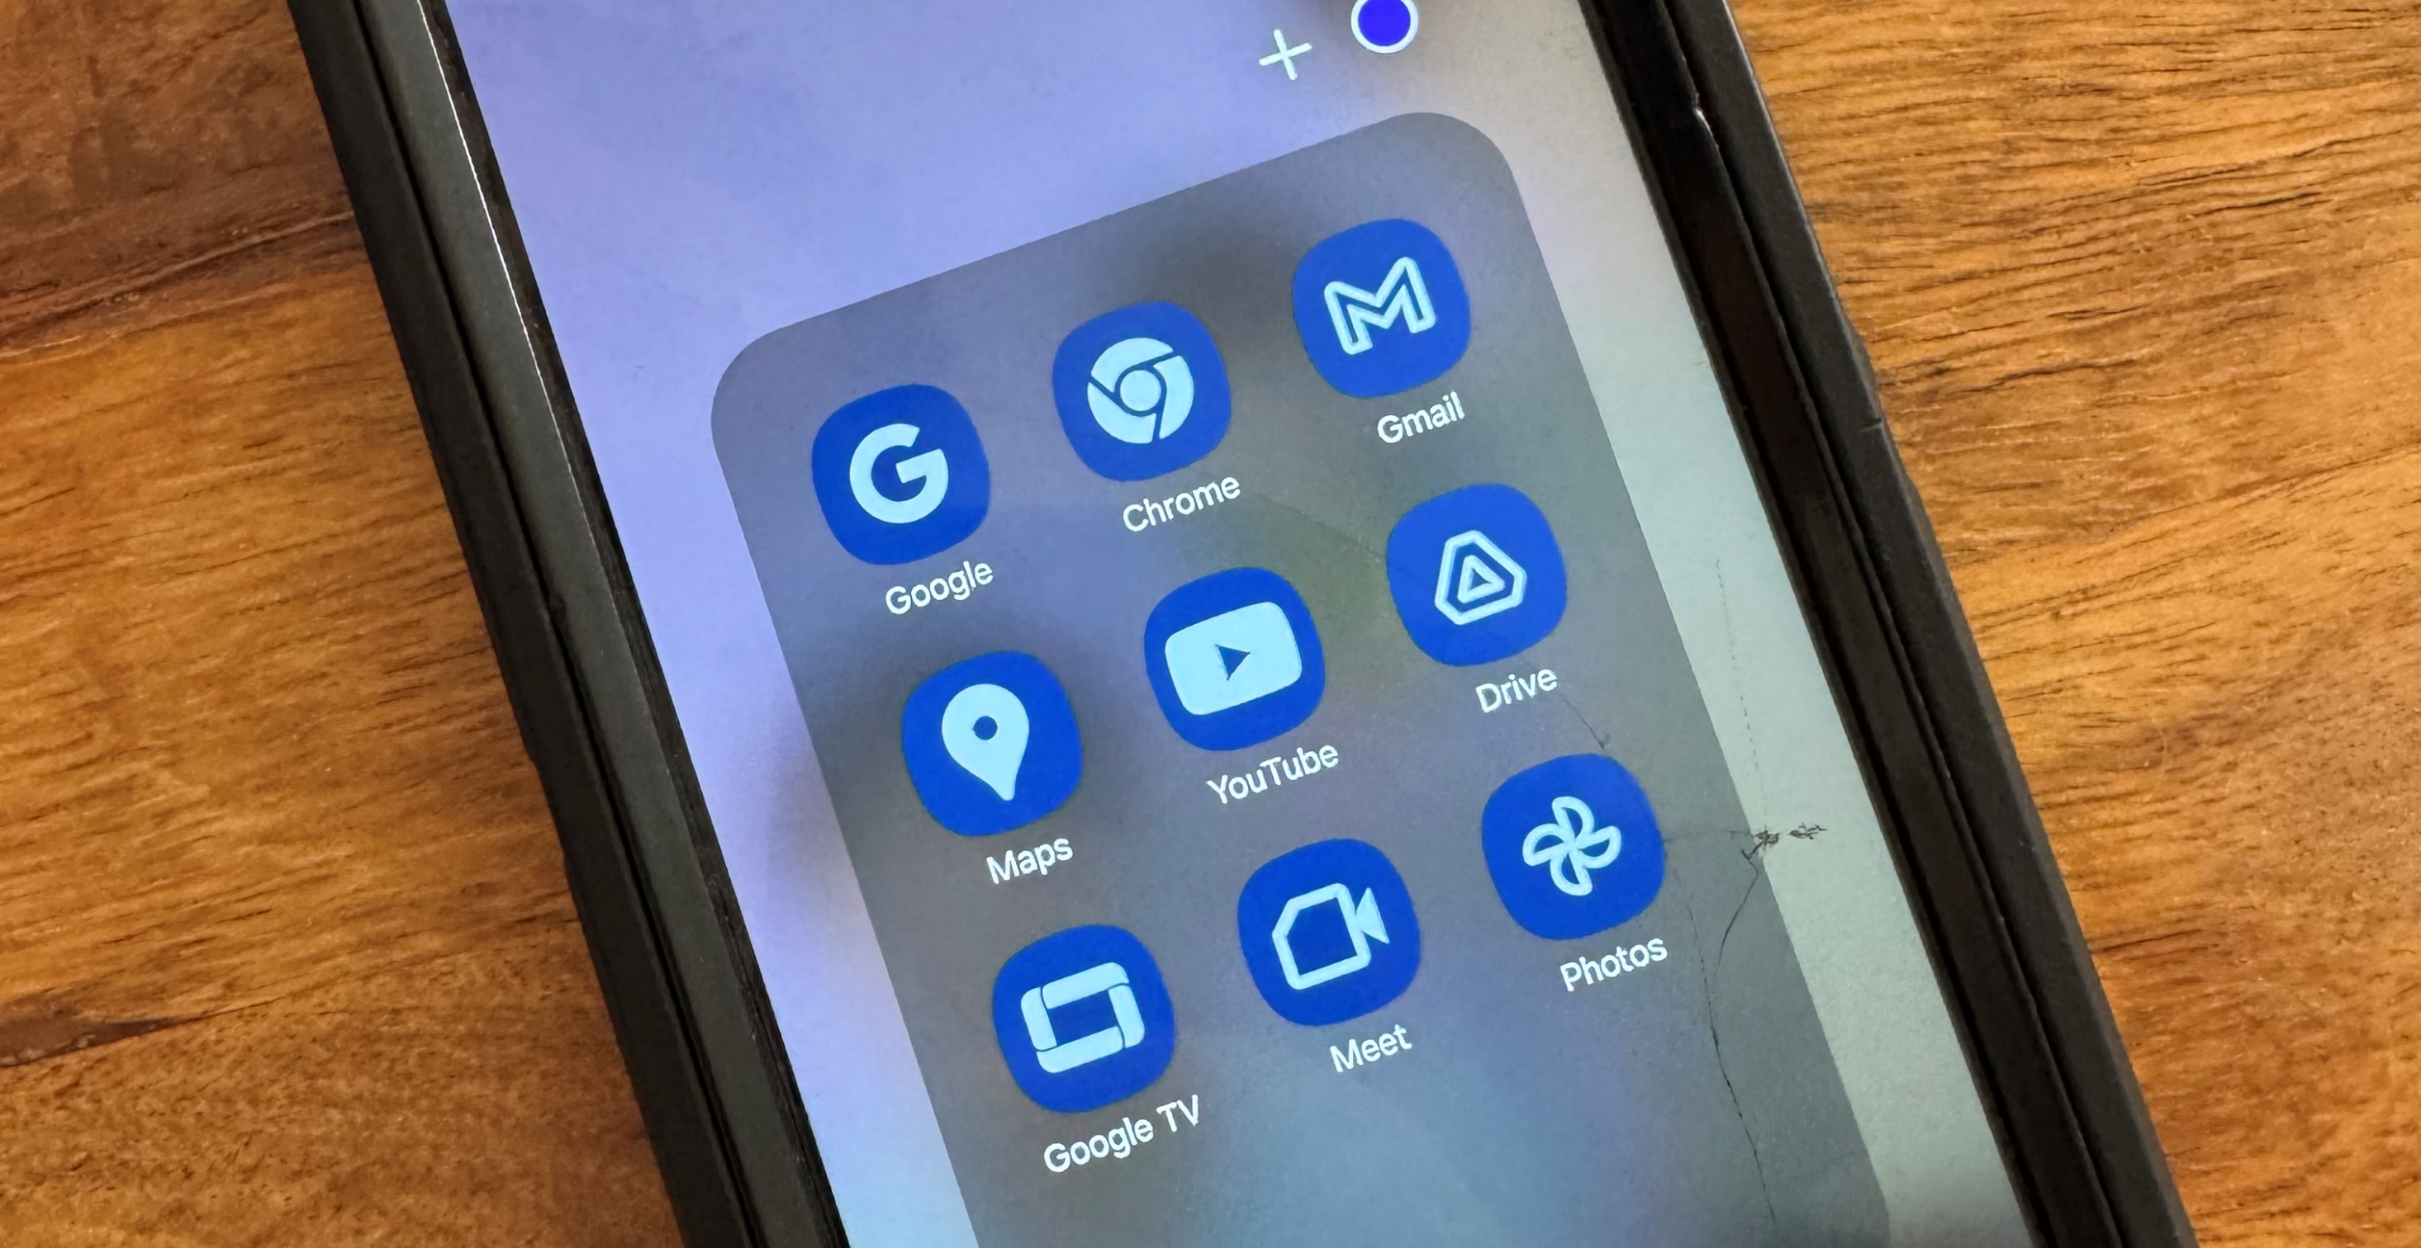
It goes almost everywhere with me. It knows everything I do each day.
It gets me up in the morning
It holds my precious memories
It relaxes me
It makes sure I don’t miss important events
It entertains me
It helps me keep up with the important issues of the world…
Photo: Caritas Australia

Slide 6
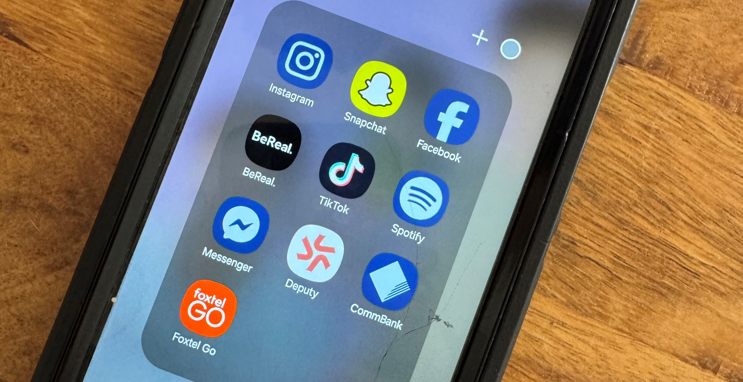
I can watch my favourite show
It assists me to stay in touch with my friends
It keeps me up to date with the live footy scores
I can watch reels
It tells me the weather
It keeps track of my steps
It sends and receives my emails
And I can even use it to make phone calls- if I need to!
Photo: Caritas Australia

Slide 7
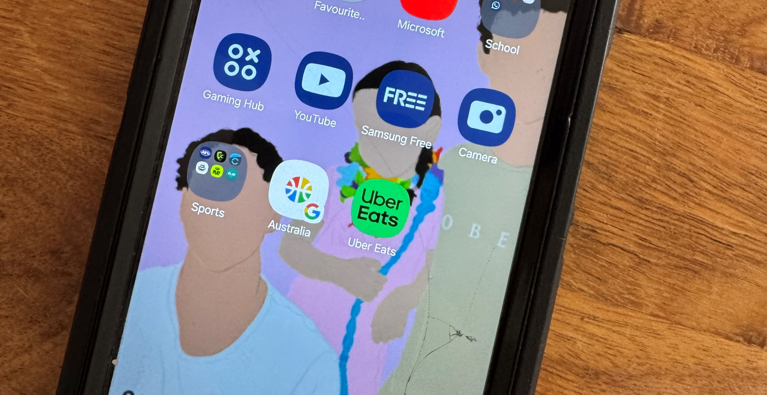
I look after it and make sure nothing happens to it. I’m sure most people do the same.
Most people would take care of their $1000+ Smartphone, wouldn’t they?
Photo: Caritas Australia

Slide 8

Imagine how much better the world would be if we took as much care of other people and the environment as we do of our technology.
An aerial view of a Training Centre in the Solomon Islands. Photo: Neil Nuia/Caritas Australia

Slide 9
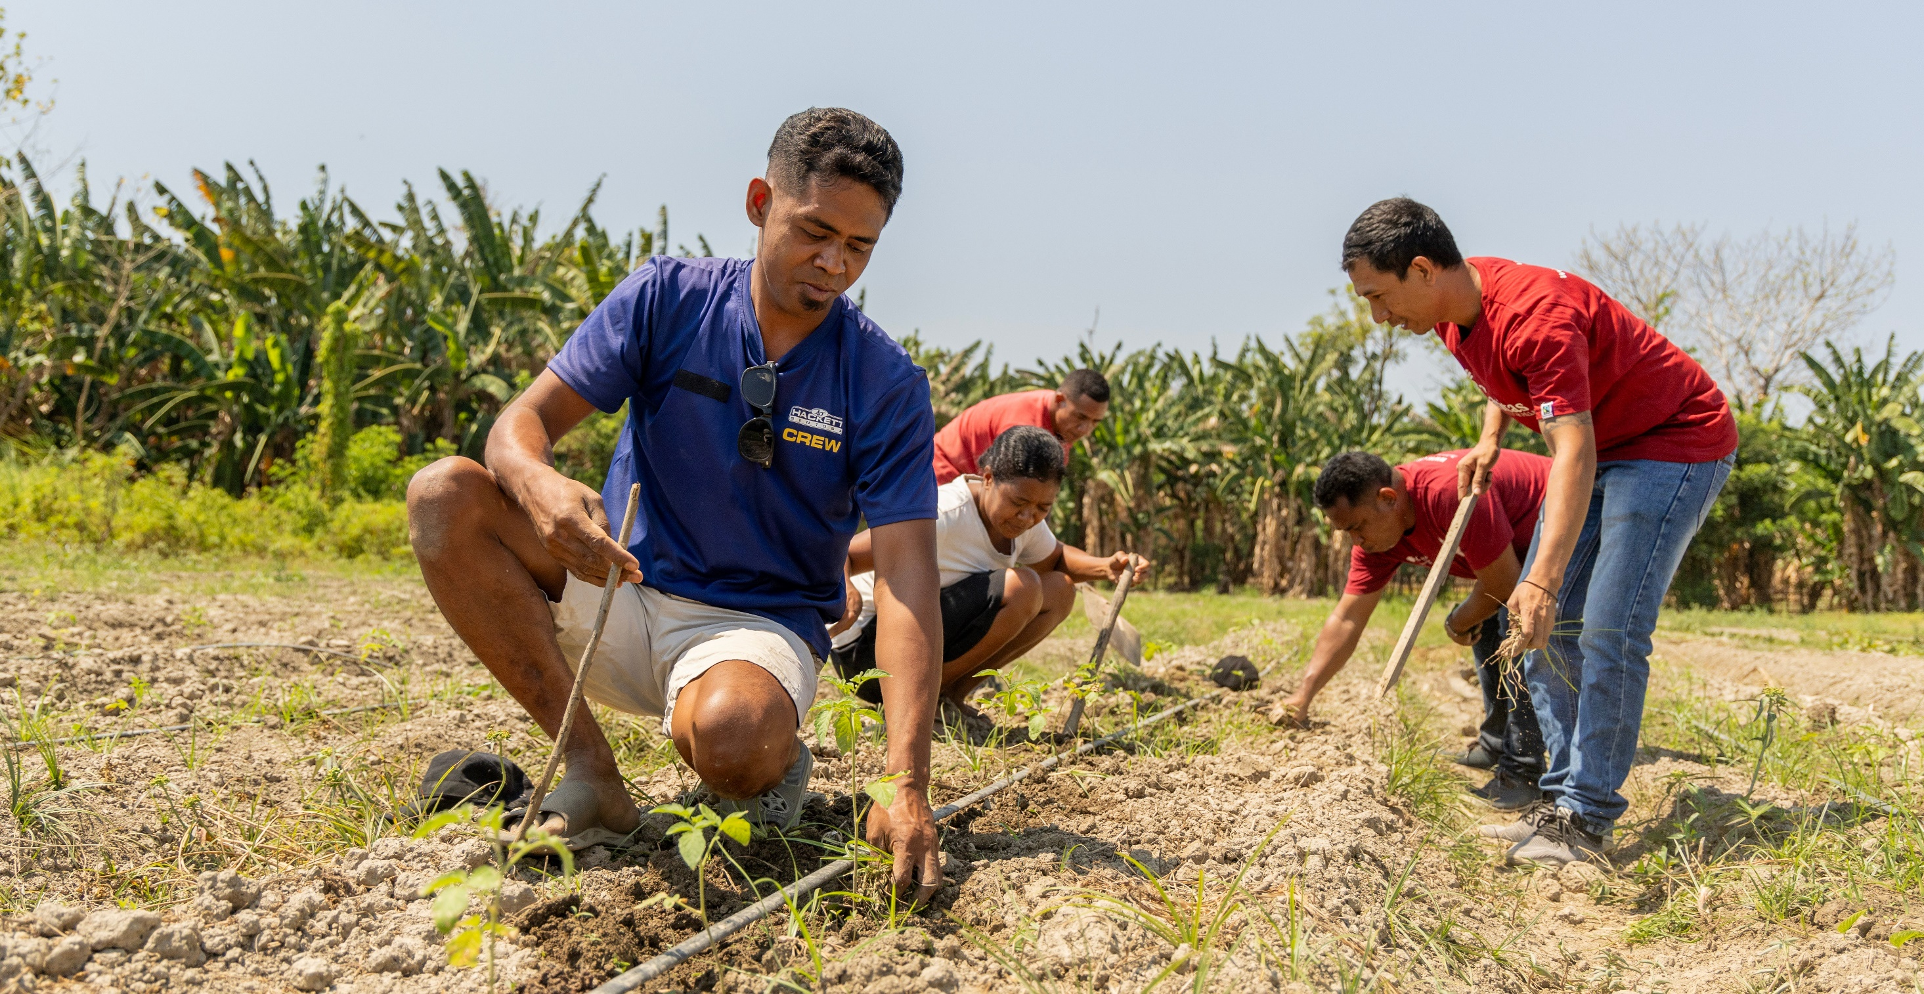
Imagine if other people and the world meant as much to us as our phone.
I wonder, how the world would look?
Chiquito is a farmer living in rural Timor Leste. After his father passed away, Chiquito took on the responsibility of supporting his whole household. Photo: Caritas Australia

Slide 10
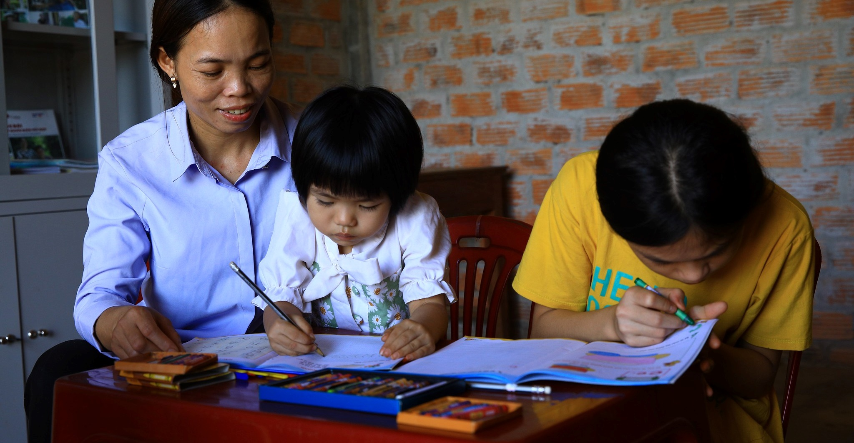
We would live in a caring world where everyone is important.
We wouldn’t be harming our planet for our own gain, not considering the impact on our global family and future generations.
Mrs Lan* assisting children living with a disability while they attend a community-based classroom in Vietnam. Photo: Phan Tam Lam/Caritas Australia
Notes:
* pseudonym name used

Slide 11
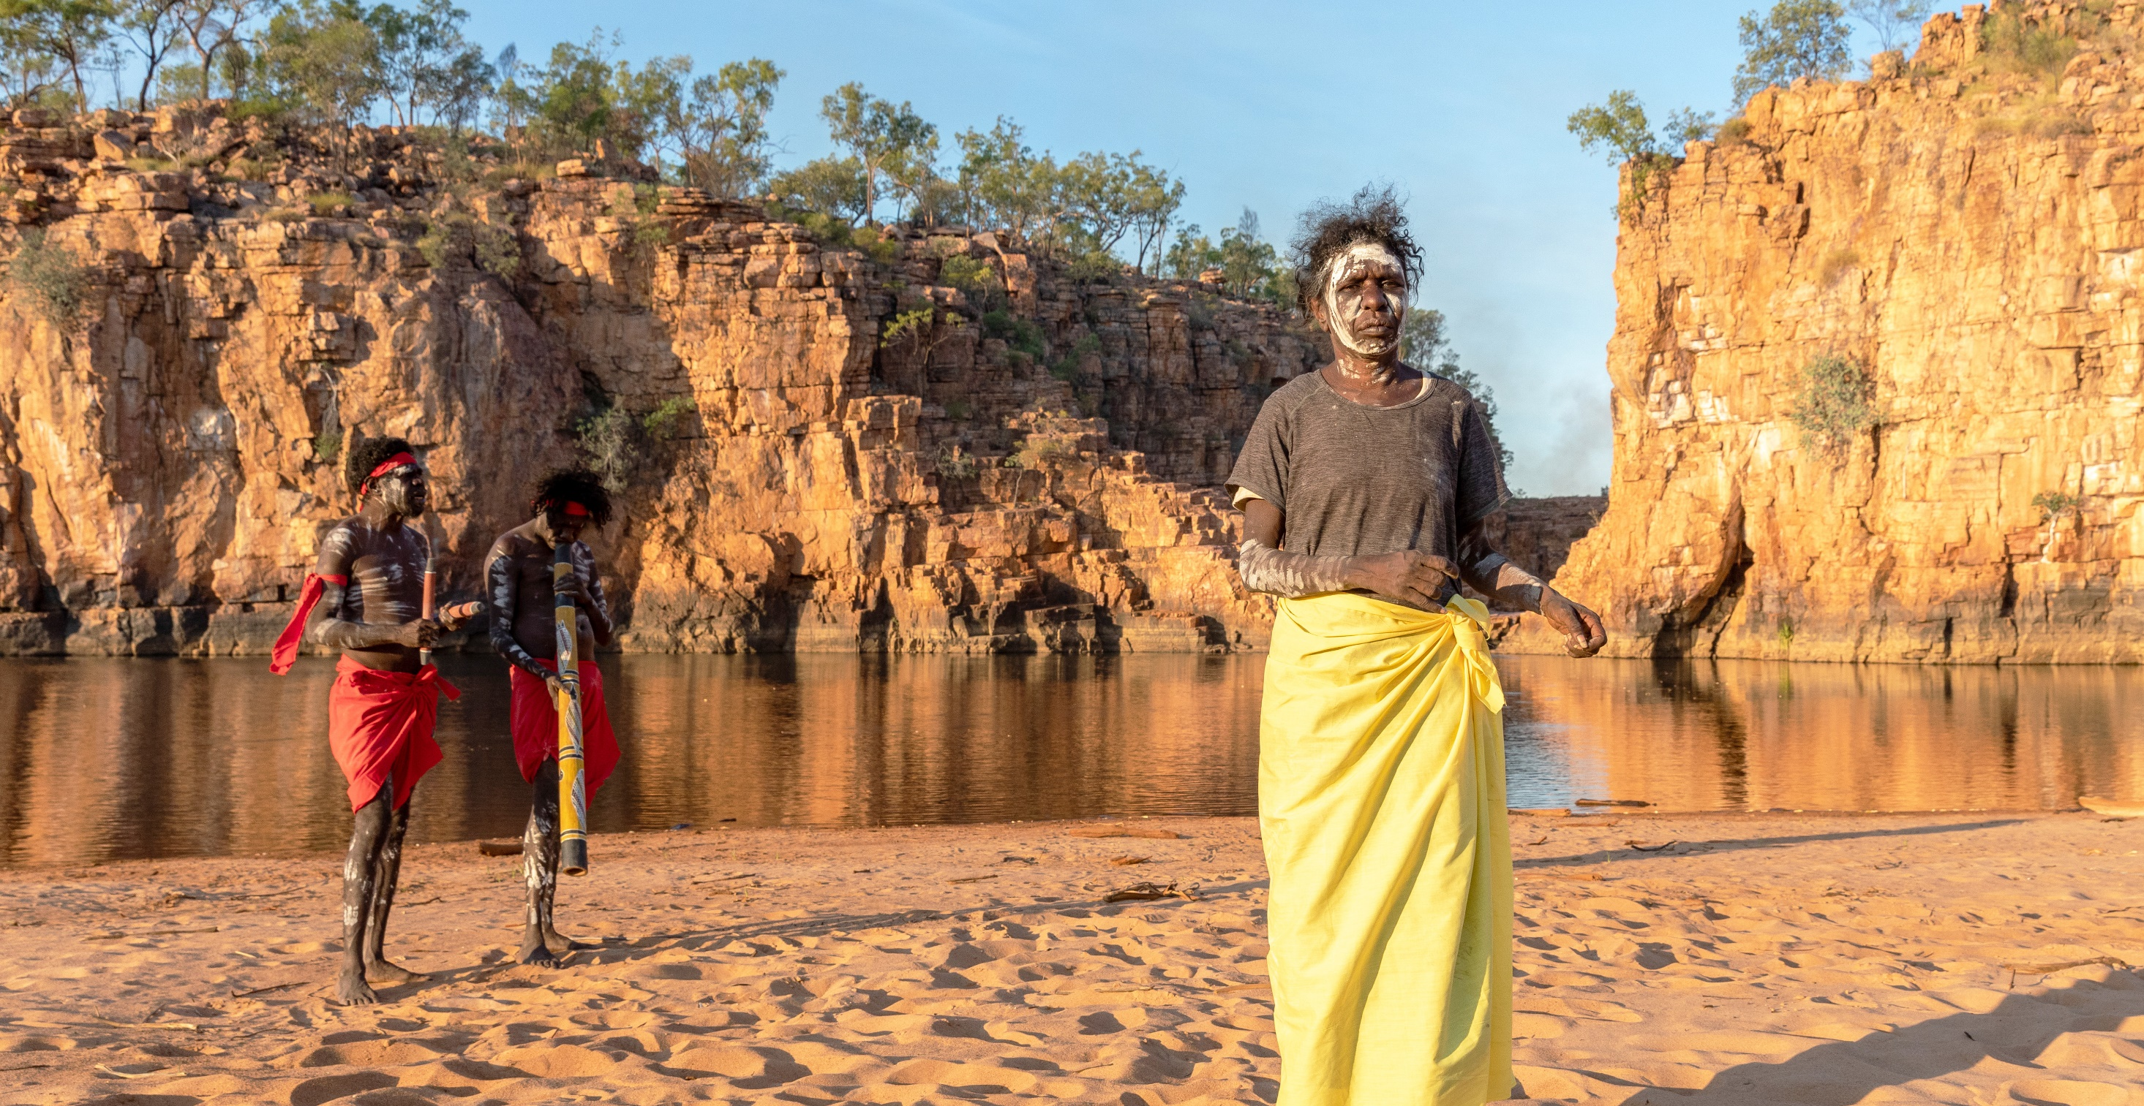
So, I say in a clear and loud voice,
“Listen to a new commandment –
Love thy neighbour as thy phone!”
Janice is seen performing a traditional dance along with her songman and beother Major (left) and her son Major (right) at Beswick Galls near Djilpin Arts in Beswick, Northern Territory, Australia. Photo: Richard Wainwright/Caritas Australia

Slide 12
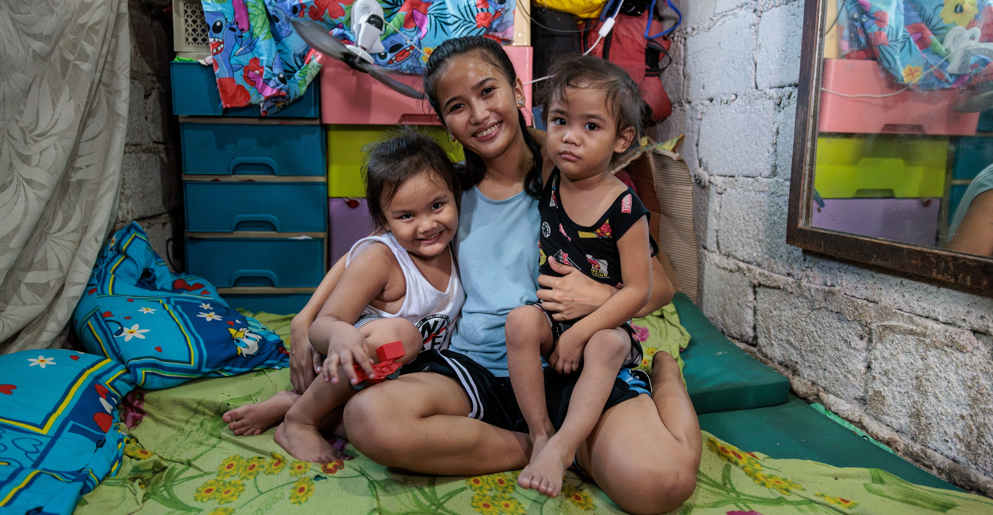
“People were created to be loved.
Things were created to be used.
The reason the world is in considerable chaos is because things are being loved and people are being used.”
John Green, TED Talk: Paper towns and why learning is awesome.
Ronita cuddles her two children in their small home in Quezon City, Philippines. Photo: Richard Wainwright/Caritas Australia
Notes:
Source: TED Talk, Paper towns and why learning is awesome
https://www.youtube.com/watch?v=NgDGlcxYrhQ
John Green, host of YouTube channel vlogbrothers, motivational speaker and young adult author of The Fault In Our Stars.

Slide 13
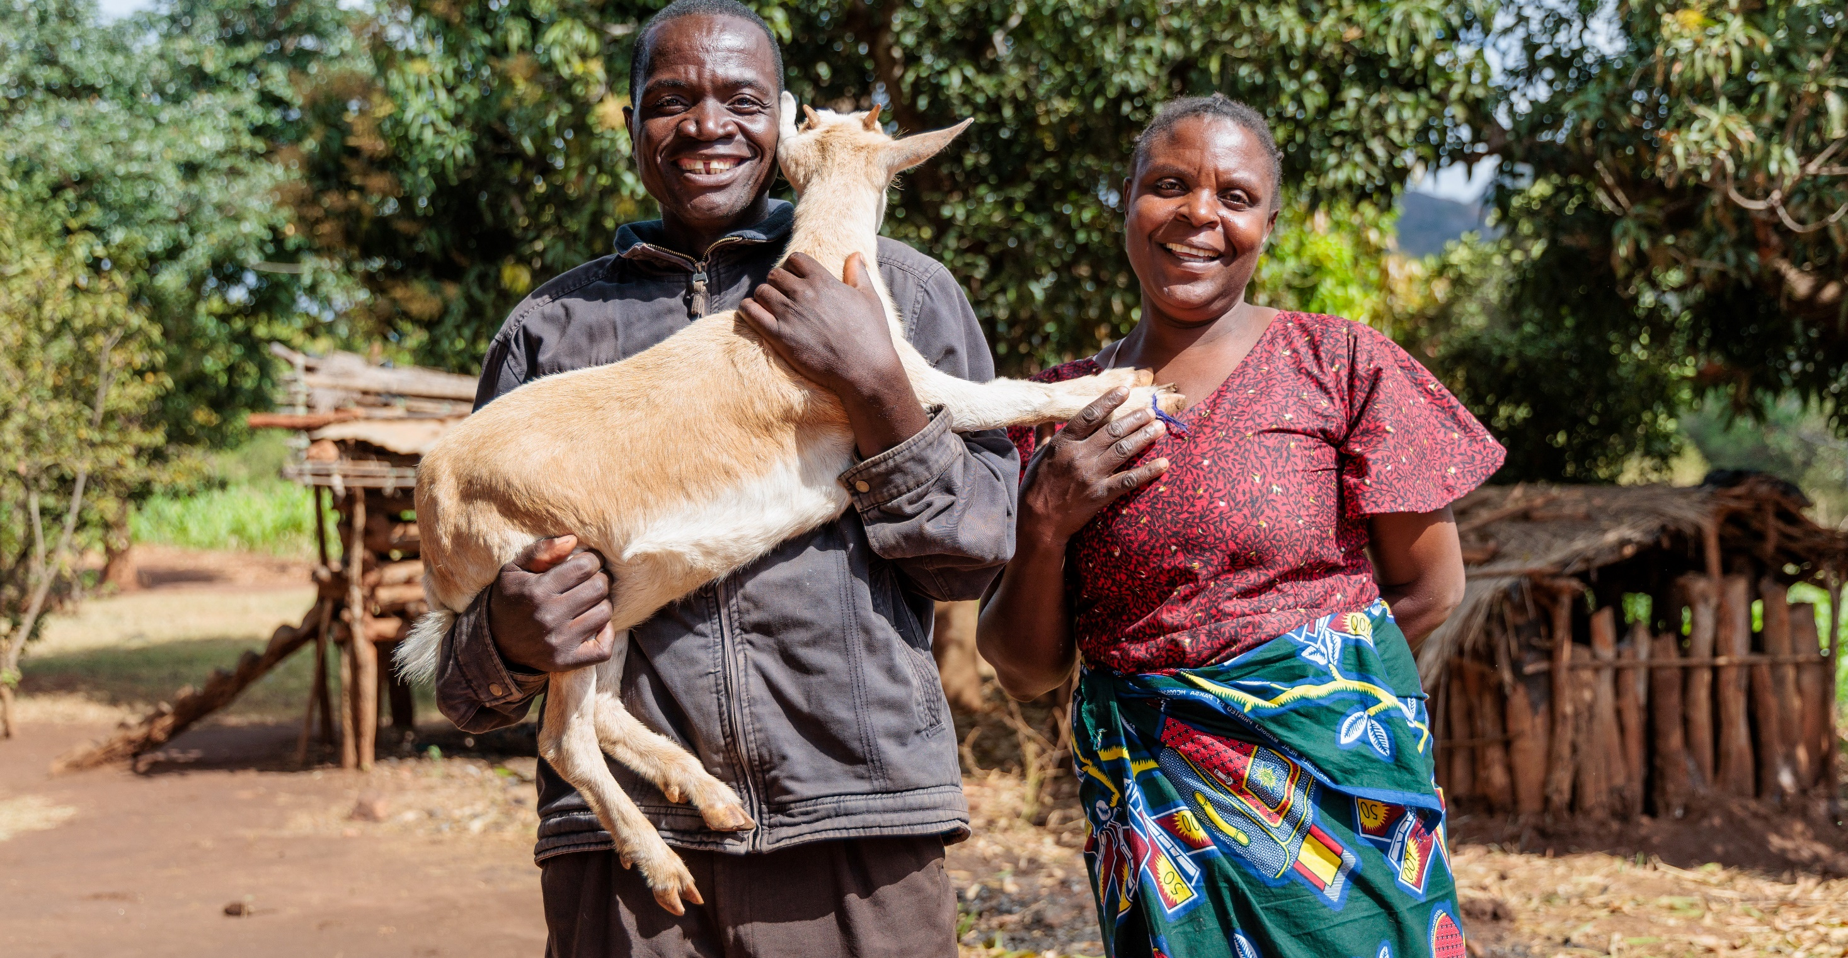
‘All creatures are connected, each must be cherished with love and respect, for all of us as living creatures are dependent on one another.’
Pope Francis, Laudato Si’ n42
Memory’s parents, Lector and Lute, carrying a goat that was provided to them by CADECOM. Photo: Caritas Australia

