Slide 1
CST: Human Dignity Middle primary: Year 3 and 4 What is dignity?
Photo: Richard Wainwright/Caritas Australia
Notes:
Laxmi (16) and her mother Mankala (52) work in their fields close to their home in Jajarkot district, western Nepal.

Slide 2
First Nations people are advised that this resource and external links may contain images, voices and names of people who have died.

Slide 3
Dignity definitions
Calm, serious, and controlled behaviour that makes people respect you.
Source: Cambridge Dictionary
The importance and value that a person has, that makes other people respect them or makes them respect themselves.
Source: Cambridge Dictionary
The state or quality of being worthy of honour.
Source: Collins Dictionary
A way of appearing or behaving that suggests seriousness and self-control.
Source: Britannica Dictionary
The quality of being worthy of honour or respect.
Source: Britannica Dictionary
Notes:
Please note that definitions have animations.

Slide 4
Children’s Rights
Every child has the right to life.
Every child has the right to a name and a nationality.
Every child has the right to be with their family or with those who will care for them best.
Every child has the right to enough food and clean water.
Every child has the right to an adequate standard of living.
Every child has the right to health care.
Every child with a disability has the right to special care and support.
Every child has the right to relax and play.
Continued on next slide

Slide 5
Children’s Rights
Every child has the right to privacy.
Every child has the right to education.
Every child has the right to be kept safe and not to be hurt or neglected.
No child should be used as cheap labour or as a soldier.
Children who break the law should not be treated cruelly.
Every child has the right to speak their own language and practise their own religion.
Every child has the right to say what they think and to be heard.
Every child has the right to meet their friends and join groups.
Source: adjusted from Amnesity UK

Slide 6
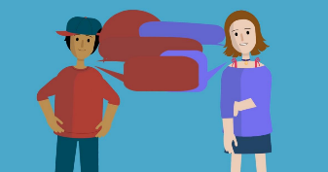
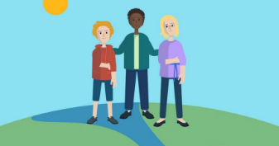
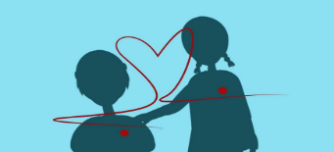
Encyclical Quotes And Illustration Solutions
‘I hope that if everyone can respect each other’s dignity, we can have true friendship between everyone around the world. This is my dream.’ Pope Francis, Fratelli Tutti n8
‘We can be friends with people no matter where they live! Caring for people like their are our friends, can change the world!’ Pope Francis, Fratelli Tutti n99
‘God dreamed of every person in our world. We are all loved, important and needed.’ Pope Francis, Laudato Si’ n65

Slide 7
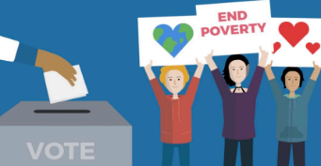
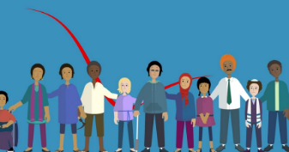
Encyclical Quotes And Illustration Solutions
‘The story of the Good Samaritan teaches us something important about how we should live together. We can’t ignore people who are struggling. We should try our best to help them.’ Pope Francis, Fratelli Tutti n68
‘Every single person in the world should be able to live a good life, with dignity, no matter what. We have dignity because God gave it to us.’ Pope Francis, Fratelli Tutti n107

Slide 8
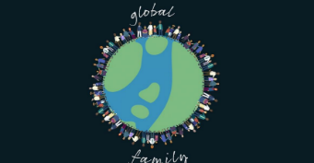
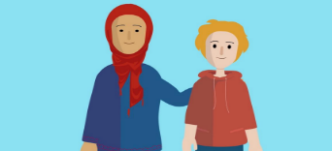
Encyclical Quotes And Illustration Solutions
‘To care for the world in which we live means to care for ourselves. Yet we need to think of ourselves more and more as a single family dwelling in a common home.’ Pope Francis, Fratelli Tutti n17
‘No matter if you have a lot of money or not a lot, everyone has the same amount of dignity because God made us all equal.’ Pope Francis, Laudato Si’ n94

Slide 9
Psalm 139:13-14
“You made my whole being. Your formed me in my mother’s body. I praise you because you made me in an amazing and wonderful way. What you have done is wonderful. I know this very well.”
International Children’s Bible
Photo: Richard Wainwright/Caritas Australia
Notes:
Ronita (22) holds up Egzy Grey (3) in their small home in Quezon City, Philippines. Photo: Richard Wainwright/Caritas Australia
Discuss:
- What does this quote mean?
- What does this quote suggest about God’s creation of humanity?
- How should we think of ourselves? Of others?

Slide 10
Creator God, Your image is alive in every human person giving to each of us an unbreakable dignity.
Photo: Neil Nuia/Caritas Australia
Notes:
Adapted Prayer Source: Australian Catholic Social Justice Council
Photo: Shaniella looks out over the ocean from a Rural Training Centre near the capital Honiara, Solomon Islands.

Slide 11
Create in us a desire to act to work together and a willingness to share with others our time, our energy, our skills and talents, and our wealth.
Photo: Arlette Bashizi/Caritas Australia
Notes:
Photo: Rosalie (standing) attends a Saving and Internal Lending Community group (SILC) meeting near her home in Bukavu, eastern Democratic Republic of Congo, July 2021. Rosalie is now the president of this SILC group which provided a loan to start her business.

Slide 12
As we share and enjoy the fruits of your creation, restore in us your vision of a world made whole, and inspire us to commit ourselves to the good of all.
Photo: Caritas Australia
Photo:
Notes:
Photo: Durga is developing a rooftop vegetable garden to grow sustainable produce as part of the Nepal Livelihood and Resilience Project.

Slide 13
Gracious God, give us ears to hear, eyes to see and hearts to love, so that we reflect you in our way of life; in our choices, words and actions.
Photo: Richard Wainwright/Caritas Australia
Notes:
A First Nations child standing out the front of Djilpiin Arts in Norther Territory, Australia.

Slide 14
Jesus is the good news to the poor. As his followers, may we recognise the call to be the same.
Amen.
Photo: Caritas Australia
Notes:
Leaia and a Caritas Samoa representative standing outside of Leaia’s make-shift home.

